Slide 1
TARGET STUDY RESULTS

Slide 2
TARGET Primary Study Objective
A real-world retrospective study that confirms TheraSphere for HCC as safe and effective in a select patient population, demonstrating predictable clinical outcomes across a broad patient population in 8 countries.
Establish the relationships between:
Normal tissue adsorbed dose (NTAD) and occurrence of grade 3 or higher hyperbilirubinemia
Tumor absorbed dose (TAD) and Objective Response Rate (ORR)
TAD and Overall Survival (OS)

Slide 3
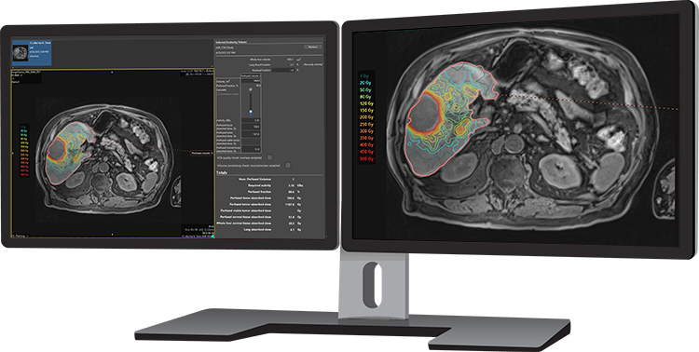
TARGET Study Design
Key Patient Characteristics
Mainly Intermediate and Advanced HCC: 32.5% BCLC B and 54.5% BCLC C
7 cm median target lesion
33% PVT*
Dosimetry Approach
Investigator review of patient chart and dosimetry calculation
Retrospective dosimetry evaluation with multi-compartment approach using Simplicit⁹⁰Y™ personalized dosimetry software to determine TAD and NTAD
*TheraSphere not indicated for patients with PVT.
*By reverse KM method

Slide 4
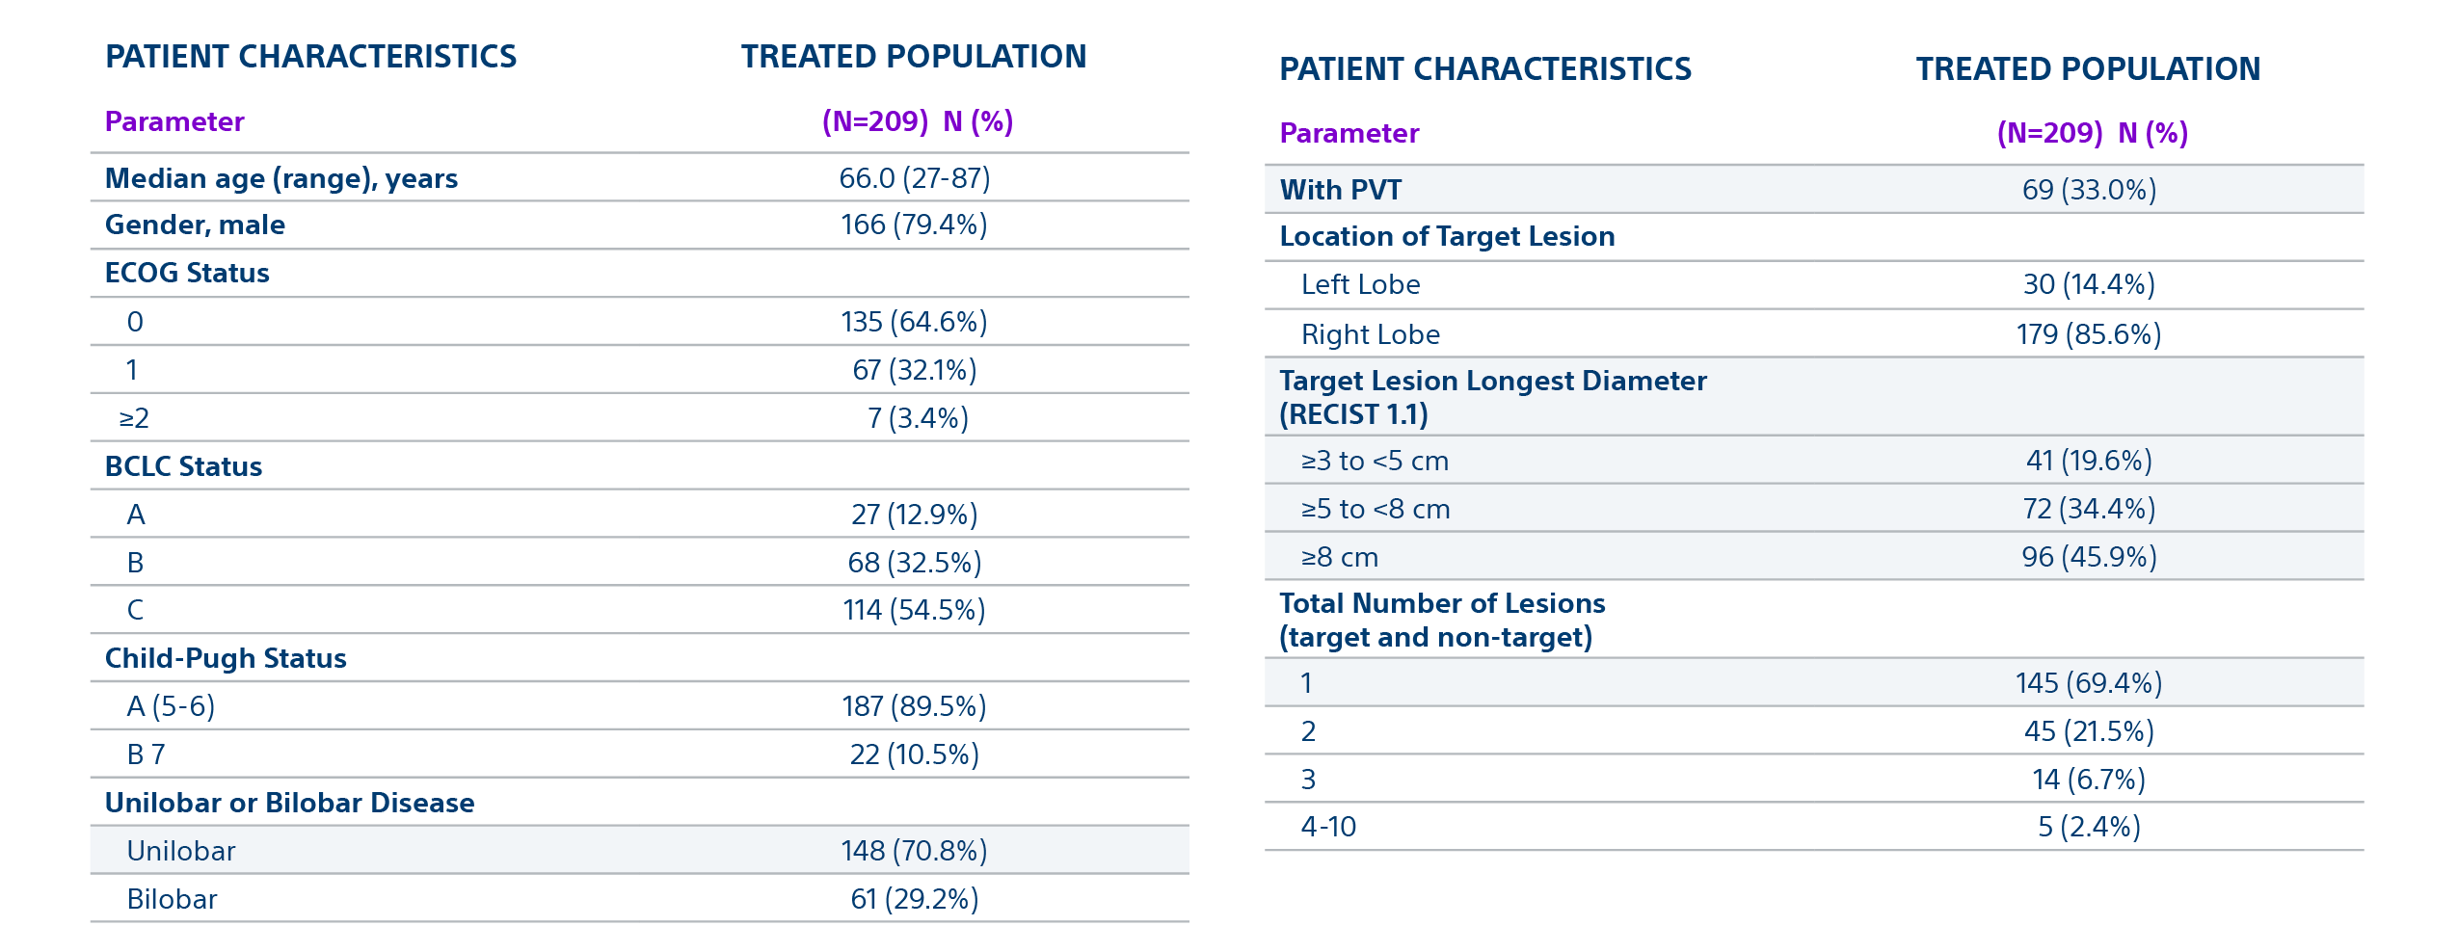
TARGET Study Baseline Characteristics

Slide 5
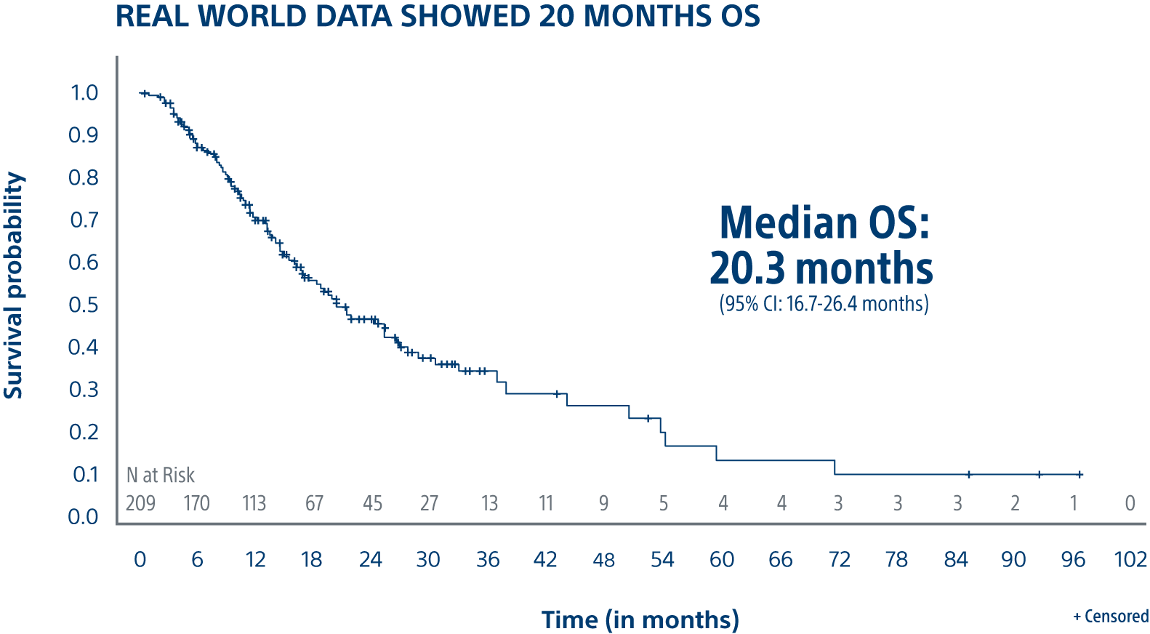
TARGET is a global evaluation of advanced dosimetry in transarterial radioembolization of hepatocellular carcinoma (HCC) with TheraSphere Y-90 glass microspheres
Results
70.8% ORR* for the target lesion (mRECIST)
61.7% ORR** for all lesions (mRECIST)
20.3 months median Overall Survival
Overall Survival for All Patients with TheraSphere Y-90 Glass Microspheres
*95% CI = 64.3 - 76.6%
**95% CI = 55.0 - 68.0%
Notes:
Again, we show that there are 3 independent US sites all with HIGHLY Reproducible results with high dose to tumor in Patients that met study criteria demonstrating a Low recurrence rate Early and Advanced HCC
Overall Survival was 93% in patients with transplant or resection following TheraSphere at 3 years and 84% overall survival rate in patients where TheraSphere was the primary therapy at 3 years
The low recurrence rate of 5.6% is lesions not in the TheraSphere treated area, I believe (Kirk can correct me if I am wrong), but I believe even in ablation they can see has high as 10% recurrence rate on lesions.
At the 3 year or 36 month mark as noted in this slide, we have very good confidence in these numbers, kirk maybe you could make some comments on our 5 year survival numbers and additional points on this slide.

Slide 6
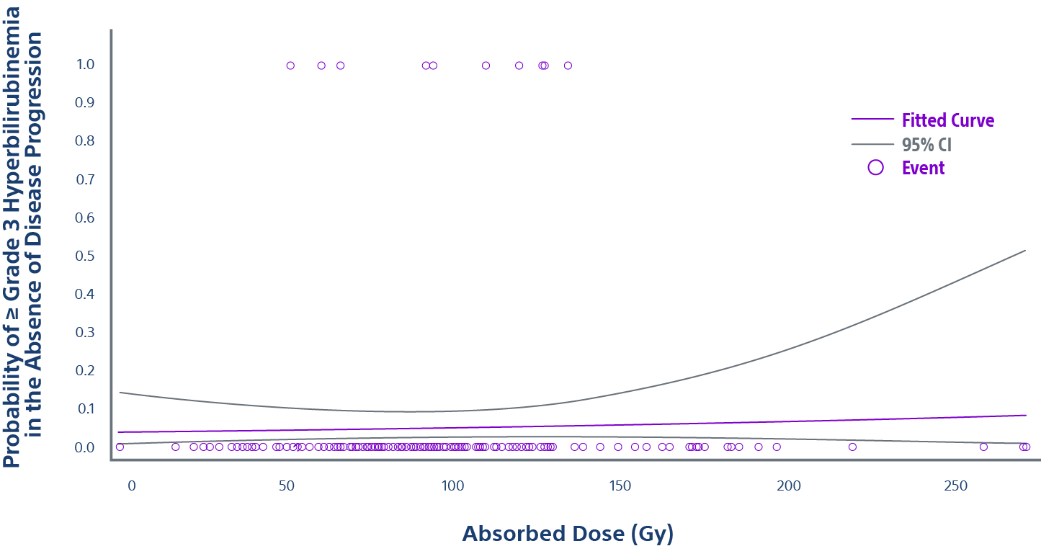
Low rate of ≥ grade 3 hyperbilirubinemia confirms safety of TARGET study
NTCP (Normal Tissue Complication Probability) Curve based on ⁹⁹Tc-MAA
Only 4.8% of patients (10/209) experienced ≥ Grade 3 hyperbilirubinemia in the absence of disease progression.
Regarding the low rate of event, no correlation could be established with the normal tissue absorbed dose (p=0.6 for NTAD).

Slide 7
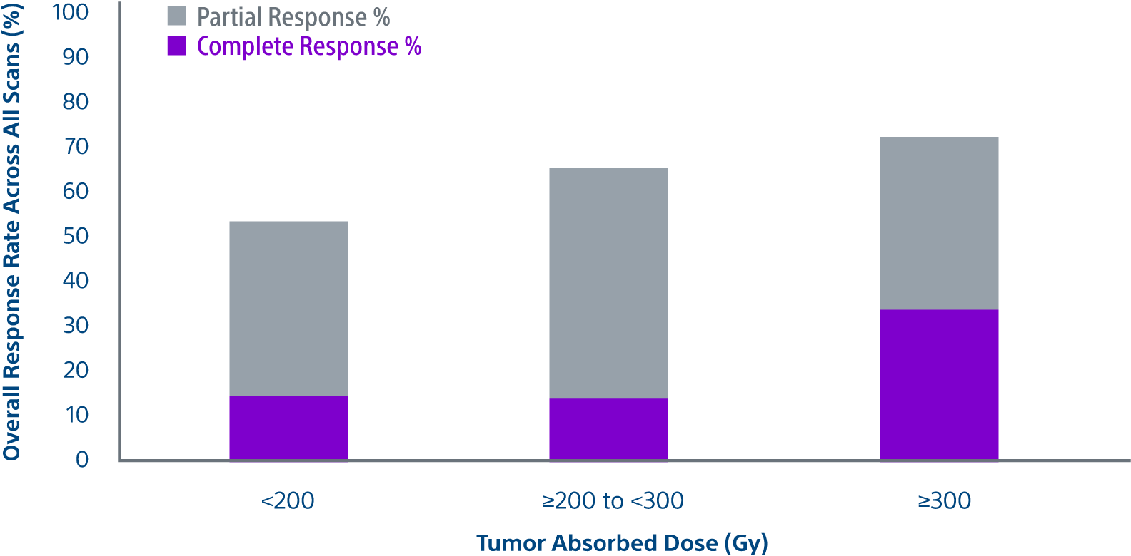
Tumor absorbed dose was predictive of response ^{1,2}
ORR Across All Scans for All Patients with TheraSphere Y-90 Glass Microspheres
Responders had a 17% higher mean tumor absorbed dose (225.5 Gy*) compared with
non-responders (188.3 Gy**)
*95% CI = 201.0 - 253.0 Gy
**95% CI = 164.6 - 215.3 Gy; p=0.046
Total perfused tumor absorbed dose and best response (61.7%) according to mRECIST
Non-responders (defined as stable disease, progressive disease, or non-evaluable) are not represented in the graph

Slide 8
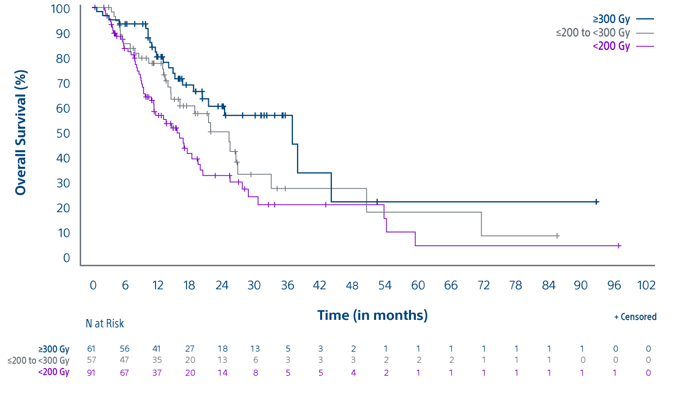
Tumor absorbed dose was predictive of overall survival
KAPLAN-MEIER OVERALL SURVIVAL CURVES
Total Perfused Tumor Absorbed Dose by subgroups with TheraSphere Y-90 Glass Microspheres
Median Overall Survival
>300 Gy - 36.7 months
(95% CI: 20.2 - 43.9 months)
>200 - <300 Gy - 25.1 months
(95% CI: 14.5 - 32.9 months)
<200 Gy - 16.1 months
(95% CI: 11.3 - 19.4 months)

Slide 9
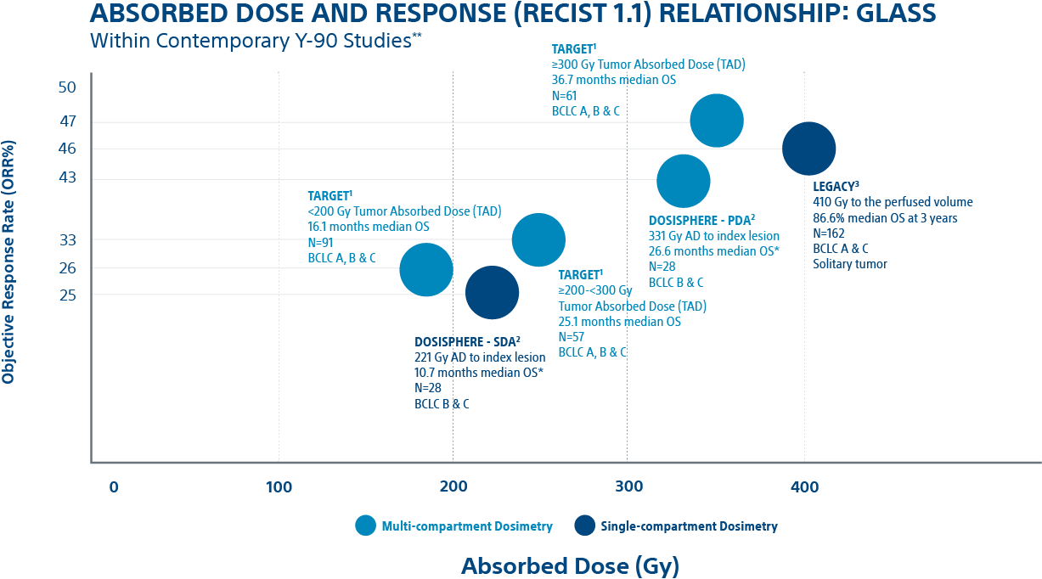
TARGET study takeaways
The TARGET study provides real-world data confirming a significant association between TAD and objective response and between TAD and OS in HCC patients treated with TheraSphere Y-90 glass microspheres.
Dose Matters
Deliver the highest dose to the tumor that is safely possible to maximize patient response and improve survival
Predictability
Predictable results across 8 countries using multi-compartmental dosimetry using Simplicit⁹⁰Y personalized dosimetry software
Consistency
Like the LEGACY study and DOSISPHERE-01 trial results, the TARGET study reinforces the association between higher tumor absorbed dose and clinical outcomes
1. ORR measured in total perfused tumor by mRECIST, 70.8% ORR for the target lesion and 61.7% ORR for all lesions. Lam, Marnix. A Global Study of Advanced Dosimetry in the Treatment of Hepatocellular Carcinoma with Yttrium-90 Glass Microspheres: Analyses from the TARGET Study. Presented at SIR. March 25, 2021. 2. Standard dosimetry arm (SDA) in DOSISPHERE received 120 +/- 20 Gy to the perfused lobe. Personalized dosimetry arm (PDA) had goal of >/= 205 Gy to the index lesion, 250-300 Gy if possible and limit non-tumor tissue dose to </= 120 Gy. Response and survival measured in modified intent to treat (ITT) population. Garin E, et al. Personalised versus standard dosimetry approach of selective internal radiation therapy in patients with locally advanced hepatocellular carcinoma (DOSISPHERE-01): a randomised, multicentre, open-label phase 2 trial. Lancet Gastroenterol Hepatol. 2021;6(1):17-29. doi:10.1016/S2468-1253(20)30290-9. 3. LEGACY reported three-year survival rate of 86.6%. Primary confirmed response rate of 72.2% by mRECIST and 46.3% by RECIST 1.1 and best response rate of 88.3% by mRECIST. Salem R, Johnson GE, Kim E, Riaz A, Bishay V, Boucher E, Fowers K, Lewandowski R, Padia SA. Yttrium-90 Radioembolization for the Treatment of Solitary, Unresectable Hepatocellular Carcinoma: The LEGACY Study. Hepatology. 2021 Mar 19. doi: 10.1002/hep.31819.
** Studies not designed for head-to-head comparisons

Slide 11
Important Information
Health economic and reimbursement information provided by Boston Scientific Corporation is gathered from third-party sources and is subject to change without notice as a result of complex and frequently changing laws, regulations, rules and policies. This information is presented for illustrative purposes only and does not constitute reimbursement or legal advice. Boston Scientific encourages providers to submit accurate and appropriate claims for services. It is always the provider's responsibility to determine medical necessity, the proper site for delivery of any services and to submit appropriate codes, charges, and modifiers for services that are rendered. Boston Scientific recommends that you consult with your payers, reimbursement specialists and/or legal counsel regarding coding, coverage and reimbursement matters. It is always the provider's responsibility to understand and comply with national coverage determinations (NCD), local coverage determinations (LCD) and any other coverage requirements established by relevant payers which can be updated frequently.
CPT® Copyright 2019 American Medical Association. All rights reserved. CPT is a registered trademark of the American Medical Association. Applicable FARS/DFARS Restrictions Apply to Government Use. Fee schedules, relative value units, conversion factors, and/or related components are not assigned by the AMA, are not part of CPT, and the AMA is not recommending their use. The AMA does not directly or indirectly practice medicine or dispense medical services. The AMA assumes no liability for data contained or not contained herein.

Slide 12
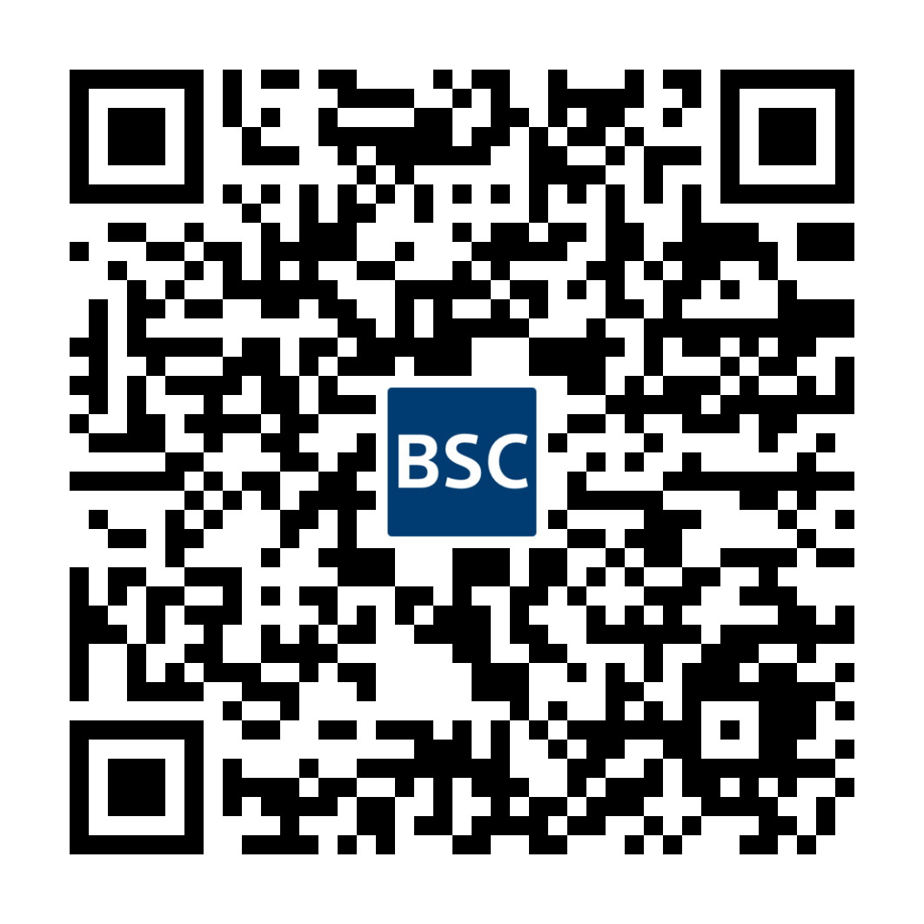
Important Information
ThereSphere™ Y-90 Glass Microspheres
Indications, Safety, and Warnings
https://www.bostonscientific.com/therasphere-indications
Note: Dose to the liver does not exceed 150 Gy. The physician should always take the above-noted Pre-treatment High Risk Factors into consideration for each patient when making decisions regarding the use of TheraSphere for treatment.
TheraSphere is a registered trademark of Theragenics Corporation used under license by Boston Scientific Medical Device Limited, a wholly owned indirect subsidiary of Boston Scientific Corporation.
Simplicit90YTM is a registered trademark of Boston Scientific Medical Device Limited, a wholly owned indirect subsidiary of Boston Scientific Corporation, and is used under license by Mirada Medical Limited. All trademarks are the property of their respective owners.

