Slide 1
THE LEGACY STUDY RESULTS

Slide 2
LEGACY Primary Study Objectives
The LEGACY STUDY:
To assess the local tumor control AND duration of response following treatment with TheraSphere
Y-90 glass microspheres used as either:
neoadjuvant to transplantation or resection OR
stand-alone
in patients with unresectable, solitary lesion HCC.
Localized mRECIST is defined as the response of the lesion within the Y-90 glass treated area
Salem R et al. "3020.2: Yttrium-90 Glass Microspheres in the Treatment of Hepatocellular Carcinoma: The LEGACY Study," CIRSE 2020 Virtual Summit, September 12-15, 2020

Slide 3
LEGACY Study Design
3 independent US sites with highly reproducible results of high ablative dose to tumor in patients that met study criteria demonstrating a low recurrence rate in Early and Advanced HCC
Consecutively treated Y-90 glass microsphere patients
  Between January 2014 and December 2017 included
Median follow-up of 29.9* months
Key Eligibility Criteria:
  Unresectable solitary lesion (≤8cm)
  Received selective, lobar, or mixed (selective plus lobar) TheraSphere Y-90 glass microspheres
  CP A
  BCLC A or BCLC C
  No prior liver transplantation, resection, LRT or systemic therapy
  No PVT or EHD
*By reverse KM method
Y90: Yttrium-90; CP: Child-Pugh; BCLC: Barcelona Clinic Liver Cancer; ECOG: Eastern Cooperative Oncology Group; LRT: logoregional therapy; PVT: portal vein thrombosis; EHD: extrahepatic disease
Salem R et al. "3020.2: Yttrium-90 Glass Microspheres in the Treatment of Hepatocellular Carcinoma: The LEGACY Study," CIRSE 2020 Virtual Summit, September 12-15, 2020

Slide 4
LEGACY Study Baseline Characteristics
Patient Characteristics | Treated Population (N=162) N (%)
Median age (range), years | 66 (21-90)
≥ 18 to < 65 | 69 (42.6)
≥ 65 to < 75 | 64 (39.5)
≥ 75 | 29 (17.9)
Gender, male | 123 (75.9)
HCC Etiology
HCV | 112 (69.1)
Alcohol | 48 (29.6)
NASH | 23 (14.2)
HBV | 15 (9.3)
Other/unknown | 5 (3.1)
ECOG Status
0 | 98 (60.5)
1 | 64 (39.5)
BCLC Status
A | 98 (60.5)
C | 64 (39.5)
AFP ≥ 200 ng/mL | 24 (14.8)
Treatment Characteristics | Treated Population (N=162) N (%)
Median Tumor Size (range), cm | 2.6 (0.9-8.1)
Initial Y90 Treatment Goal
Radiation segmentectomy | 104 (64.2)
Radiation lobectomy | 8 (5.0)
Bridge to liver transplantation | 36 (22.2)
Other | 1 (0.6)
Unknown | 13 (8.0)
Type of Infusion
Selective | 155 (95.7)
Lobar | 3 (1.9)
Mixed | 4 (2.5)
Absorbed dose to perfused liver volume (Gy), median, (IQR) | 410.1 (199.7, 797.7)
Number of TheraSphere Treatments
1 | 130 (80.2)
≥2 | 32 (19.8)
Salem R et al. "3020.2: Yttrium-90 Glass Microspheres in the Treatment of Hepatocellular Carcinoma: The LEGACY Study," CIRSE 2020 Virtual Summit, September 12-15, 2020

Slide 5
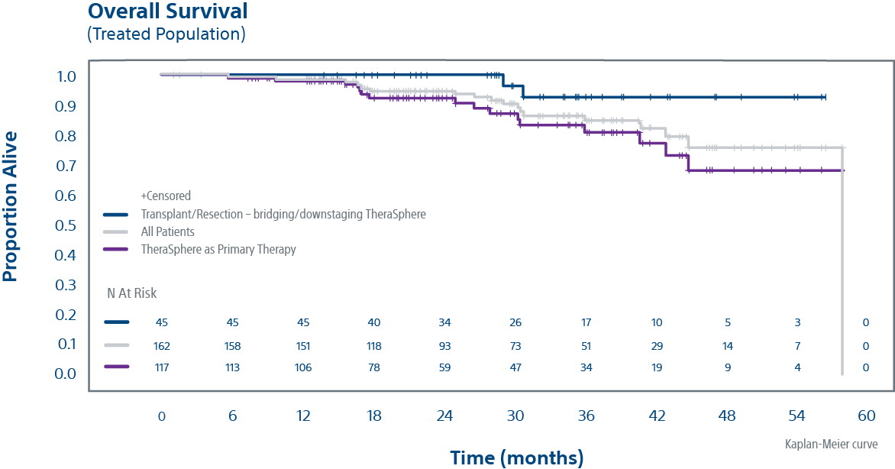
LEGACY is a robust multicenter study that evaluated TheraSphere™ as a Neoadjuvant or Standalone Therapy in Treating Primary Liver Cancer (HCC)
HIGHLIGHT DURABLE TUMOR CONTROL IN EARLY & ADVANCED HCC
93% Overall Survival rate at 3 years in patients with transplant or resection following TheraSphere
84% Overall Survival rate at 3 years in patients where TheraSphere was the primary therapy
TheraSphere patients treated as a destination therapy compared favorably to those receiving transplant or resection
Salem R et al. "3020.2: Yttrium-90 Glass Microspheres in the Treatment of Hepatocellular Carcinoma: The LEGACY Study," CIRSE 2020 Virtual Summit, September 12-15, 2020
Notes:
Again, we show that there are 3 independent US sites all with HIGHLY Reproducible results with high dose to tumor in Patients that met study criteria demonstrating a Low recurrence rate Early and Advanced HCC
Overall Survival was 93% in patients with transplant or resection following TheraSphere at 3 years and 84% overall survival rate in patients where TheraSphere was the primary therapy at 3 years
The low recurrence rate of 5.6% is lesions not in the TheraSphere treated area, I believe (Kirk can correct me if I am wrong), but I believe even in ablation they can see has high as 10% recurrence rate on lesions.
At the 3 year or 36 month mark as noted in this slide, we have very good confidence in these numbers, kirk maybe you could make some comments on our 5 year survival numbers and additional points on this slide.

Slide 6
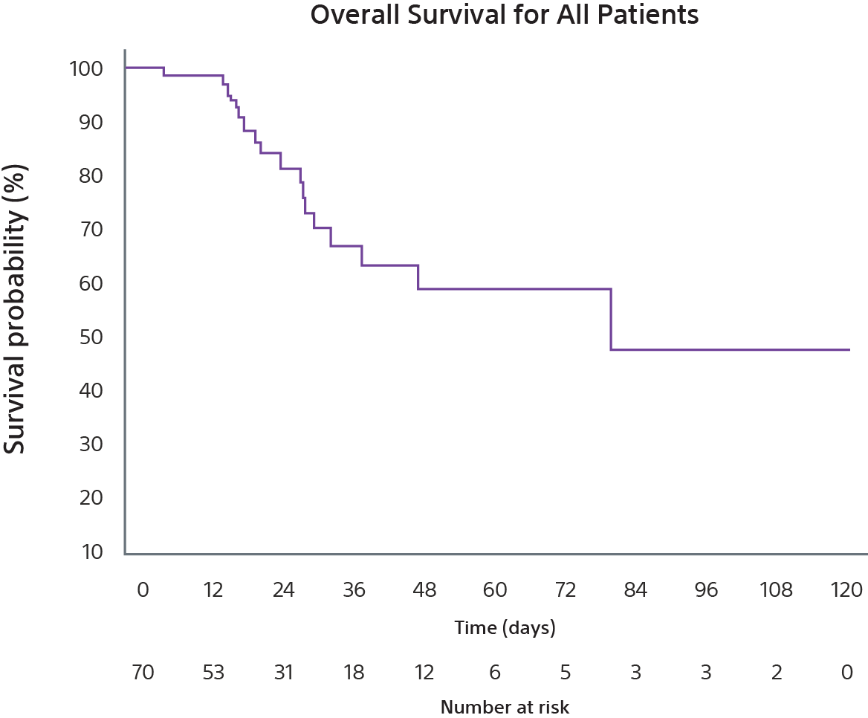
Radiation Segmentectomy Long-term outcomes demonstrated a median overall survival of 6.7 years suggesting radiation segmentectomy should be the preferred treatment approach when possible in unresectable HCC patients
Radiation segmentectomy is a proven treatment option for unresectable early HCC patients
Overall Survival for All Patients with TheraSphere Glass Y-90 Microspheres
In a 70-patient cohort with solitary HCC ≤ 5 cm, patients experienced:
  Local tumor control (72% had no target lesion progression at 5 years)
  Minimal recurrence (9.8%)
  Prolonged time to progression (median TTP= 29 months)
Authors note that overall survival outcomes were comparable to curative treatments (RF ablation, resection and transplant)
Lewandowski RJ, Gabr A, Abouchaleh N et al. Radiation segmentectomy: potential curative therapy for early hepatocellular carcinoma. Radiology. 2018; 287(3): 1050-1058

Slide 7
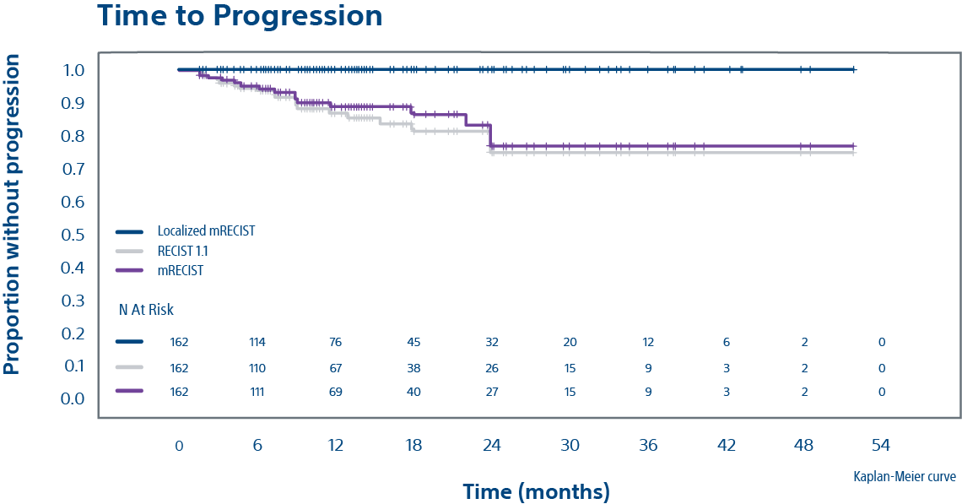
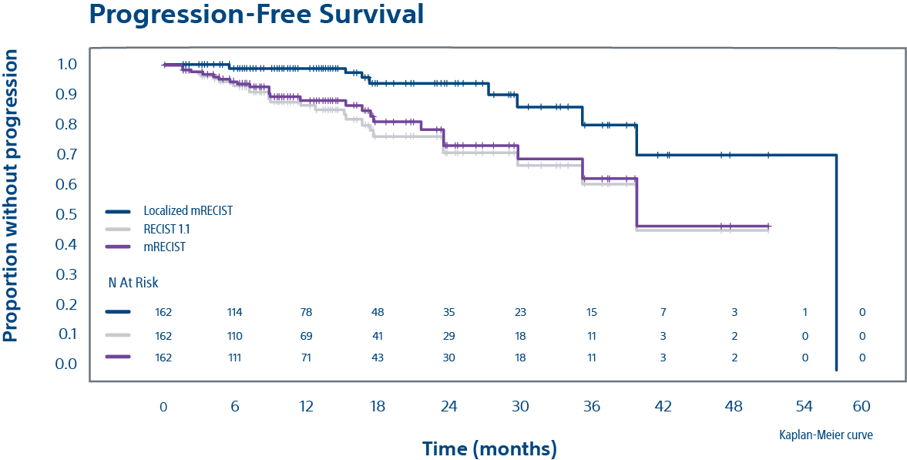
Time to Event Outcomes (Treated Population)
Time to Progression with TheraSphere Glass Y-90 Microspheres
Progression-Free Survival with TheraSphere Glass Y-90 Microspheres
% patients without localized tumor progression at 24 M
Localized mRECIST | 100.0%
mRECIST | 84.1%
RECIST 1.1 | 82.0%
% Patients alive and Progression-free at 24 M
Localized mRECIST | 93.9%
mRECIST | 78.8%
RECIST 1.1 | 76.7%
Local recurrence rate of 5.6% and is 9/162
Median time to best response: 3.9 months (95% CI: 3.5, 4.1)
Salem R et al. "3020.2: Yttrium-90 Glass Microspheres in the Treatment of Hepatocellular Carcinoma: The LEGACY Study," CIRSE 2020 Virtual Summit, September 12-15, 2020

Slide 8
The LEGACY Study Summary
TheraSphere glass Y-90 treatment resulted in:​
88.3% ORR (best response): 84.0% CR and 4.3% PR (localized mRECIST) ​
High perfused volume absorbed dose (median 410 Gy) was well tolerated and effective as a selective ablative treatment ​
96.8% achieved their best response with a single Y-90 glass (TheraSphere) microsphere treatment​
OS compared favorably between patients receiving Y-90 glass (TheraSphere) microspheres as stand-alone therapy and those receiving Y-90 as neoadjuvant to transplant/resection​
No new safety signals were identified
Y90: Yttrium 90; ORR: Objective response rate; CR: complete response; PR: partial response; DoR: duration of response M: months; CP: Child-Pugh; ECOG: Eastern Cooperative Oncology Group; OS: overall survival; Gy: Gray
Salem R et al. "3020.2: Yttrium-90 Glass Microspheres in the Treatment of Hepatocellular Carcinoma: The LEGACY Study," CIRSE 2020 Virtual Summit, September 12-15, 2020

Slide 10
Important Information
Health economic and reimbursement information provided by Boston Scientific Corporation is gathered from third-party sources and is subject to change without notice as a result of complex and frequently changing laws, regulations, rules and policies. This information is presented for illustrative purposes only and does not constitute reimbursement or legal advice. Boston Scientific encourages providers to submit accurate and appropriate claims for services. It is always the provider's responsibility to determine medical necessity, the proper site for delivery of any services and to submit appropriate codes, charges, and modifiers for services that are rendered. Boston Scientific recommends that you consult with your payers, reimbursement specialists and/or legal counsel regarding coding, coverage and reimbursement matters. It is always the provider's responsibility to understand and comply with national coverage determinations (NCD), local coverage determinations (LCD) and any other coverage requirements established by relevant payers which can be updated frequently.
CPT® Copyright 2019 American Medical Association. All rights reserved. CPT is a registered trademark of the American Medical Association. Applicable FARS/DFARS Restrictions Apply to Government Use. Fee schedules, relative value units, conversion factors, and/or related components are not assigned by the AMA, are not part of CPT, and the AMA is not recommending their use. The AMA does not directly or indirectly practice medicine or dispense medical services. The AMA assumes no liability for data contained or not contained herein.

Slide 11
Important Information
TheraSphere™ Yttrium-90 Glass Microspheres
INDICATION FOR USE: TheraSphere is indicated for use as selective internal radiation therapy (SIRT) for local tumor control of solitary tumors (1-8 cm in diameter), in patients with unresectable hepatocellular carcinoma (HCC), Child- Pugh Score A cirrhosis, well-compensated liver function, no macrovascular invasion, and good performance status. CONTRAINDICATIONS: TheraSphere is contraindicated in patients: whose Tc-99m macroaggregated albumin (MAA) hepatic arterial perfusion scintigraphy shows any deposition to the gastrointestinal tract that may not be corrected by angiographic techniques • who show shunting of blood to the lungs that could result in delivery of greater than 16.5 mCi (0.61 GBq) of Y-90 to the lungs. Radiation pneumonitis has been seen rarely in patients receiving doses to the lungs greater than 30 Gy in a single treatment. • in whom hepatic artery catheterization is contraindicated, such as patients with vascular abnormalities or bleeding diathesis • who have pulmonary insufficiency (conventionally defined by an arterial oxygen pressure (Pa,O2) of < 60 mmHg, or oxygen saturation (Sa,O2) of < 90%) or severe liver dysfunction, including hepatic encephalopathy, clinically evident ascites or treatment with diuretics for ascites • with portal vein thrombosis (PVT) Type 4 involvement and lack of Tc-99m MAA deposition on the PVT seen on the Tc-99m MAA imaging with >70% tumor replacement in the liver • with comorbidities or poor overall health (e.g., ECOG performance status rating > 2) which may make the patient a poor candidate for locoregional radiation treatment. • who are pregnant. WARNINGS: The following pre-treatment, high-risk factors (disease characteristics) have been associated with serious adverse events deemed possibly related to use of the device: infiltrative tumor type • tumor nodules too numerous to count • AST or ALT > 5 times ULN • bilirubin > 2 mg/dL • tumor volume > 50% combined with albumin < 3 g/dL. Keep the TheraSphere dose vial upright and stored in its lead pot before and during patient treatment, except as required for radiation measurement. Do not open the dose vial acrylic shield prior to patient treatment. Post-treatment, waste materials require caution to prevent contamination and beta shielding due to residual glass microspheres. PRECAUTIONS: GENERAL PRECAUTIONS: As in any intra-arterial procedure, aseptic technique should be practiced, and care should be taken to ensure minimum patient anesthesia exposure extraneous to therapeutic objective. • Consideration of patient comorbidities should be used when determining the type and volume of fluid to infuse via catheter to avoid electrolyte imbalance, fluid shift, and hyperglycemia. • It is important to avoid any aggressive arterial procedure that may lead to arterial spasm that impairs TheraSphere distribution into the perfused liver target volume which may lead to underdosing or non- target deposition of TheraSphere. PRECAUTION IN PATIENTS WITH IMPAIRED LIVER FUNCTION: No efficacy or safety data from the LEGACY study are available to support the use of the device in patients with Child-Pugh score B or C cirrhosis. PRECAUTION IN VULNERABLE PATIENTS: No effectiveness or safety data are available to support the use of the device in children or breast- feeding women. ENDOCRINE DISRUPTION, CARCINOGENICITY, MUTAGENICITY, TOXICITY TO REPRODUCTION: Ideally the use of this radioactive device in women of childbearing capability should be performed during the first few (approximately 10) days following the onset of menses. RADIATION SAFETY: Radioactive products should be used only by healthcare professionals who are qualified by specific training in the safe use and handling of radionuclides and whose experience and training have been approved by the appropriate government agency authorized to license the use of radionuclides. • As in the use of any radioactive material, ensure minimum radiation exposure to the patient extraneous to the therapeutic objective, and to minimize radiation exposure to workers and others in contact with the patient. RELEASE AND POST-TREATMENT PRECAUTIONS: Post treatment patient care: use universal precautions for body fluid contact. Trace Y-90 may be detectible in blood and urine; handle with gloves and dispose as normal body fluids. The radiation field is expected to be less than 1 mrem/h (10 µSv/h) at 3 ft (1 m) from the patient’s abdomen. Supplemental shielding and segregation of the patient are not required to maintain exposure to others below regulated limits. • Release instructions: The patient should follow good hygiene (e.g., proper hand washing). Caregivers, family, and others do not require restrictions on patient contact; however, they can minimize their radiation exposure by avoiding prolonged time (>12 hours per day) within 1 ft (0.3 m) of the patient’s abdomen for the first week post therapy. Patients should be advised that radiation emitted from the patient may be detectible at security screening (e.g., international travel). • Special precautions post-administration: If the patient requires hospitalization, surgery, medical assessment or treatment regarding any part of their thorax or abdomen within first 2 weeks of treatment, the patient should advise the hospital and treating physician of the Y-90 TheraSphere implant. The physician should consult their radiation safety staff for handling and disposal of liver tissue. • Special liver tissue handling: Special liver tissue handling may be required for post-treatment surgery, explant, or transplant since the glass microspheres remain permanently implanted in the liver tissue. Disclosure of the treatment will be required if cremation is considered. POTENTIAL ADVERSE EVENTS: The use of this product leads to irradiation of both tumorous and normal liver tissue. As a result, patients with compromised liver function may be at greater risk of liver function impairment and hence could experience complications. Clinical side effects usually occur within the first 4 to 6 weeks after treatment. Based on clinical trial data, literature reviews and post market surveillance, adverse events potentially associated with treatment using Y-90 microspheres, including TheraSphere, may include the following: Allergic reaction • Altered liver function, acute or chronic • Anorexia • Anxiety • Ascites • Bile Duct injury • Bleeding/hemorrhage • Chills / rigors • Cholecystitis (inflammatory or infectious) • Colitis • Death • Dehydration • Diarrhea • Dizziness • Dyspnea • Edema (any location) • Electrolyte abnormalities • Elevated BUN/creatinine • Fall • Fatigue • Fever • Gastrointestinal bleeding / hemorrhage • Gastrointestinal ulcer or ulceration • Hepatic encephalopathy • Hepatorenal failure • Hiccups • Hypertension • Hypotension • Infection (any location) • Liver failure, acute or chronic • Lymphopenia • Malaise • Mood alteration • Muscle weakness • Nausea • Neutropenia • Pain (any location) • Pancreatitis • Platelet count abnormalities • Pleural effusion • Portal hypertension • Pre-existing chronic liver disease decompensation • Pulmonary edema • Pulmonary fibrosis • Radiation hepatitis • Radiation induced disease, acute • Radio Embolization Induced Liver Disease (REILD) • Sepsis • Supraventricular arrhythmia • Thrombosis (arterial or venous) • Tumor inflammation (including tumor edema) • Tumor-lysis syndrome • Vomiting • Weight loss. Complications related to the administration procedure itself may include: Allergic reaction: Arterial injury including vessel dissection • Aspiration pneumonia • Bruising/bleeding/hematoma at site • Constipation/abdominal distension • Fatigue • Flushing • Infection • Nausea • Nerve damage. CAUTION: Federal (USA) law restricts this device to sale by or on order of a physician.PI-992004-AA
Note: Dose to the liver does not exceed 150 Gy. The physician should always take the above-noted Pre-treatment High Risk Factors into consideration for each patient when making decisions regarding the use of TheraSphere for treatment.
TheraSphere is a registered trademark of Theragenics Corporation used under license by Biocompatibles UK Ltd. All other trademarks are property of their respective owners.

