Slide 1
DOSISPHERE-01 Trial
5-year results

Slide 2
DOSISPHERE-01 primary trial objective
Level 1 evidence showed that unresectable HCC patients who received a personalized TheraSphere dose using multi-compartment dosimetry and were downstaged to resection saw durable, long-term overall survival.
A randomized, multicenter, investigator-sponsored phase II trial comparing the clinical outcomes of SIRT with TheraSphere in patients with intermediate/advanced HCC using two pre-treatment dosimetry determination methods:
Standard, single-compartment dosimetry (SDA), defined as a uniform distribution of absorbed dose within the perfused volume – both tumor and normal liver
Personalized dosimetry (PDA), defined as multi-compartment Y-90 distribution of absorbed dose within the perfused volume that accounts for preferential blood flow into the tumor compared with normal parenchyma

Slide 3
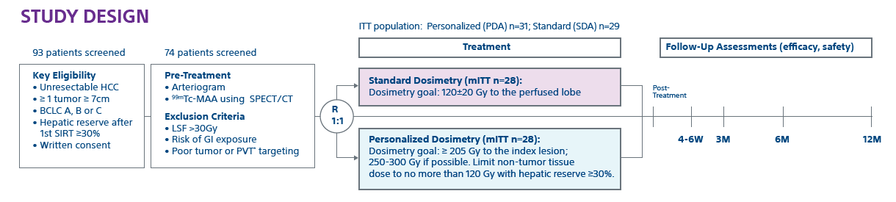
DOSISPHERE-01 trial design
*By reverse KM method
* TheraSphere not indicated for patients with PVT.

Slide 4
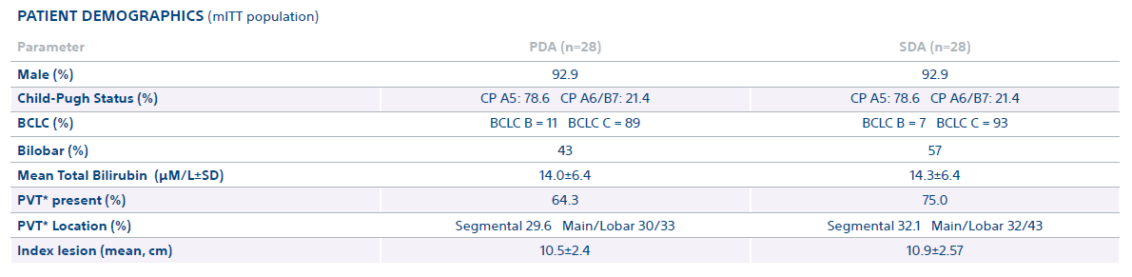
Patient demographics
* TheraSphere not indicated for patients with PVT.

Slide 5
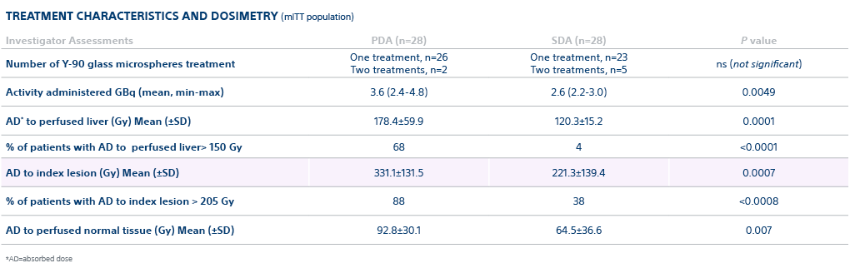
Treatment characteristics and dosimetry

Slide 6
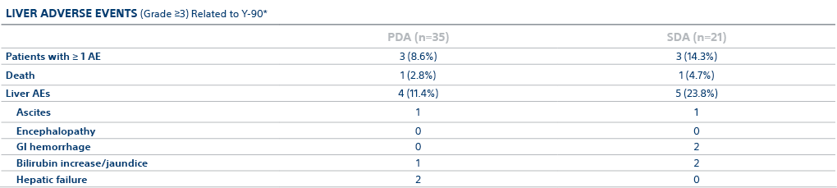
Liver adverse events
*Patients allocated to either PDA or SDA based on treatment received (dose received) versus allocation by randomization.

Slide 7
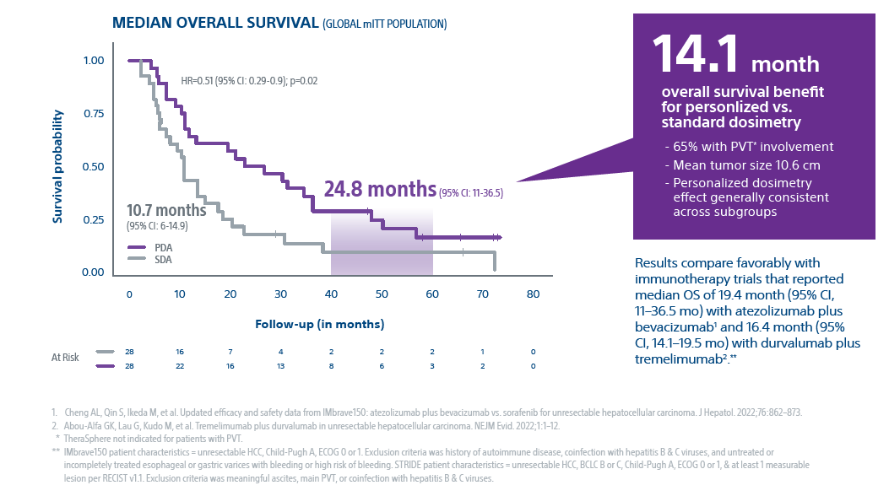
After analysis of long-term 65.8 month follow-up, improvement in median OS was sustained in the PDA group
Median Overall Survival (global mITT population) with TheraSphere Y-90 Glass Microspheres
1. Cheng AL, Qin S, Ikeda M, et al. Updated efficacy and safety data from IMbrave150: atezolizumab plus bevacizumab vs. sorafenib for unresectable hepatocellular carcinoma. J Hepatol. 2022;76:862–873. 2. Abou-Alfa GK, Lau G, Kudo M, et al. Tremelimumab plus durvalumab in unresectable hepatocellular carcinoma. NEJM Evid. 2022;1:1–12. * TheraSphere not indicated for patients with PVT. ** IMbrave150 patient characteristics = unresectable HCC, Child-Pugh A, ECOG 0 or 1. Exclusion criteria was history of autoimmune disease, coinfection with hepatitis B & C viruses, and untreated or incompletely treated esophageal or gastric varices with bleeding or high risk of bleeding. STRIDE patient characteristics = unresectable HCC, BCLC B or C, Child-Pugh A, ECOG 0 or 1, & at least 1 measurable lesion per RECIST v1.1. Exclusion criteria was meaningful ascites, main PVT, or coinfection with hepatitis B & C viruses.
Notes:
Again, we show that there are 3 independent US sites all with HIGHLY Reproducible results with high dose to tumor in Patients that met study criteria demonstrating a Low recurrence rate Early and Advanced HCC
Overall Survival was 93% in patients with transplant or resection following TheraSphere at 3 years and 84% overall survival rate in patients where TheraSphere was the primary therapy at 3 years
The low recurrence rate of 5.6% is lesions not in the TheraSphere treated area, I believe (Kirk can correct me if I am wrong), but I believe even in ablation they can see has high as 10% recurrence rate on lesions.
At the 3 year or 36 month mark as noted in this slide, we have very good confidence in these numbers, kirk maybe you could make some comments on our 5 year survival numbers and additional points on this slide.

Slide 8
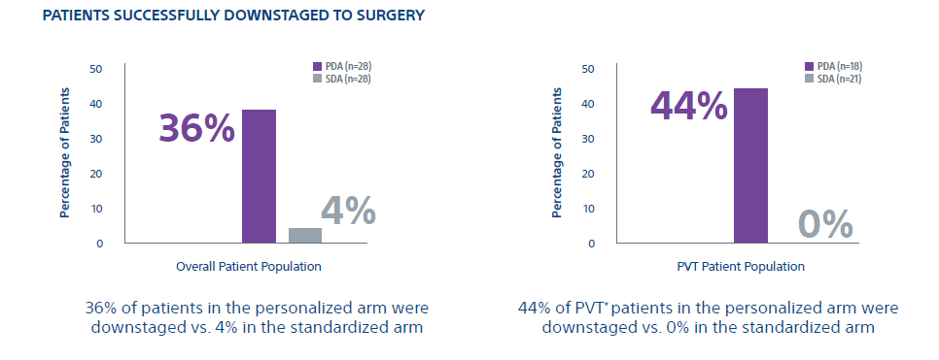
Personalized dosimetry allowed more patients to be downstaged to resection, resulting in durable, long-term overall survival
Index lesion response rate at 3 months using EASL in the MITT population with TheraSphere Y-90 Glass Microspheres
* TheraSphere not indicated for patients with PVT.

Slide 9
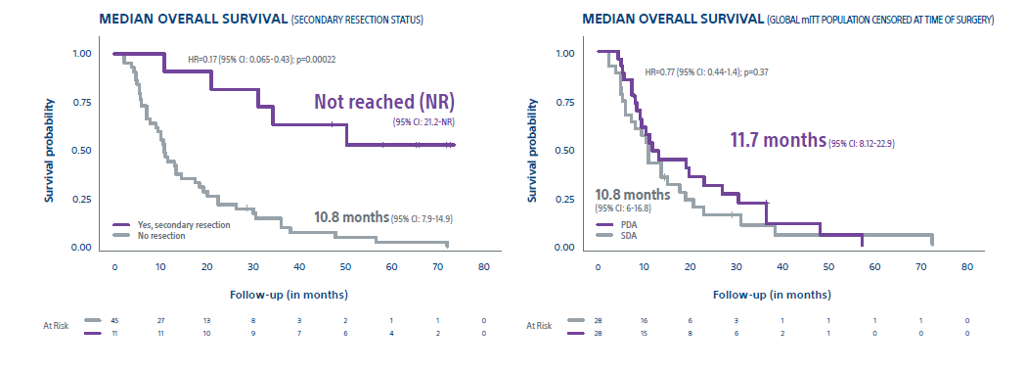
The prognostic impact of secondary surgery on long-term OS is highlighted by the loss of difference in median OS censored at the time of surgery between arms

Slide 10
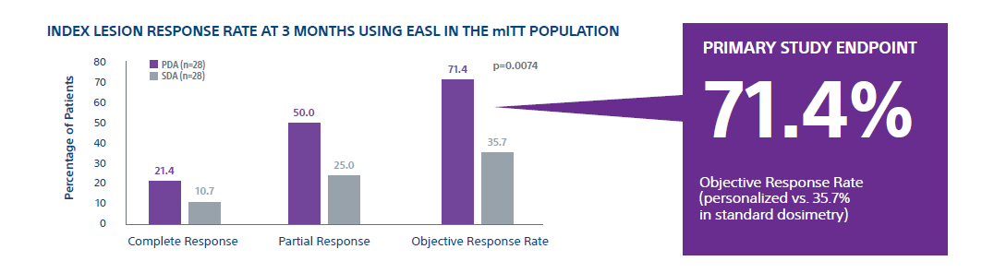
Significantly improved response rate with personalized dosimetry
Index lesion response rate at 3 months using EASL in the MITT population with TheraSphere Y-90 Glass Microspheres

Slide 11
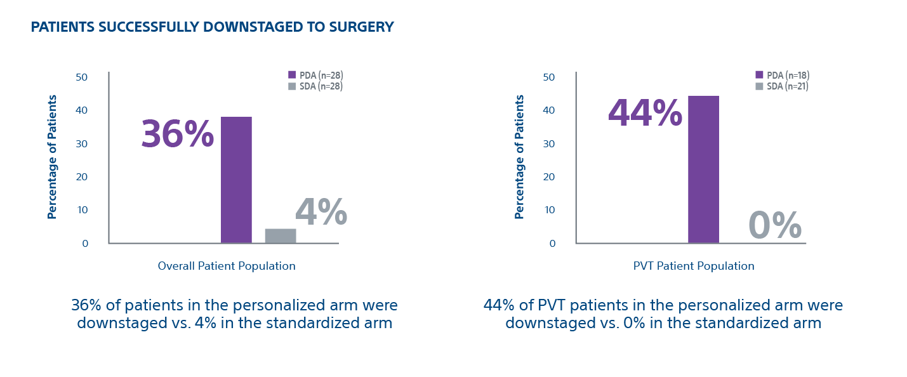
Personalized dosimetry downstaged more patients to surgery
Patients successfully downstaged to surgery with TheraSphere Y-90 Glass Microspheres

Slide 12
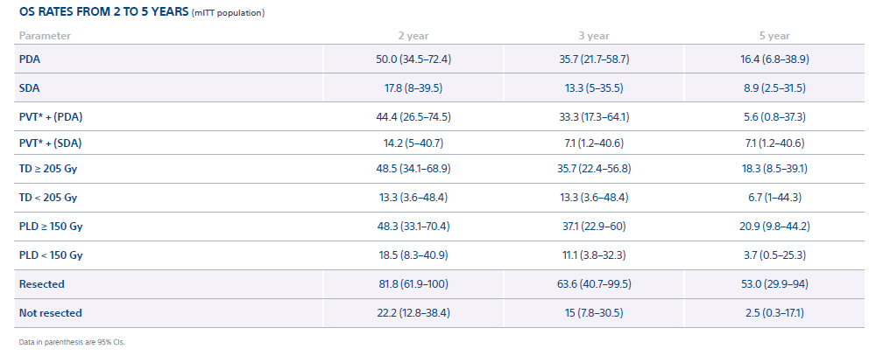
OS rates decreased for patients with poor features (those randomly assigned to SDA, receiving a TD <205 Gy or a PLD <150 Gy, or not downstaged to resection). Only resected patients displayed an OS rate >50% at 5 years.
* TheraSphere not indicated for patients with PVT.

Slide 13
Conclusion
After a long-term follow-up period, a meaningful improvement in OS was sustained after personalized dosimetry. OS was dramatically improved for patients who were downstaged toward resection and then resected, including most PVT* patients.
Because the 5-year survival rates for patients without resection remain low, randomized trials comparing SIRT with personalized dosimetry plus immunotherapy versus immunotherapy alone are now warranted in this specific patient population.
* TheraSphere not indicated for patients with PVT.

Slide 15
Important Information
Health economic and reimbursement information provided by Boston Scientific Corporation is gathered from third-party sources and is subject to change without notice as a result of complex and frequently changing laws, regulations, rules and policies. This information is presented for illustrative purposes only and does not constitute reimbursement or legal advice. Boston Scientific encourages providers to submit accurate and appropriate claims for services. It is always the provider's responsibility to determine medical necessity, the proper site for delivery of any services and to submit appropriate codes, charges, and modifiers for services that are rendered. Boston Scientific recommends that you consult with your payers, reimbursement specialists and/or legal counsel regarding coding, coverage and reimbursement matters. It is always the provider's responsibility to understand and comply with national coverage determinations (NCD), local coverage determinations (LCD) and any other coverage requirements established by relevant payers which can be updated frequently.
CPT® Copyright 2019 American Medical Association. All rights reserved. CPT is a registered trademark of the American Medical Association. Applicable FARS/DFARS Restrictions Apply to Government Use. Fee schedules, relative value units, conversion factors, and/or related components are not assigned by the AMA, are not part of CPT, and the AMA is not recommending their use. The AMA does not directly or indirectly practice medicine or dispense medical services. The AMA assumes no liability for data contained or not contained herein.

Slide 16
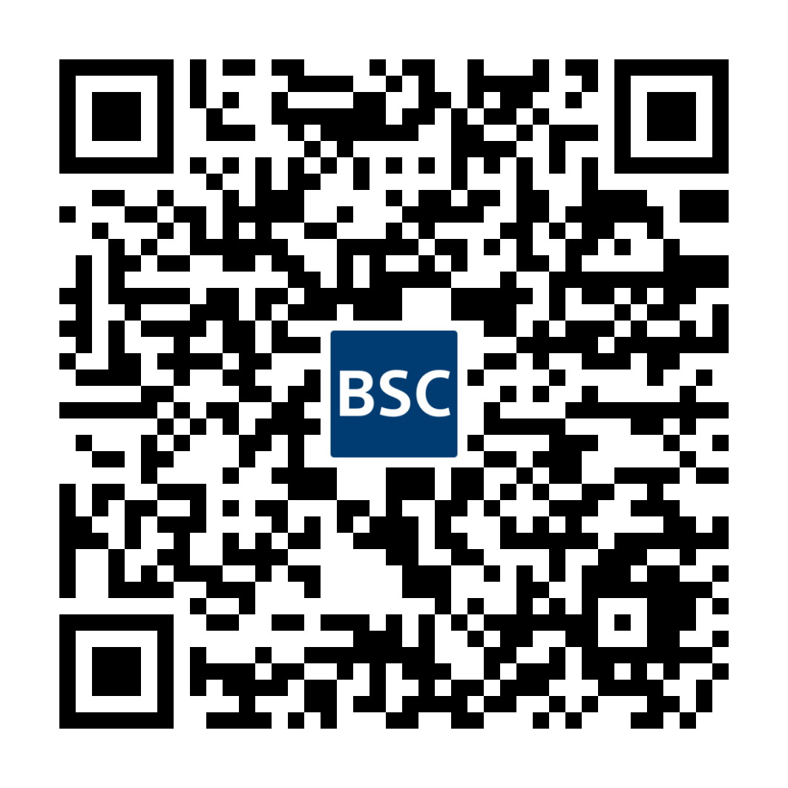
Important Information
ThereSphere™ Y-90 Glass Microspheres
Indications, Safety, and Warnings
https://www.bostonscientific.com/therasphere-indications
Note: Dose to the liver does not exceed 150 Gy. The physician should always take the above-noted Pre-treatment High Risk Factors into consideration for each patient when making decisions regarding the use of TheraSphere for treatment.
TheraSphere is a registered trademark of Theragenics Corporation used under license by Boston Scientific Medical Device Limited, a wholly owned indirect subsidiary of Boston Scientific Corporation. All other trademarks are property of their respective owners.

