Slide 1


Slide 2
Physician Presenter Disclaimer
Products, services, or therapies discussed in this presentation may be subject to regulatory approval/clearance and therefore labeling may change.
Opinions given during this presentation are my personal, professional opinion.
(Note to physician: Review disclaimer and insert appropriate language and/or content changes to fit your individual circumstances and address any content changes.)

Slide 3
[Physician Name]
[Credentials/Specialty/Title]
[Practice Name/Hospital]
[Locations]
[Contact Information]
[Education]
[Affiliations]

Slide 4
[Physician]
Specializes in
[Include additional information about your practice]

Slide 5

Prostate Overview

Slide 6
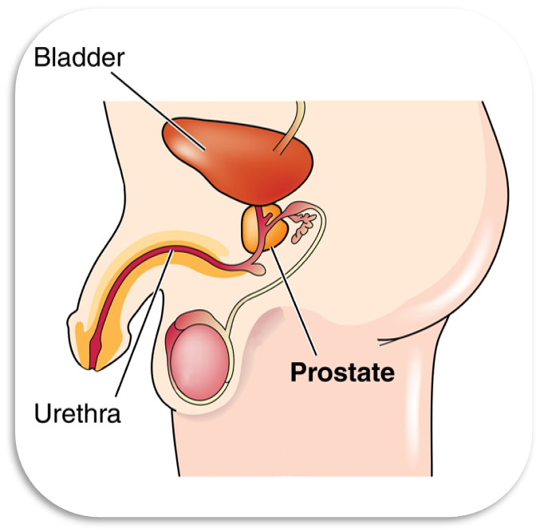
What is the Prostate?¹
Walnut sized gland at base of male bladder
Surrounds the urethra
Produces fluid that transports sperm during ejaculation
Prostate grows to its normal adult size in a man’s early 20s; it begins to grow again during the mid-40s

Slide 7
What Can Happen to the Prostate?²
Enlarged Prostate or Benign Prostatic Hyperplasia (BPH)
Prostatitis
Prostate Cancer
Each condition affects the prostate differently.

Slide 8
What is BPH?
BPH
Benign
=
Non-cancerous
Prostatic
=
Relating to the prostate gland
Hyperplasia
=
More cells than normal³
=
Commonly known as enlarged prostate, BPH means the prostate gland has grown larger than normal
Normal adult size = approximately 1.5 inches in diameter¹
Benign prostatic hyperplasia/enlargement can lead to bladder outlet obstruction (BOO)⁴ which can cause lower urinary tract symptoms (LUTS)⁴

Slide 9
Does BPH Mean I Have Prostate Cancer?
BPH’s Relation to Prostate Cancer
BPH is not prostate cancer⁵
BPH does not cause prostate cancer⁵
BPH symptoms are similar to those of cancer¹
BPH may co-exist with prostate cancer¹
Prostate-Specific Antigen (PSA) levels alone do not distinguish BPH from prostate cancer.¹ Both BPH and prostate cancer can cause elevated PSA levels.¹

Slide 10
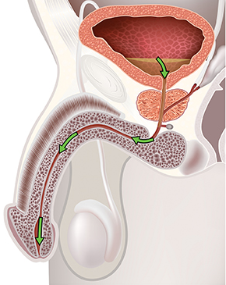
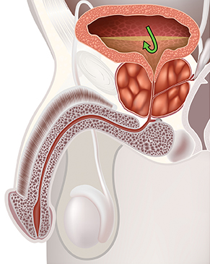
Normal vs. Enlarged Prostate
As the prostate enlarges, pressure can be put on the urethra causing urinary problems (LUTS)¹
Prostate size does not correlate with degree of obstruction or severity of symptoms.³
Normal Prostate
Enlarged Prostate

Slide 11
What are the Symptoms of BPH?¹
Frequent urination during the day and/or night
Sudden urge to urinate
Burning, painful urination
Weak urine flow
Sensation the bladder is not empty after urination
Inability to urinate
Trouble stopping and starting of urine flow

Slide 12

BPH Can Affect Quality of Life
Many men who suffer from BPH may experience a reduction in quality of life.
Up to 95% of men with moderate symptoms are unhappy and don’t want to spend the rest of their life with these symptoms⁹
51% of men say BPH interferes with one aspect of their normal life⁶
Studies show 49% of men experience sexual problems associated with LUTS⁸
BPH also affects men’s partners quality of life, daily routines and relationships⁷

Slide 13
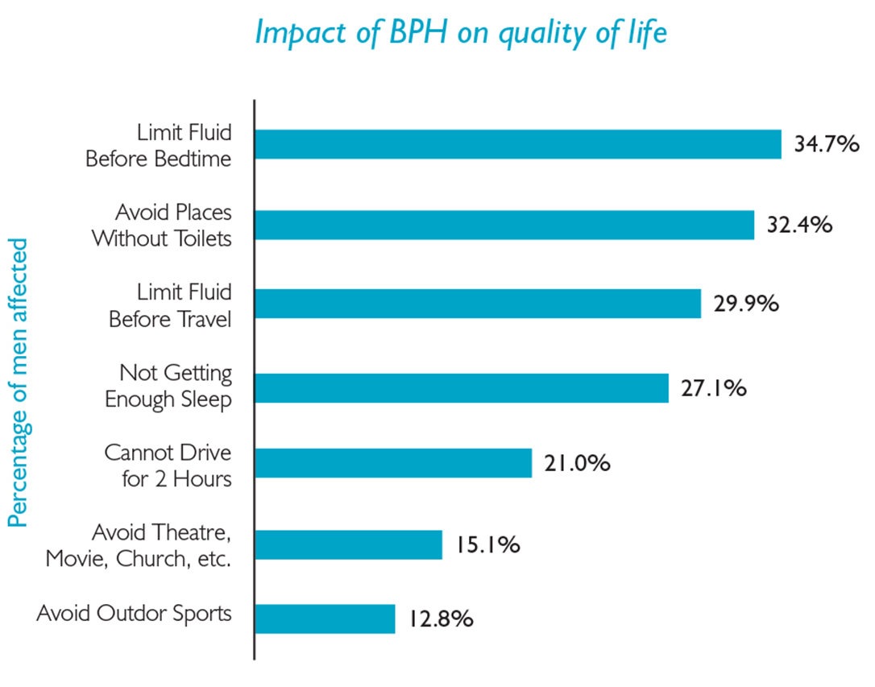
How Does BPH Affect Quality of Life?⁶

Slide 14
Who Can Get BPH?
BPH affects 50% of men over 50¹⁰
Affects 40-50% of men ages 51-60¹¹
Affects 80%+ men over age 80¹¹
Obesity, higher body mass index (BMI) and lack of exercise may increase the risk of BPH³

Slide 15
How is an Enlarged Prostate Diagnosed?¹²
Medical History
Physical Exam*
Prostate Exam
Digital rectal exam (DRE)
Urinary Output Testing
Peak urinary flow (Qmax) testing
Post-void urine volume testing
Self Evaluation of Symptoms
American Urological Association Symptom Index (AUA-SI)
International Prostate Symptom Score (IPSS)
Quality of Life (QoL) Questions
Bladder Impact Index (BII)
*Additional testing is optional and may be done at physician’s discretion and/or depending on patient symptoms

Slide 16
Treatment Options

Slide 17
Treatment Options Overview
WATCHFUL WAITING/
MEDICAL THERAPIES
MINIMALLY INVASIVE SURGERY
INVASIVE
SURGERY
Alpha Blockers
Microwave Therapy
(TUMT)
Open Prostatectomy
5 Alpha-Reductase
Inhibitors
Laser
TURP
(Monopolar, Bipolar, Button)

Slide 18
Complementary and Alternative Medicines
American Urological Association (AUA) Recommendation
No dietary supplement, combination phytotherapeutic agent, or other nonconventional therapy is recommended for the management of LUTS secondary to BPH. This includes saw palmetto and urtica dioica.¹²

Slide 19
Treatment Options
Watchful Waiting/Medical Therapies
Characteristics¹²
Best for men with mild symptoms
Consists of yearly exams and no active intervention
No surgery
No drugs
May involve lifestyle modification such as adjusting diet, evening fluid intake, medication use and exercise patterns
Side Effects
Symptoms may worsen or remain unchanged without lifestyle modification¹

Slide 20
Treatment Options
Medication
Alpha-Blockers¹
Characteristics
Intended for men with mild to severe symptoms¹²
Provides relief of BPH symptoms^{13*}
Works almost immediately¹
Proactive form of treatment¹⁴
*when daily dosages are taken as directed
Side Effects**
May experience drop in blood pressure¹³
Dizziness and/or fainting¹³
Fatigue¹³
Nasal Congestion¹³
Abnormal ejaculation¹⁴
Can have drug interactions with other medications¹
**Side effects to ≥ 2%

Slide 21
Treatment Options
Medication
5-Alpha Reductase Inhibitors¹
Characteristics
Intended for men with demonstrable prostatic enlargement^{12,13}
Reduces the risk of the need for surgery^{1,12,13}
Relives the symptoms of BPH^{12,13}
*when daily dosages are taken as directed
Side Effects
Erectile dysfunction (ED)/Impotence¹³**
Lowered sexual drive/libido¹³**
Ejaculation disorders¹³**
Lowers PSA levels up to 50%; can interfere with prostate cancer detection.¹
**Side effects ≥ to 2%

Slide 22
Treatment Options
Minimally Invasive Therapy
Transurethral Microwave Therapy (TUMT)
Involves the use of a microwave antennae mounted on a urethral catheter to heat the prostate.
Characteristics
Intended for men with moderate to severe symptoms¹²
Non surgical procedure¹²
Outpatient capability¹²
Lack of sexual side-effects¹²
Performed with local anesthetic¹
Side Effects
Average catheterization time: between 2 and 14 days¹
Urinary retention and incontinence¹
Urinary Tract Infections¹
May require retreatment¹
Slow improvement of symptoms¹⁵

Slide 23
Treatment Options
Minimally Invasive Surgery
TURP
Uses electricity to superheat a thin metal band that cuts the prostate tissue into small chunks.
Characteristics¹²
Intended for men with moderate to severe symptoms
Performed under general or spinal anesthesia
Typically requires post-operative hospitalization ≥ 2 days¹
Post-void residual
Improved Quality of Life scores
Provides symptoms relief
Demonstrated improved Qmax (volume of urine per sec)
Demonstrated improved prostate volume
Side Effects
TUR Syndrome¹²
Sexual problems/ED¹
Urinary retention¹
Urethral strictures¹
Prolonged catheterization¹
Bladder neck contracture¹²
Retrograde ejaculation¹
Bleeding requiring transfusion¹²

Slide 24
Treatment Options
Minimally Invasive Surgery
Laser Therapy
Uses a laser to vaporize away the prostate tissue.
Characteristics
Intended for men with BPH¹⁴
Typically done in an outpatient setting¹⁶
Provides sustainable symptom relief¹⁷
Rapid urine flow improvement after the procedure¹⁷
Minimal blood loss¹
Side Effects
Retrograde ejaculation¹⁷
Urgency/frequency¹⁶
Dysuria¹⁴
Hematuria/blood in the urine¹⁶
Urinary Retention¹⁶

Slide 25
Treatment Options
Invasive Surgery
Open Prostatectomy
Involves surgical removal of the inner portion of the prostate via a suprapubic or retropubic incision in the lower abdominal area.
Characteristics¹²
Typically is performed on patients with larger prostate volumes (>80 - 100 mL)
Effective for men with:
Very enlarged prostate glands
Bladder diverticula (pockets)
Stones
Side Effects¹²
Associated with a longer hospital stay
Risk of blood loss, transfusion significantly greater than with transurethral procedures

Slide 26

Insurance Coverage
It is the responsibility of the patient to contact their insurance provider for specific coverage information.

Slide 27
In Summary
What is the prostate and how does it work?
Enlarged prostate = BPH
Treatment Options
Watchful Waiting/Medical Therapy
Minimally Invasive Surgical Therapy
Heat Therapy
TURP
Laser Therapy
Surgical Therapy
Open Prostatectomy

Slide 28

Next Steps
Consultation with your Urologist is required to determine what therapy option is the best treatment option for you.

Slide 29
References
1. Carter HB. Prostate Disorders: the Johns Hopkins White Papers. Baltimore, MD: Johns Hopkins Medicine; 2010: 1, 3.
2. Kidney and Urinary System Disorders-Prostate Disease. http://www.hopkinsmedicine.org/healthlibrary/conditions/adult/kidney_and_urinary_system_disorders/prostate_disease_85,P01492. Accessed 6/14/12.
3. Roehrborn, C. Benign Prostatic Hyperplasia: Etiology, Pathophysiology, Epidemiology, and Natural History. Campbell-Walsh Urology Tenth Edition. Philadelphia, PA: Saunders, an Imprint of Elsevier, Inc.; 2012;91:2579.
4. Kirby, R., Gilling, P. Fast Facts: Benign Prostatic Hyperplasia, Sixth Edition. United Kingdom: Health Press; 2010:14, 16, 19. 5
5. Clinical Practice Guideline-Treating Your Enlarged Prostate. U.S. Department of Health and Human Services. Rockville, MD: Agency for Health Care Policy and Research (AHCPR) Publication No. 943-0584. February 1994; Number 8:1.
6. Garraway, WM, McKelvie, GB, Russell, EBAW, Hehir, M., Lee, R., Rogers ACN, et. Al. Impact of previously unrecognized benign prostatic hyperplasia on the daily activities of middle-aged and elderly men. British Journal of General Practice. 1993:43:318.
7. Shvartzman, P., Borkan, J., Stoliar, L., Peleg, A., Nakar, S., Nir, G., et. A. Second-hand prostatism: effects of prostatic volumes in spouses’ quality of life, daily routines and family relationships. Family Practice. 2001;18-6:610-612.
8. Rosen, R., Update on the relationship between sexual dysfunction and lower urinary tract symptoms/benign prostatic hyperplasia. Current Opinion in Urology. 2006; 16:11-12,15.
9. Bertaccini, A., Vassallo, F., Martino, F., Luzzi, L., Rossetti, S., Di Silverio, F., et. Al. Symptoms, bothersomeness and quality of life in patients with LUTS suggestive of BPH. Eur Urol. 2001;40 (Suppl 1):16.
10. Berry, S, Coffey, D, Walsh, P, Ewing, J, The Development of Human Benign Prostatic Hyperplasia with Age. Journal of Urology 1984; 132:1-6.
11. http://kidney.niddk.nih.gov/KUDiseases/pubs/kustats/index.aspx. Accessed 6/13/12.
12. American Urological Association Education Research, Inc. American Urological Association Guideline: Management of Benign Prostatic Hyperplasia (BPH), Revised, 2010:Appendix 280, 283-285.
13. Cambio, AJ, Evans, CP. Outcomes and quality of life issues in the pharmacological management of benign prostatic hyperplasia (BPH). Ther Clin Risk Manag. March 2007;3-1:193.
14. Wojcik, M., Dennison, D. Home Study Program-Photoselective vaporization of the prostate in ambulatory surgery. AORN Journal. February 2006;83-2:332.
15. Johns Hopkins Health Alert, Prostate on BPH Treatment Options: Special Report, Minimally Invasive Treatments for BPH (Benign Prostatic Hyperplasia) http://www.johnshopkinshealthalerts.com/reports/prostate_disorders/140-1.html Accessed 01/31/14.
16. Te, A., Malloy, Stein, B., Ulchaker, J., Nseyo, U., Hai, M., Malek, R. Photoselective Vaporization of the Prostate for the Treatment of Benign Prostatic Hyperplasia: 12-Month Results from the First United States Multicenter Prospective Trial. The Journal of Urology. 2004;172:1406.
17. Sarica, K., Alkan, E., Luleci, H., Tasci, A. Photoselective Vaporization of the Enlarged Prostate with KTP Laser: Long-Term Results in 240 Patients. Journal of Endourology. 2005;19-10:1200-1201.
© 2014 American Medical Systems, Inc. (“AMS”).
The grant of permission to use AMS’s copyrighted material does not constitute endorsement by AMS of any persons, products, services or organizations.
BPH-00977(2)b/March 2014

Slide 30
Thank You

