Slide 1
TARGET STUDY RESULTS

Slide 2
TARGET Primary Study Objective
A real-world retrospective study that confirms TheraSphere for HCC as safe and effective in a select patient population, demonstrating predictable clinical outcomes across a broad patient population in 8 countries.
Establish the relationships between:
Normal tissue adsorbed dose (NTAD) and occurrence of grade 3 or higher hyperbilirubinemia
Tumor absorbed dose (TAD) and Objective Response Rate (ORR)
TAD and Overall Survival (OS)

Slide 3
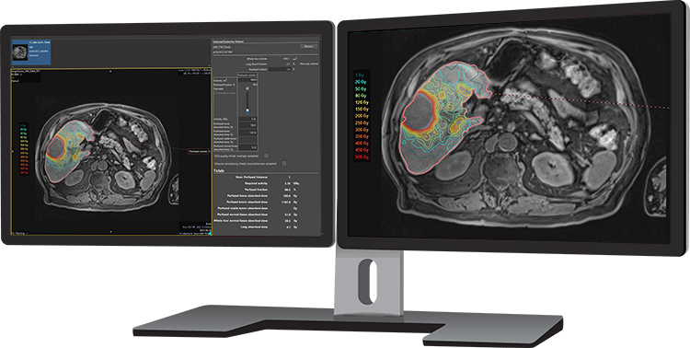
TARGET Study Design
Key Patient Characteristics
Mainly Intermediate and Advanced HCC: 32.5% BCLC B and 54.5% BCLC C
7 cm median target lesion
33% PVT*
Dosimetry Approach
Investigator review of patient chart and dosimetry calculation
Retrospective dosimetry evaluation with multi-compartment approach using Simplicit⁹⁰Y™ personalized dosimetry software to determine TAD and NTAD
*TheraSphere not indicated for patients with PVT.
*By reverse KM method

Slide 4
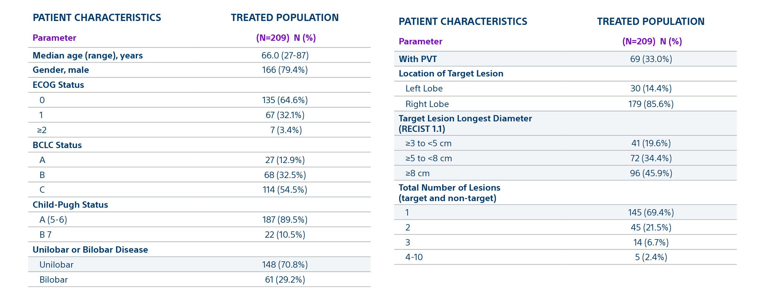
TARGET Study Baseline Characteristics

Slide 5
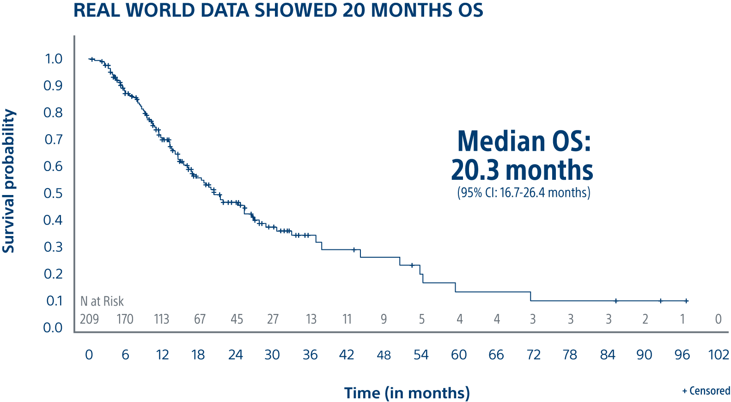
TARGET is a global evaluation of advanced dosimetry in transarterial radioembolization of hepatocellular carcinoma (HCC) with TheraSphere Y-90 glass microspheres
Results
70.8% ORR* for the target lesion (mRECIST)
61.7% ORR** for all lesions (mRECIST)
20.3 months median Overall Survival
Overall Survival for All Patients with TheraSphere Y-90 Glass Microspheres
*95% CI = 64.3 - 76.6%
**95% CI = 55.0 - 68.0%
Notes:
Again, we show that there are 3 independent US sites all with HIGHLY Reproducible results with high dose to tumor in Patients that met study criteria demonstrating a Low recurrence rate Early and Advanced HCC
Overall Survival was 93% in patients with transplant or resection following TheraSphere at 3 years and 84% overall survival rate in patients where TheraSphere was the primary therapy at 3 years
The low recurrence rate of 5.6% is lesions not in the TheraSphere treated area, I believe (Kirk can correct me if I am wrong), but I believe even in ablation they can see has high as 10% recurrence rate on lesions.
At the 3 year or 36 month mark as noted in this slide, we have very good confidence in these numbers, kirk maybe you could make some comments on our 5 year survival numbers and additional points on this slide.

Slide 6
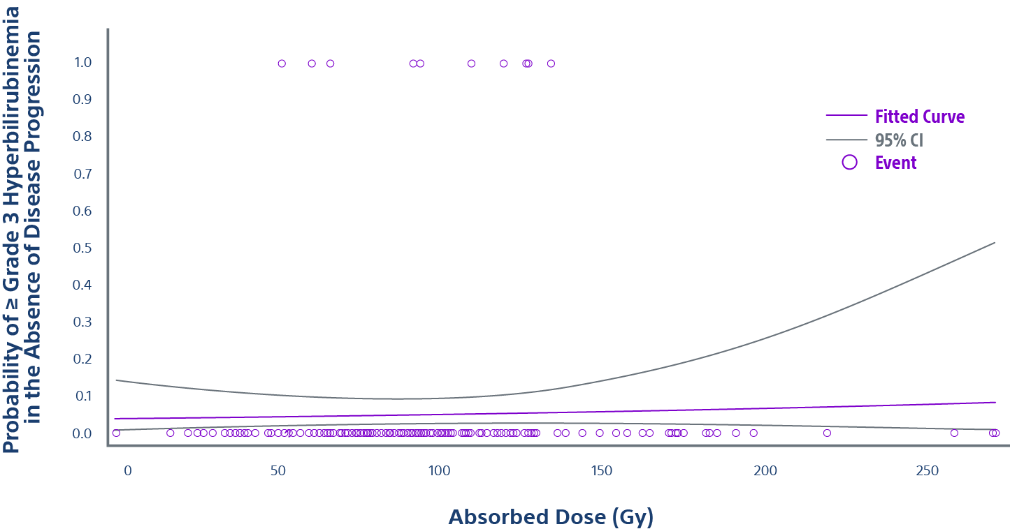
Low rate of ≥ grade 3 hyperbilirubinemia confirms safety of TARGET study
NTCP (Normal Tissue Complication Probability) Curve based on ⁹⁹Tc-MAA
Only 4.8% of patients (10/209) experienced ≥ Grade 3 hyperbilirubinemia in the absence of disease progression.
Regarding the low rate of event, no correlation could be established with the normal tissue absorbed dose (p=0.6 for NTAD).

Slide 7
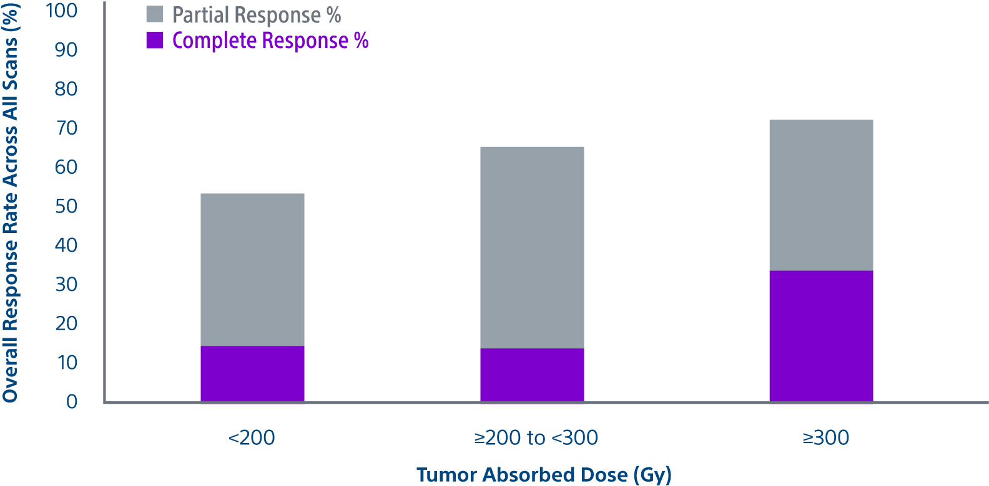
Tumor absorbed dose was predictive of response ^{1,2}
ORR Across All Scans for All Patients with TheraSphere Y-90 Glass Microspheres
Responders had a 17% higher mean tumor absorbed dose (225.5 Gy*) compared with
non-responders (188.3 Gy**)
*95% CI = 201.0 - 253.0 Gy
**95% CI = 164.6 - 215.3 Gy; p=0.046
Total perfused tumor absorbed dose and best response (61.7%) according to mRECIST
Non-responders (defined as stable disease, progressive disease, or non-evaluable) are not represented in the graph

Slide 8
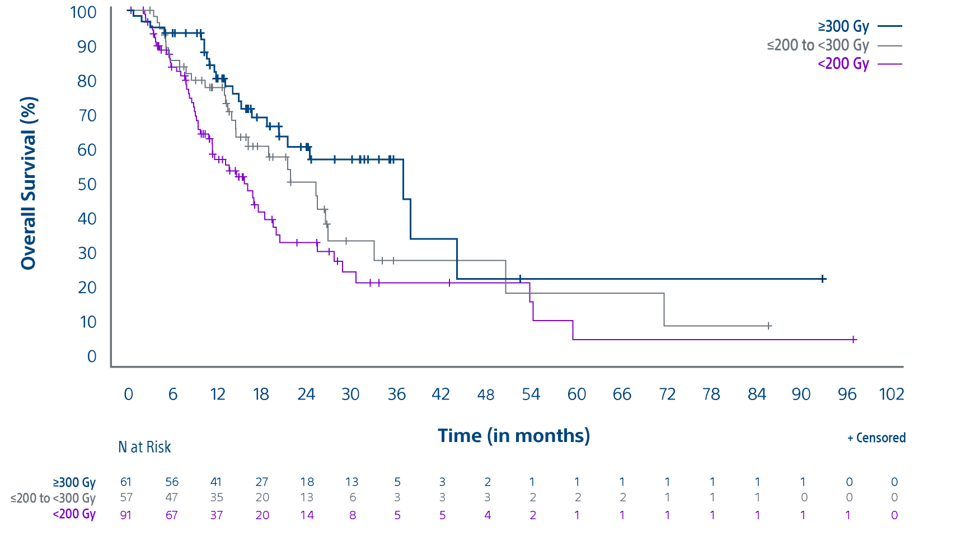
Tumor absorbed dose was predictive of overall survival
KAPLAN-MEIER OVERALL SURVIVAL CURVES
Total Perfused Tumor Absorbed Dose by subgroups with TheraSphere Y-90 Glass Microspheres
Median Overall Survival
>300 Gy - 36.7 months
(95% CI: 20.2 - 43.9 months)
>200 - <300 Gy - 25.1 months
(95% CI: 14.5 - 32.9 months)
<200 Gy - 16.1 months
(95% CI: 11.3 - 19.4 months)

Slide 9
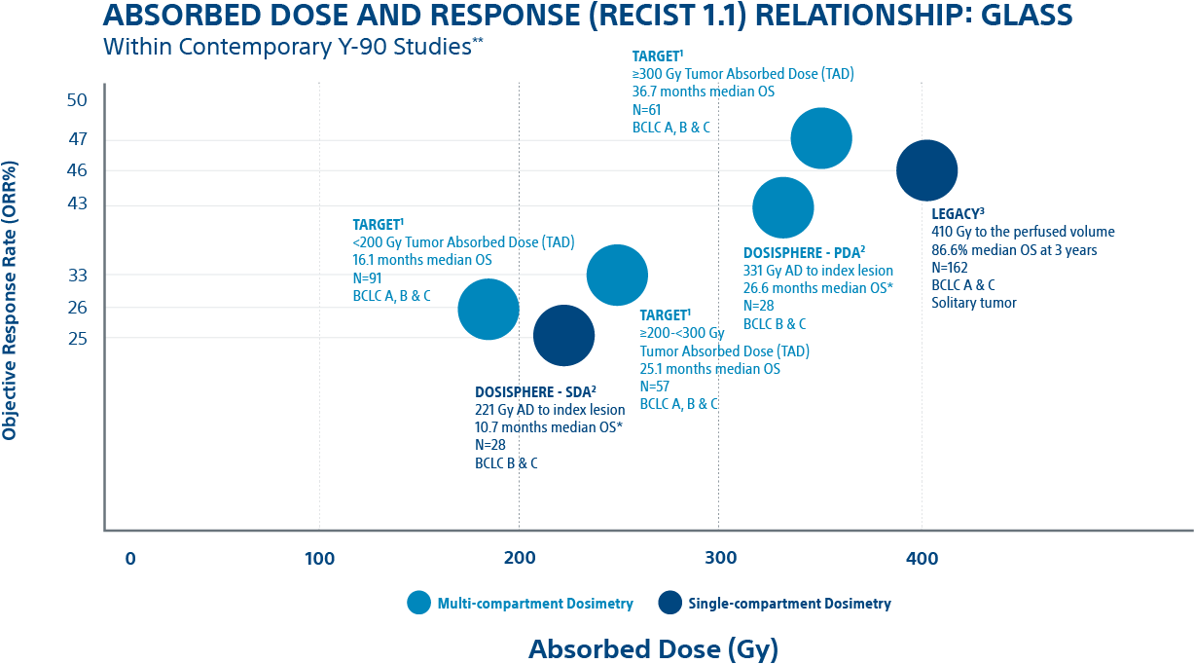
TARGET study takeaways
The TARGET study provides real-world data confirming a significant association between TAD and objective response and between TAD and OS in HCC patients treated with TheraSphere Y-90 glass microspheres.
Dose Matters
Deliver the highest dose to the tumor that is safely possible to maximize patient response and improve survival
Predictability
Predictable results across 8 countries using multi-compartmental dosimetry using Simplicit⁹⁰Y personalized dosimetry software
Consistency
Like the LEGACY study and DOSISPHERE-01 trial results, the TARGET study reinforces the association between higher tumor absorbed dose and clinical outcomes
1. ORR measured in total perfused tumor by mRECIST, 70.8% ORR for the target lesion and 61.7% ORR for all lesions. Lam, Marnix. A Global Study of Advanced Dosimetry in the Treatment of Hepatocellular Carcinoma with Yttrium-90 Glass Microspheres: Analyses from the TARGET Study. Presented at SIR. March 25, 2021. 2. Standard dosimetry arm (SDA) in DOSISPHERE received 120 +/- 20 Gy to the perfused lobe. Personalized dosimetry arm (PDA) had goal of >/= 205 Gy to the index lesion, 250-300 Gy if possible and limit non-tumor tissue dose to </= 120 Gy. Response and survival measured in modified intent to treat (ITT) population. Garin E, et al. Personalised versus standard dosimetry approach of selective internal radiation therapy in patients with locally advanced hepatocellular carcinoma (DOSISPHERE-01): a randomised, multicentre, open-label phase 2 trial. Lancet Gastroenterol Hepatol. 2021;6(1):17-29. doi:10.1016/S2468-1253(20)30290-9. 3. LEGACY reported three-year survival rate of 86.6%. Primary confirmed response rate of 72.2% by mRECIST and 46.3% by RECIST 1.1 and best response rate of 88.3% by mRECIST. Salem R, Johnson GE, Kim E, Riaz A, Bishay V, Boucher E, Fowers K, Lewandowski R, Padia SA. Yttrium-90 Radioembolization for the Treatment of Solitary, Unresectable Hepatocellular Carcinoma: The LEGACY Study. Hepatology. 2021 Mar 19. doi: 10.1002/hep.31819.
** Studies not designed for head-to-head comparisons

Slide 11
Important Information
Health economic and reimbursement information provided by Boston Scientific Corporation is gathered from third-party sources and is subject to change without notice as a result of complex and frequently changing laws, regulations, rules and policies. This information is presented for illustrative purposes only and does not constitute reimbursement or legal advice. Boston Scientific encourages providers to submit accurate and appropriate claims for services. It is always the provider's responsibility to determine medical necessity, the proper site for delivery of any services and to submit appropriate codes, charges, and modifiers for services that are rendered. Boston Scientific recommends that you consult with your payers, reimbursement specialists and/or legal counsel regarding coding, coverage and reimbursement matters. It is always the provider's responsibility to understand and comply with national coverage determinations (NCD), local coverage determinations (LCD) and any other coverage requirements established by relevant payers which can be updated frequently.
CPT® Copyright 2019 American Medical Association. All rights reserved. CPT is a registered trademark of the American Medical Association. Applicable FARS/DFARS Restrictions Apply to Government Use. Fee schedules, relative value units, conversion factors, and/or related components are not assigned by the AMA, are not part of CPT, and the AMA is not recommending their use. The AMA does not directly or indirectly practice medicine or dispense medical services. The AMA assumes no liability for data contained or not contained herein.

Slide 12
Important Information
TheraSphere™ Yttrium-90 Glass Microspheres
INDICATION FOR USE: TheraSphere is indicated for use as selective internal radiation therapy (SIRT) for local tumor control of solitary tumors (1-8 cm in diameter), in patients with unresectable hepatocellular carcinoma (HCC), Child- Pugh Score A cirrhosis, well-compensated liver function, no macrovascular invasion, and good performance status. CONTRAINDICATIONS: TheraSphere is contraindicated in patients: whose Tc-99m macroaggregated albumin (MAA) hepatic arterial perfusion scintigraphy shows any deposition to the gastrointestinal tract that may not be corrected by angiographic techniques • who show shunting of blood to the lungs that could result in delivery of greater than 16.5 mCi (0.61 GBq) of Y-90 to the lungs. Radiation pneumonitis has been seen rarely in patients receiving doses to the lungs greater than 30 Gy in a single treatment. • in whom hepatic artery catheterization is contraindicated, such as patients with vascular abnormalities or bleeding diathesis • who have pulmonary insufficiency (conventionally defined by an arterial oxygen pressure (Pa,O2) of < 60 mmHg, or oxygen saturation (Sa,O2) of < 90%) or severe liver dysfunction, including hepatic encephalopathy, clinically evident ascites or treatment with diuretics for ascites • with portal vein thrombosis (PVT) Type 4 involvement and lack of Tc-99m MAA deposition on the PVT seen on the Tc-99m MAA imaging with >70% tumor replacement in the liver • with comorbidities or poor overall health (e.g., ECOG performance status rating > 2) which may make the patient a poor candidate for locoregional radiation treatment. • who are pregnant. WARNINGS: The following pre-treatment, high-risk factors (disease characteristics) have been associated with serious adverse events deemed possibly related to use of the device: infiltrative tumor type • tumor nodules too numerous to count • AST or ALT > 5 times ULN • bilirubin > 2 mg/dL • tumor volume > 50% combined with albumin < 3 g/dL. Keep the TheraSphere dose vial upright and stored in its lead pot before and during patient treatment, except as required for radiation measurement. Do not open the dose vial acrylic shield prior to patient treatment. Post-treatment, waste materials require caution to prevent contamination and beta shielding due to residual glass microspheres. PRECAUTIONS: GENERAL PRECAUTIONS: As in any intra-arterial procedure, aseptic technique should be practiced, and care should be taken to ensure minimum patient anesthesia exposure extraneous to therapeutic objective. • Consideration of patient comorbidities should be used when determining the type and volume of fluid to infuse via catheter to avoid electrolyte imbalance, fluid shift, and hyperglycemia. • It is important to avoid any aggressive arterial procedure that may lead to arterial spasm that impairs TheraSphere distribution into the perfused liver target volume which may lead to underdosing or non- target deposition of TheraSphere. PRECAUTION IN PATIENTS WITH IMPAIRED LIVER FUNCTION: No efficacy or safety data from the LEGACY study are available to support the use of the device in patients with Child-Pugh score B or C cirrhosis. PRECAUTION IN VULNERABLE PATIENTS: No effectiveness or safety data are available to support the use of the device in children or breast- feeding women. ENDOCRINE DISRUPTION, CARCINOGENICITY, MUTAGENICITY, TOXICITY TO REPRODUCTION: Ideally the use of this radioactive device in women of childbearing capability should be performed during the first few (approximately 10) days following the onset of menses. RADIATION SAFETY: Radioactive products should be used only by healthcare professionals who are qualified by specific training in the safe use and handling of radionuclides and whose experience and training have been approved by the appropriate government agency authorized to license the use of radionuclides. • As in the use of any radioactive material, ensure minimum radiation exposure to the patient extraneous to the therapeutic objective, and to minimize radiation exposure to workers and others in contact with the patient. RELEASE AND POST-TREATMENT PRECAUTIONS: Post treatment patient care: use universal precautions for body fluid contact. Trace Y-90 may be detectible in blood and urine; handle with gloves and dispose as normal body fluids. The radiation field is expected to be less than 1 mrem/h (10 µSv/h) at 3 ft (1 m) from the patient’s abdomen. Supplemental shielding and segregation of the patient are not required to maintain exposure to others below regulated limits. • Release instructions: The patient should follow good hygiene (e.g., proper hand washing). Caregivers, family, and others do not require restrictions on patient contact; however, they can minimize their radiation exposure by avoiding prolonged time (>12 hours per day) within 1 ft (0.3 m) of the patient’s abdomen for the first week post therapy. Patients should be advised that radiation emitted from the patient may be detectible at security screening (e.g., international travel). • Special precautions post-administration: If the patient requires hospitalization, surgery, medical assessment or treatment regarding any part of their thorax or abdomen within first 2 weeks of treatment, the patient should advise the hospital and treating physician of the Y-90 TheraSphere implant. The physician should consult their radiation safety staff for handling and disposal of liver tissue. • Special liver tissue handling: Special liver tissue handling may be required for post-treatment surgery, explant, or transplant since the glass microspheres remain permanently implanted in the liver tissue. Disclosure of the treatment will be required if cremation is considered. POTENTIAL ADVERSE EVENTS: The use of this product leads to irradiation of both tumorous and normal liver tissue. As a result, patients with compromised liver function may be at greater risk of liver function impairment and hence could experience complications. Clinical side effects usually occur within the first 4 to 6 weeks after treatment. Based on clinical trial data, literature reviews and post market surveillance, adverse events potentially associated with treatment using Y-90 microspheres, including TheraSphere, may include the following: Allergic reaction • Altered liver function, acute or chronic • Anorexia • Anxiety • Ascites • Bile Duct injury • Bleeding/hemorrhage • Chills / rigors • Cholecystitis (inflammatory or infectious) • Colitis • Death • Dehydration • Diarrhea • Dizziness • Dyspnea • Edema (any location) • Electrolyte abnormalities • Elevated BUN/creatinine • Fall • Fatigue • Fever • Gastrointestinal bleeding / hemorrhage • Gastrointestinal ulcer or ulceration • Hepatic encephalopathy • Hepatorenal failure • Hiccups • Hypertension • Hypotension • Infection (any location) • Liver failure, acute or chronic • Lymphopenia • Malaise • Mood alteration • Muscle weakness • Nausea • Neutropenia • Pain (any location) • Pancreatitis • Platelet count abnormalities • Pleural effusion • Portal hypertension • Pre-existing chronic liver disease decompensation • Pulmonary edema • Pulmonary fibrosis • Radiation hepatitis • Radiation induced disease, acute • Radio Embolization Induced Liver Disease (REILD) • Sepsis • Supraventricular arrhythmia • Thrombosis (arterial or venous) • Tumor inflammation (including tumor edema) • Tumor-lysis syndrome • Vomiting • Weight loss. Complications related to the administration procedure itself may include: Allergic reaction: Arterial injury including vessel dissection • Aspiration pneumonia • Bruising/bleeding/hematoma at site • Constipation/abdominal distension • Fatigue • Flushing • Infection • Nausea • Nerve damage. CAUTION: Federal (USA) law restricts this device to sale by or on order of a physician.PI-992004-AA
Note: Dose to the liver does not exceed 150 Gy. The physician should always take the above-noted Pre-treatment High Risk Factors into consideration for each patient when making decisions regarding the use of TheraSphere for treatment.
TheraSphere is a registered trademark of Theragenics Corporation used under license by Biocompatibles UK Ltd. All other trademarks are property of their respective owners.

Slide 13
Important Information
Simplicit90Y™ Personalized Dosimetry Software
Intended Use (US Only): Simplicit90Y™ is intended to be used by trained medical professionals for TheraSphere™ pre-treatment dosimetry planning and post-treatment dosimetry evaluation following Y90 treatment. Simplicit90Y is a medical image and information management system that is intended to receive, transmit, store, retrieve, display and process digital medical images, as well as create, display and print reports from those images. The medical modalities of these medical imaging systems include, but are not limited to, CT, MRI, SPECT and PET. Simplicit90Y provides the user with the means to display, register and fuse medical images from multiple modalities. Simplicit90Y provides tools to create, transform, and modify contours for the user to define objects in medical image volumes for use in TheraSphere pre-treatment dosimetry planning and for post-treatment dosimetry. The objects include, but are not limited to, tumors and normal tissues. For post-Yttrium-90 (Y90) treatment, Simplicit90Y should only be used for the retrospective determination of dose and should not be used to prospectively calculate dose or for the case where there is a need for retreatment using Y90 microspheres.
Indication for Use (US Only): Simplicit90Y is a standalone software device that is used by trained medical professionals as a tool to aid in evaluation and information management of digital medical images. Simplicit90Y supports the reading, rendering and display of a range of DICOM compliant imaging and related formats including but not limited to CT, PT, NM, SPECT, MR, SC, RTSS. Simplicit90Y enables the saving of sessions in a proprietary format as well as the export of formats including CSV and PDF files. Simplicit90Y is indicated, as an accessory to TheraSphere, to provide pre-treatment dosimetry planning support including Lung Shunt Fraction estimation (based on planar scintigraphy) and liver single-compartment MIRD schema dosimetry, in accordance with TheraSphere labelling. Simplicit90Y provides tools to create, transform, and modify contours/Regions of Interest for calculation of Lung Shunt Fraction and Perfused Volume. Simplicit90Y includes features to aid in TheraSphere dose vial selection, dose vial ordering and creation of customizable reports. Simplicit90Y is indicated for post-treatment dosimetry and evaluation following Yttrium-90 (Y-90) microsphere treatment. Simplicit90Y provides tools to create, transform, and modify contours/Regions of Interest for the user to define objects in medical image volumes to support TheraSphere post-Y-90 treatment calculation and evaluation. The objects include, but are not limited to, tumors and normal tissues, and liver volumes. Simplicit90Y is indicated for registration, fusion display and review of medical images allowing medical professionals to incorporate images, such as CT, MRI, PET, CBCT and SPECT in TheraSphere Yttrium-90 (Y-90) microspheres pre-treatment planning and post-Y-90 treatment evaluation For post-Yttrium-90 (Y-90) treatment, Simplicit90Y should only be used for the retrospective determination of dose and should not be used to prospectively calculate dose or for the case where there is a need for retreatment using Y-90 microspheres. PI-994110-AA
Simplicit90Y™ is a registered trademark of Boston Scientific Corporation. All trademarks are the property of their respective owners.

