Slide 1

Sustainability Storybook
GI Endoscopy

Slide 2

As a leading provider of GI Endoscopy devices, Boston Scientific is taking action to protect the environment

Slide 3
Our commitment to improving patient health comes with a responsibility to protect the planet we all share
As we work to solve healthcare’s toughest challenges,
we are taking decisive action to reduce our environmental impacts and achieve carbon neutrality¹.
1. Carbon neutrality by 2030 in all manufacturing and key distribution sites (scopes 1 & 2).

Slide 4
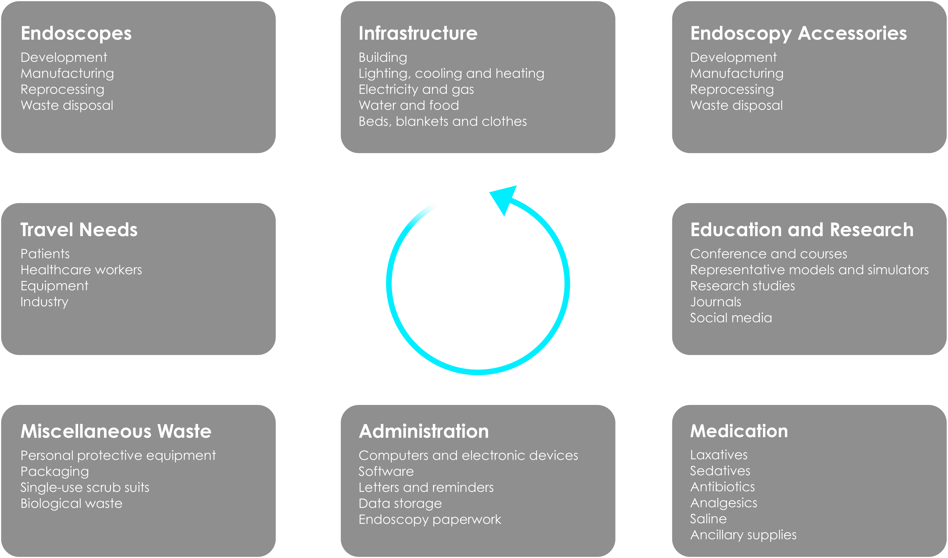
The areas in which GI Endoscopy impacts the environment as shown in the ESGE and ESGENA position statement (2022)
1. De Santiago, E. R. et al. (2022) Reducing the environmental footprint of gastrointestinal endoscopy: European Society of Gastrointestinal Endoscopy (ESGE) and European Society of Gastroenterology and Endoscopy Nurses and Associates (ESGENA) Position Statement. Endoscopy, 54(08), 797–826.

Slide 5
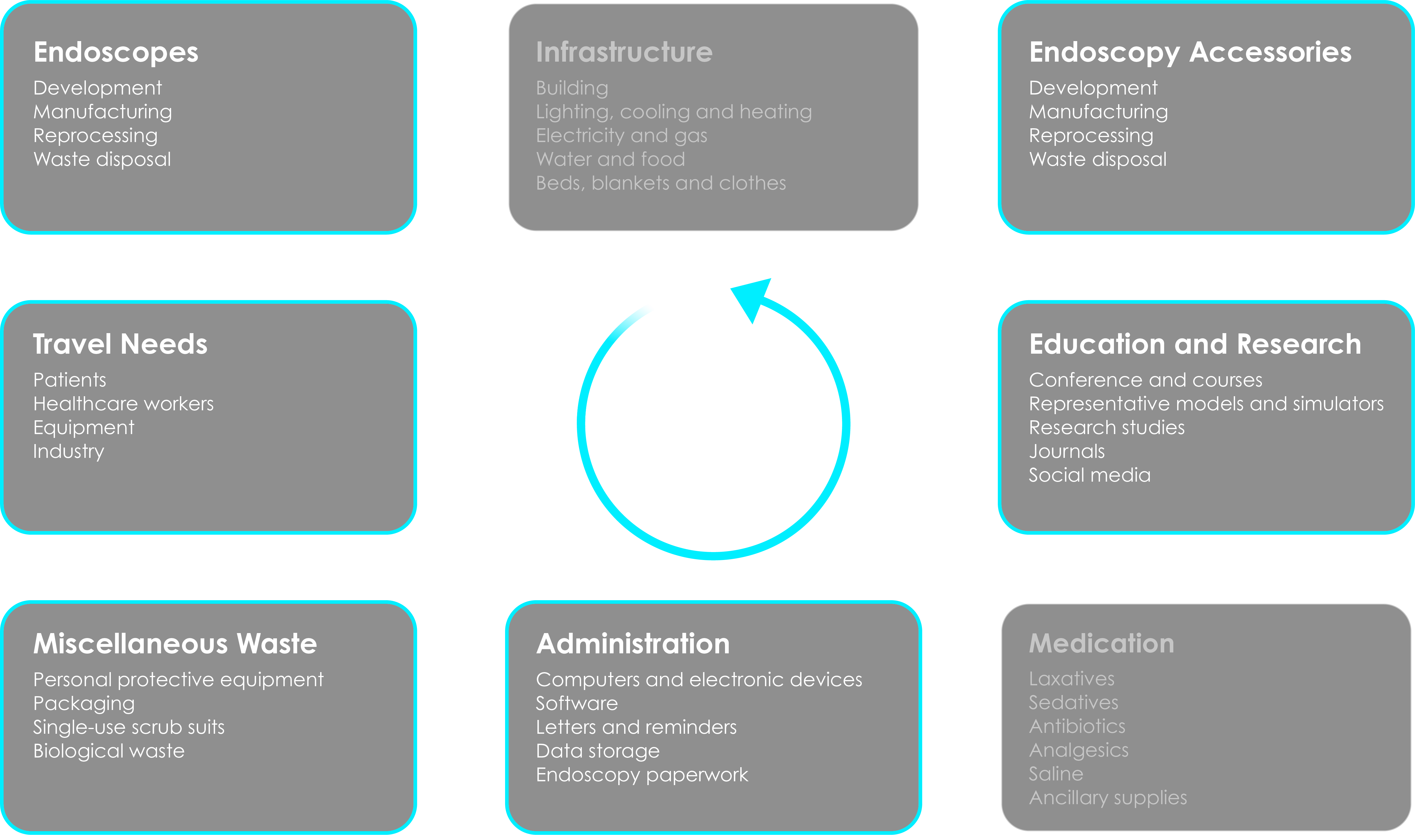
The following highlights the areas in which Boston Scientific can support
1. De Santiago, E. R. et al. (2022) Reducing the environmental footprint of gastrointestinal endoscopy: European Society of Gastrointestinal Endoscopy (ESGE) and European Society of Gastroenterology and Endoscopy Nurses and Associates (ESGENA) Position Statement. Endoscopy, 54(08), 797–826.

Slide 6


According to the ESGE and ESGENA position statement¹, GI Endoscopy should become a net-zero greenhouse gas emissions practice by 2050
Boston Scientific has committed to net-zero greenhouse gas emissions by 2050, approved under the Science Based Targets Initiative (SBTi) net-zero standard.
Click the button below to learn more

Slide 7


According to the ESGE and ESGENA position statement¹, GI Endoscopy should become a net-zero greenhouse gas emissions practice by 2050
Protecting the environment
Reducing our environmental impact
Our path to net-zero¹
Boston Scientific has committed to net-zero greenhouse gas emissions by 2050, approved under the Science Based Targets Initiative (SBTi) Net-Zero Standard.
Click the button below to learn more
1. Trajectory to net-zero emissions defined by science-based targets to reach net-zero greenhouse gas emissions across the value chain by 2050 from a 2019 base year.
2. Inclusive of all manufacturing and key distribution sites only.
3. Purchased electricity matched with electricity from renewable sources.

Slide 8

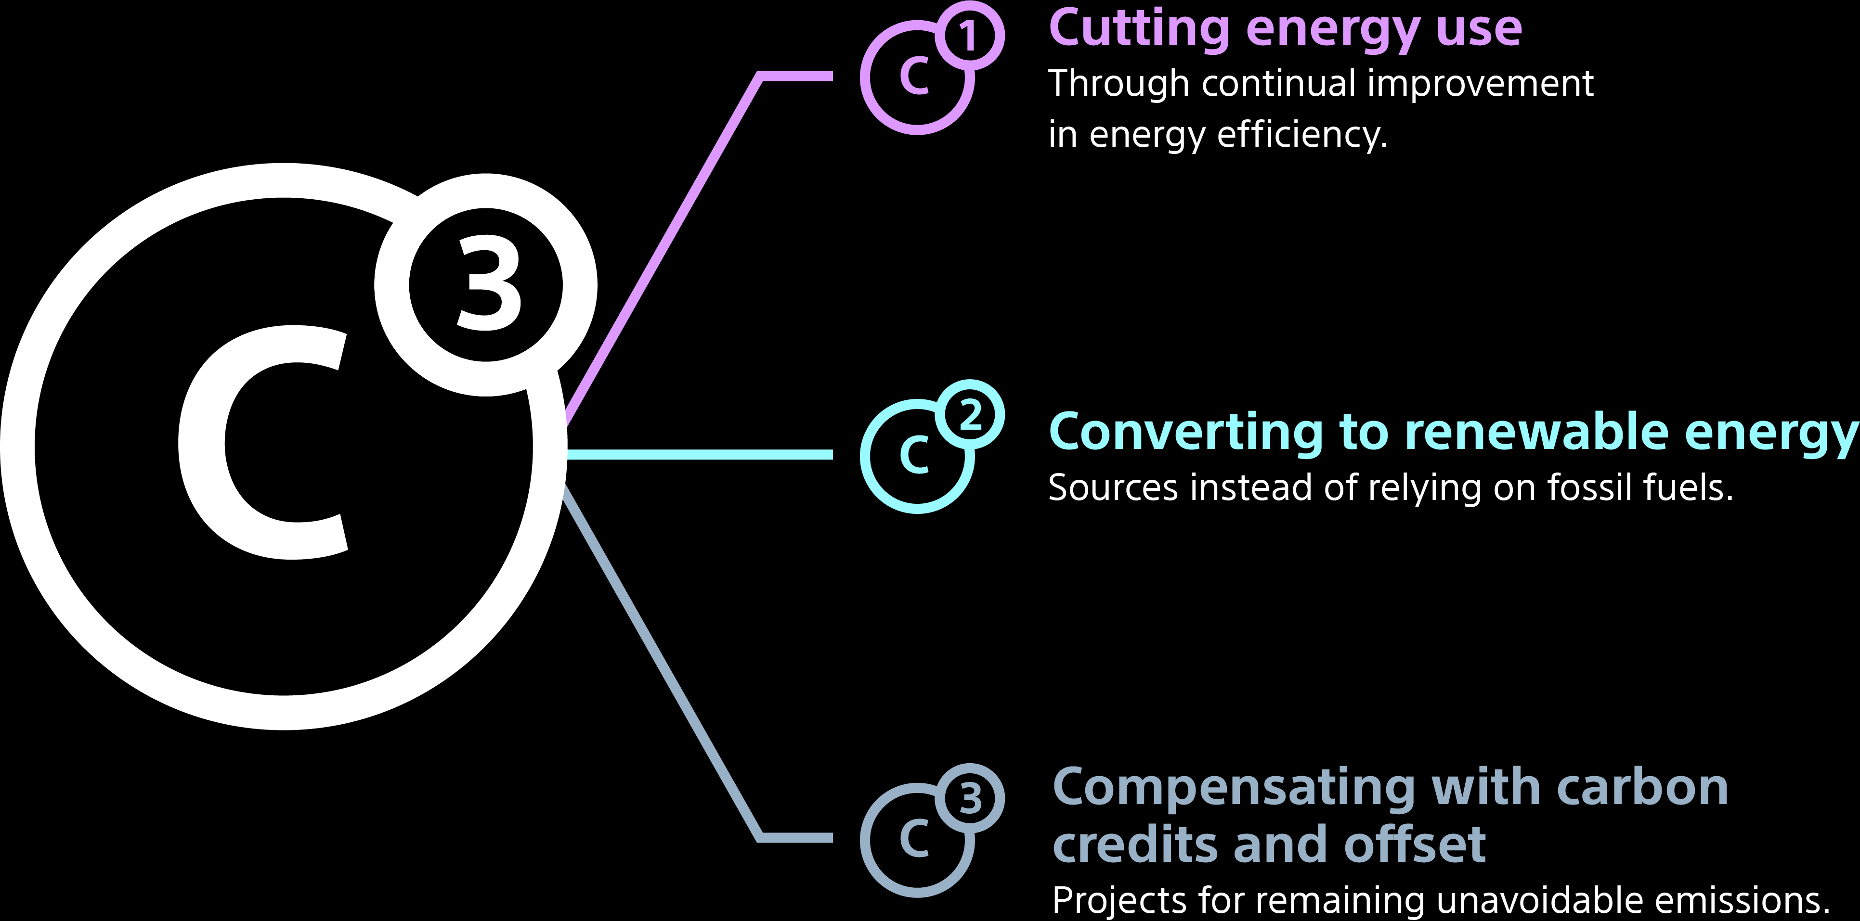
In 2017 we launched our strategy
A central component of the company’s carbon neutrality approach is our C³ energy strategy. Global and site teams collaborate across Boston Scientific to meet our objectives:

Slide 9
Cutting energy use
To ensure we’re investing in energy efficiency at all sites and developing new construction that meets the highest climate standards, we adhere to the Leadership in Energy and Environmental Design (LEED) framework and the International Organisation for Standardisation (ISO) 50001:2018 energy management standard.
20%
Since 2017, Boston Scientific has decreased energy intensity globally by 20%¹.
1. Energy Intensity is measured by the quantity of energy required per unit output or activity so that using less energy to produce a product reduces the intensity.

Slide 10
Converting to renewable energy¹
76%
of electricity consumed is generated from renewable sources.
Medical devices are dispatched to hospitals in EMEA and around the world from our key distribution centre at Kerkrade, the Netherlands.
All electrical power is sourced from wind farms and new on-site solar and we are transitioning from fossil fuel to electricity generated heat using heat pumps.
We are proud to be recognised as leaders in sustainable logistics since 2018 by Lean & Green, one of Europe’s leading programmes in this area.
1. Purchased electricity matched with electricity from renewable sources, inclusive of all manufacturing and key distribution sites only.

Slide 11
The following are a few specific examples of how Boston Scientific is supporting the sector’s ambition to tackle climate change

Slide 12
Cholangiography as an outpatient procedure can help reduce the environmental impact associated with overnight hospital stays
Approximately 20% of ERCP procedures are repeated within 1 year¹.
ERCPs represent 2.6% of the GI Endoscopy workload¹.
1. NHS Digital (2022), Hospital Episode Statistics (HES): Admitted patient care - provider level analysis. Available at https://digital.nhs.uk/data-and-information/data-tools-and-services/data-services/hospital-episode-statistics Date accessed: June 2022.

Slide 13
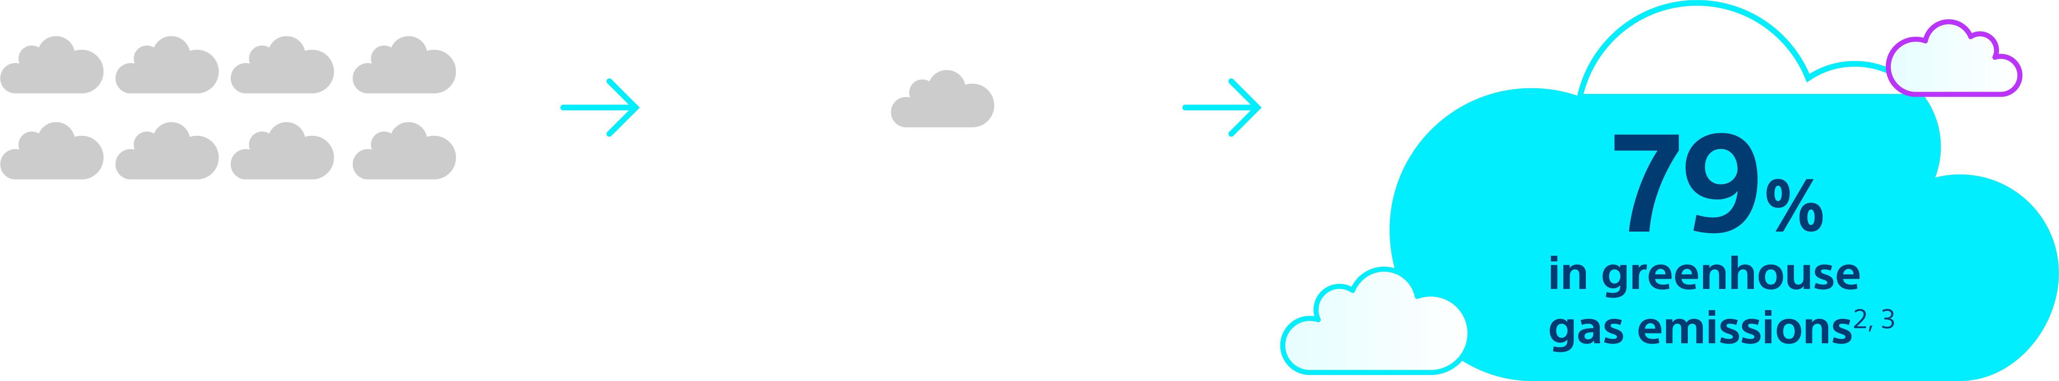
The SpyGlass™ DS Cholangioscope impact on greenhouse gas (GHG)
As a result of reduced hospital readmissions
Without SpyGlass DS:
With SpyGlass DS:
This equates to a reduction of:
65%
1. Boston Scientific. Data on File. SpyGlass DS sustainable journey. June 2022.
2. Sustainable Care Pathways Guidance: Inpatient bed day module published 2015, Surgical Procedure Module Published 2015 Sustainable Care Pathways Guidance – Sustainable Healthcare Coalition: (https://shcoalition.org/sustainable-care-pathways-guidance/).
3. Sustainable Care Pathways Guidance: Patient travel module published 2015, Surgical Procedure Module Published 2015 Sustainable Care Pathways Guidance – Sustainable Healthcare Coalition: (https://shcoalition.org/sustainable-care-pathways-guidance/).
Disclaimer: Results could vary based on hospital usage, since the model assumed a 200 patient throughput and every hospital won’t have the same stone clearance rate.

Slide 14
Virtual training and online educational modalities can reduce the environmental impact of GI Endoscopy, as a result of less people travelling
Personal Development Programs (PDPs):
ePreceptor
Nurse focused interactive training sessions delivered online covering anatomy, disease states, procedure and product knowledge.
Hospitals across EMEA have technology to broadcast live endoscopy cases to viewers worldwide.
Smart Glasses
EDUCARE
Remote visual connections between a physician performing a procedure and another at a separate location, allowing on-demand training and support.
Our platform for on-demand learning modules, clinical overviews and case studies.

Slide 15

According to the ESGE and ESGENA position statement¹, single use endoscopes should be reserved for highly selected patients, considered on a case-by-case basis
Segmenting ERCP patients by infection risk allows endoscopists to make more informed decisions about the risk benefit ratio of single-use duodenoscope technology.
We’re reducing the risk of infection for the most vulnerable patients with the EXALT™ Model D Single-use Duodenoscope.
1. De Santiago, E. R. et al. (2022) Reducing the environmental footprint of gastrointestinal endoscopy: European Society of Gastrointestinal Endoscopy (ESGE) and European Society of Gastroenterology and Endoscopy Nurses and Associates (ESGENA) Position Statement. Endoscopy, 54(08), 797–826.

Slide 16
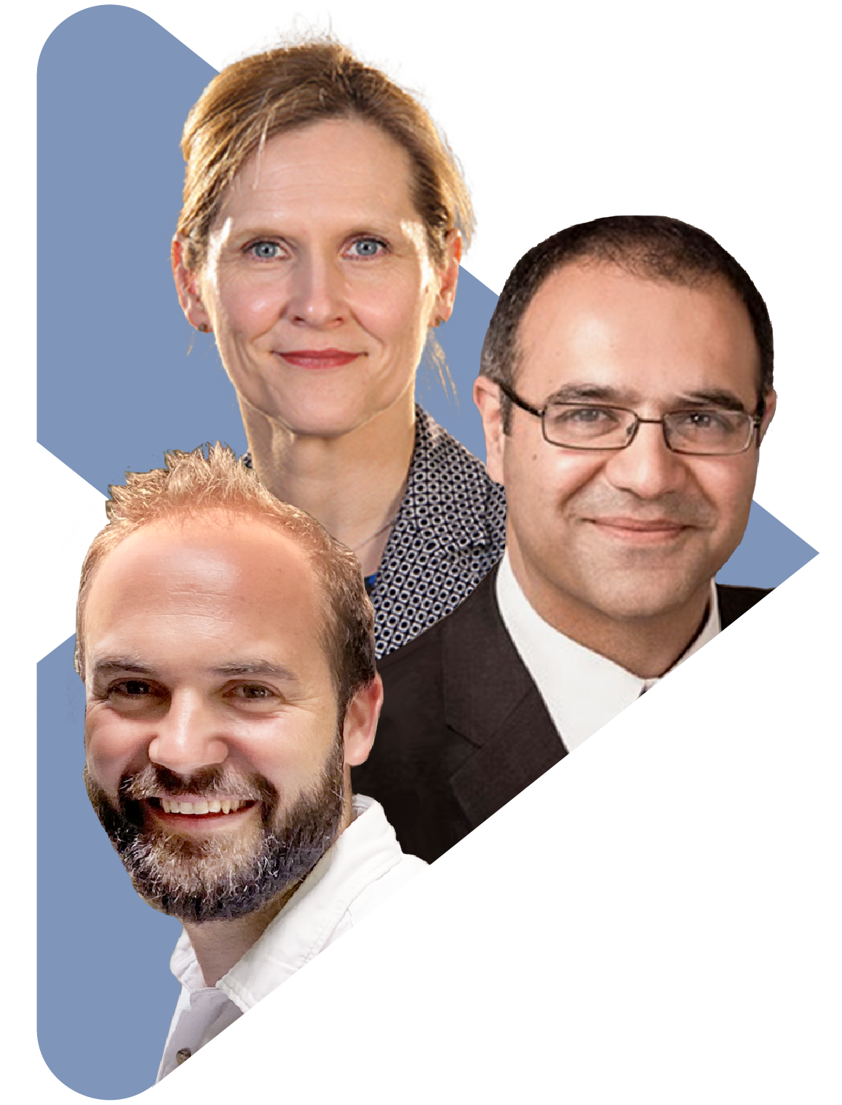
We continue to fund research into green and sustainable GI Endoscopy
We are proud to collaborate with experts* and industry leaders in supporting a UK study which will provide an accurate quantification of the environmental impact of endoscopy and highlight parts of the process which
contribute most to the negative impacts.
*Dr. Baddeley, Prof. Hayee and Prof. Thomas-Gibson

Slide 17
Addressing the environmental impact of single-use GI endoscopic devices
In Europe, we initiated a market search for waste management partners to find single use scope recycling solutions for our customers in 2019.
As a result, we initiated a recycling pilot project in Germany to help reduce incineration and landfill volumes in Europe for our customers.
Globally, we removed 170+ metric tons of packaging from our waste stream and 1,000 metric tons of recycled content were used in packaging in 2022.
Boston Scientific has
a zero-waste goal of diverting a minimum of 90% of our own waste from landfills and incineration by 2030¹.
We collaborate with industry peers in the Healthcare Plastics Recycling Council (HPRC) to reduce waste, limit emissions and maximise opportunities to recycle.
Our packaging and labelling practices include optimising design, reducing waste and limiting emissions from shipping. Our global teams implemented more than 50 packaging improvement projects in 2022.
Our teams in the United States offer systems for recycling devices and converting product waste to energy. In 2022, participating customers recycled 97% of EXALT™ Model D devices.

Slide 18
In summary, a lot of work has already been done. However, there is still a lot more to do to minimise the environmental impact of GI Endoscopy
Our commitment to improving patient health will continue to come with a responsibility to protect the planet we all share.

Slide 19
CAUTION: The law restricts these devices to sale by or on the order of a physician. Indications, contraindications, warnings, and instructions for use can be found in the product labelling supplied with each device or at www.IFU-BSCI.com. Products shown for INFORMATION purposes only and may not be approved or for sale in certain countries. This material is not intended for use in France. 2023 Copyright © Boston Scientific Corporation or its affiliates. All rights reserved. XXX-XXXX-XXX

