Slide 1
Early neo2 Registry
+ Quantitative Angiographic Aortic Regurgitation Comparison:
ACURATE neo to ACURATE neo2
© 2021 Boston Scientific Corporation or its affiliates. All rights reserved. SH-1014506-AC
Caution: Investigational Device. Limited by US law to investigational use only. Not available for sale.

Slide 2
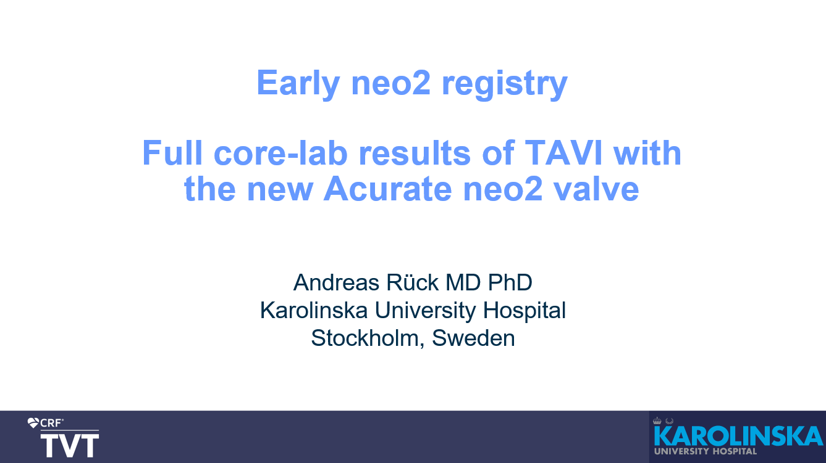
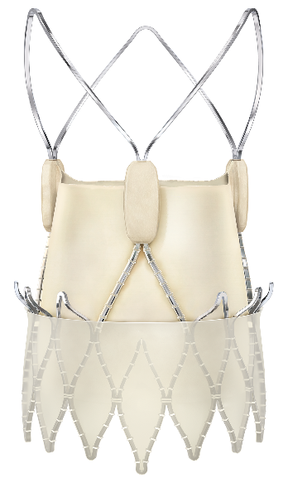
Early neo2 Registry data - TVT Late Breaker
Caution: Investigational Device. Limited by US law to investigational use only. Not available for sale.

Slide 3
Early neo2 Registry – Study summary
Design | Independently core-lab assessed*, Investigator-initiated and conducted, single arm, multicenter and retrospective Registry 12 European centers in Germany, Sweden, Denmark, Austria, Finland, Switzerland and the Netherlands
Objective | To document and report the first real-world, large-scale set of clinical results for the ACURATE neo2 Aortic Valve System
Primary Outcomes | Paravalvular leak, post-operative mean gradient, PPI, 30-day Mortality and Stroke
Sample Size | 554 consecutive patients from September 2020 to March 2021
Principal Investigator | Dr Andreas Rück - Karolinska University Hospital Stockholm
*85% of patients had echo available for core lab analysis
Caution: Investigational Device. Limited by US law to investigational use only. Not available for sale.

Slide 4
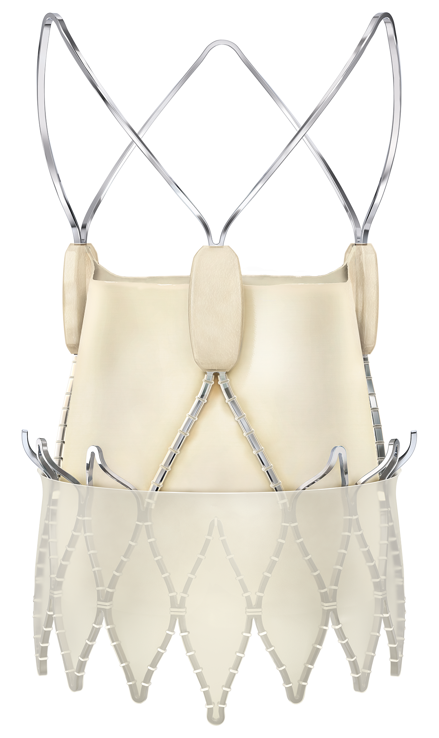
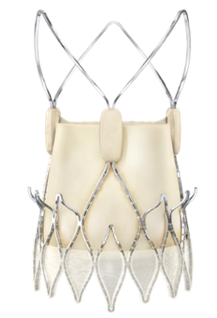
Early neo2 Registry Study Considerations
Early neo2 Registry assessed the performance of ACURATE neo2
+60%
Larger Outer
Sealing Skirt*
Early neo2 Registry
ACURATE IDE
SCOPE I & II trial
*compared to ACURATE neo
Caution: Investigational Device. Limited by US law to investigational use only. Not available for sale.

Slide 5
Early neo2 Registry Sites
Center | Site PI | n
Kerkhoff Klinik, Bad Nauheim | Won-Keun Kim | 142
Karolinska, Stockholm | Chris Meduri | 86
Herzzentrum Leipzig | Mohamed Abdel-Wahab | 77
HDZ NRW, Bad Oeynhausen | Tanja Rudolph | 48
Elisabeth-Krankenhaus, Essen | Alexander Wolf | 40
Rigshospitalet, Copenhagen | Ole de Backer | 35
Medizinische Universität Wien | Christian Hengstenberg | 31
University Hospital Helsinki | Mika Laine | 28
SUS, Lund | Henrik Bjursten | 25
DHZ München | Costanza Pellegrini | 20
Kantonsspital Luzern | Stefan Toggweiler | 15
University Medical Center Groningen | Joanna Wykrzykowska | 7
The registry was conducted at 12 European centers in Germany (5), Sweden (2), Denmark (1), Austria (1), Finland (1), Switzerland (1) and the Netherlands (1)
Enrollment started in September 2020 and this presentation includes patients enrolled until March 2021
Caution: Investigational Device. Limited by US law to investigational use only. Not available for sale.

Slide 6
Early neo2 Registry – Baseline Characteristics
554 consecutive patients implanted with ACURATE neo2 at 12 centers across Europe
Baseline Characteristics | N=554
Age (yrs) | 82
Female % | 66
Atrial fibrillation % | 38
Prior Pacemaker % | 10
EuroSCORE II % | 4.5
STS score % | 3.7
LVEF % | 56
Aortic mean gradient (mmHg) | 43
Bicuspid %* | 3
Valve-in-Valve %* | 2
*Valve-in-Valve & Bicuspid contraindicated in ACURATE IDE
Caution: Investigational Device. Limited by US law to investigational use only. Not available for sale.

Slide 7
Early neo2 Registry – Procedural Characteristics
ACURATE neo2 size distribution
Procedural data | N=554
General anesthesia % | 0.2
Femoral access % | 99.6
Pre-dilatation % | 87
Post-dilatation % | 36
Anulus size mm (average) | 23.7
Procedural/In-hospital Complications
Second valve implanted %* | 0.9
Annular rupture % | 0
Coronary obstruction % | 0
Intraprocedural death % | 0.2
Major vascular complication (in-hospital) % | 3.4
Major or life-threatening bleeding (in-hospital) % | 4.8
Acute kidney injury (AKIN grade 3) % | 0.2
Small (23 mm) 21%
Large (27 mm) 38%
Medium (25 mm) 41%
ACURATE neo2 shows reduced need for post-dilation*
* = Relative to the post-dilation rate reported in SCOPE I and II
*Second valve implanted as a bailout strategy
Caution: Investigational Device. Limited by US law to investigational use only. Not available for sale.
Notes:
The average annulus size treated in this study was 23.7 mm with an ACURATE neo2 size distribution of Small (21%), Medium (41%) and Large (38%).
The sizing matrix for ACURATE neo2 and ACURATE neo is the same. However, previous studies have indicated that appropriate oversizing of ACURATE can lead to reduced paravalvular leak, with this as a key finding from the SCOPE I and II trials, from which a smaller percentage of patients received a large ACURATE valve size. ¹
The rates of pre-dilatation rate of the Early neo2 Registry (87%) is in line with previous ACURATE studies, ^{2, 3} as pre dilatation is mandated per the ACURATE neo2 IFU.
The rate of post-dilatation of the Early neo2 Registry (36%) is lower than previous ACURATE neo studies (SCOPE I: 53%, SCOPE II: 46%). This may be related to the improved acute PVL performance of ACURATE neo2.
1.Kim WK, et al., Effectiveness and Safety of the ACURATE Neo Prosthesis in 1,000 Patients With Aortic Stenosis, American Journal of Cardiology, 2020
2. Lanz J., et al. Safety and efficacy of a self-expanding versus a balloon-expandable bioprosthesisfor transcatheter aortic valve replacement in patients with symptomatic severe aortic stenosis: A randomized non-inferiority trial. Lancet. 2019;394(10209):1619-28.
3. Tamburino C., et al. Comparison of self-expanding bioprostheses for transcatheter aortic valve replacement in patients with symptomatic severe aortic stenosis: the SCOPE 2 randomised clinical trial. Circulation 2020;142:2431–2442.

Slide 8
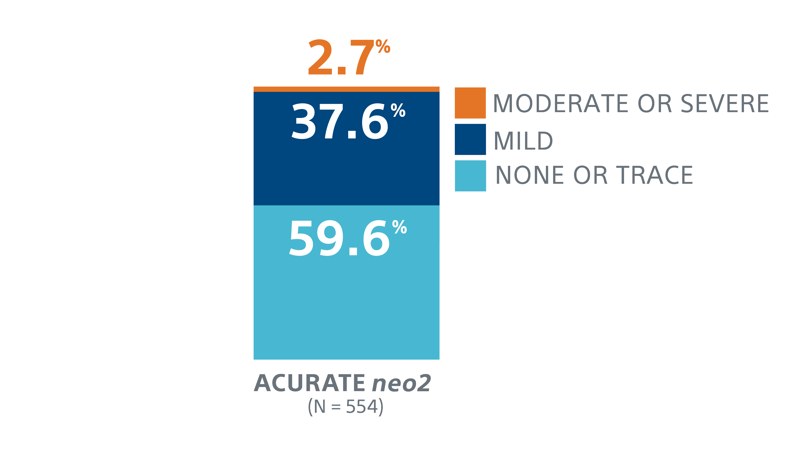
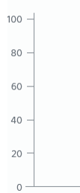

Early neo2 Registry – Primary Outcomes
Primary outcomes
Paravalvular leak >mild % * | 2.7
Post-operative mean gradient (mmHg) * | 8.0
New pacemaker implantation (in-hospital) % | 6.0
Mortality (30 days) % | 1.3
Stroke (in-hospital) % ** | 2.1
Paravalvular Leak
Echo Core lab assessed*
* By core lab, 85% of 554 patients had echo available for core lab analysis
** Major and minor stroke
The Early neo2 Registry reported a core lab assessed 2.7% rate of moderate or greater PVL, 37.6% mild and 59.6% none/trace PVL
Caution: Investigational Device. Limited by US law to investigational use only. Not available for sale.
Notes:
Reminder that the EuroPCR presented data showed a site reported 1.3% rate of moderate or greater, 33.3% mild and 65.4% none/trace PVL rates with a postoperative mean gradient of 9mmHg at the EURO PCR congress 2021

Slide 9
Quantitative Angiographic Assessment of Aortic Regurgitation Presented at EuroPCR 2021
Design | Investigator-initiated and conducted retrospective core lab analysis 2 Early neo2 Registry centers (Karolinska University Hospital, Stockholm, Sweden and Kerkhoff Klinik, Bad Nauheim, Germany)
Objective | To compare quantitative angiographic aortic regurgitation (qAR), an objective, accurate, and reproducible tool for aortic regurgitation adjudication, between ACURATE neo2 and ACURATE neo.
Primary Results | Mean aortic regurgitation fraction and aortic regurgitation severity
Sample Size | 228 patients who underwent TAVI -- 120 implanted with ACURATE neo2 in the Early neo2 Registry from Karolinska University Hospital and Kerkhoff Klinik, Bad Nauheim and 108 implanted with ACURATE neo from Karolinska University Hospital only
Principal Investigators | Dr Andreas Rück - Karolinska University Hospital, Stockholm Dr Hideyuki Kawashima - CORRIB Research Center for Advanced Imaging and Core Laboratory, National University of Ireland
Separate core lab adjudicated assessment of aortic regurgitation using videodensitometry on angiography (qAR)
Caution: Investigational Device. Limited by US law to investigational use only. Not available for sale.
Notes:
Quantitative angiographic aortic regurgitation assessment was developed to enable an objective quantification of the aortic regurgitation post TAVI.
It uses videodensitometry to compare the time-density ratios between contrast regurgitated into the left ventricular outflow tract and contrast injected into the aortic root during aortography.
The use of quantitative videodensitometric aortography is an objective, accurate, and reproducible methodology for adjudication of AR following TAVI, that was validated against echocardiography and MRI, which is why it was used to compare ACURATE neo2 and ACURATE neo data

Slide 10
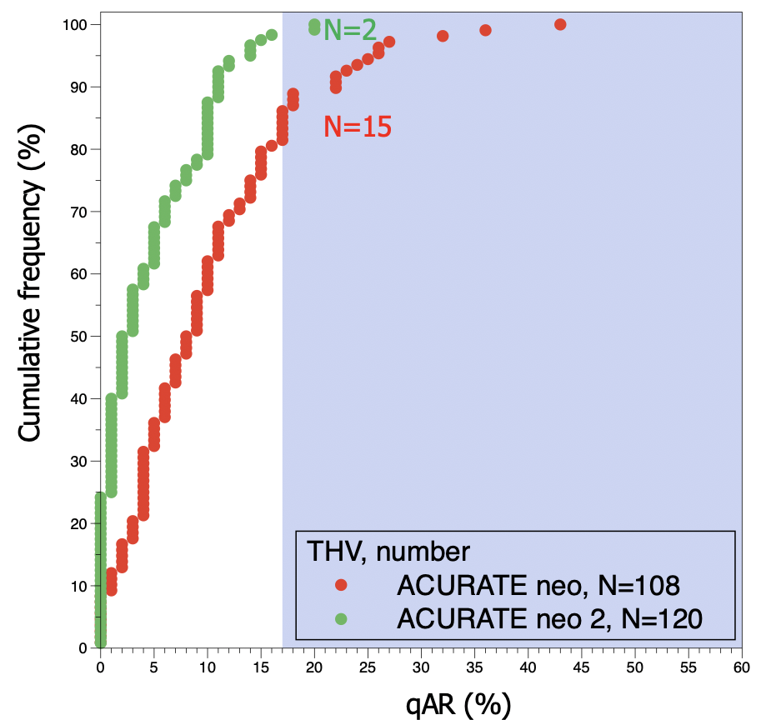
Quantitative Angiographic Assessment of Aortic Regurgitation Presented at EuroPCR 2021
Aortic regurgitation severity grade
Cumulative frequency
curves of qAR
P<0.001
P<0.001
EuroPCR 2021 e-poster: Rück, Soliman et al.
ACURATE neo2 associated with 5.5% and 12.2% absolute risk reduction of aortic regurgitation fraction and rate of moderate or severe aortic regurgitation compared to ACURATE neo
Caution: Investigational Device. Limited by US law to investigational use only. Not available for sale.
Notes:
Cumulative frequency chart indicates that only 2/120 patients from the ACURATE neo2 cohort (1.7%) reported moderate to severe aortic regurgitation.
Quantitative angiographic aortic regurgitation assessment was developed to enable an objective quantification of the aortic regurgitation post TAVI.
It uses videodensitometry to compare the time-density ratios between contrast regurgitated into the left ventricular outflow tract and contrast injected into the aortic root during aortography.
The use of quantitative videodensitometric aortography is an objective, accurate, and reproducible methodology for adjudication of AR following TAVI, that was validated against echocardiography and MRI, which is why it was used to compare ACURATE neo2 and ACURATE neo data.

Slide 11
Summary
Early neo2 Registry is the 1st large (n=554) real-world report of clinical experience of ACURATE neo2 including core-lab analysis of echocardiograms.
Early neo2 Registry demonstrated a core lab assessed moderate or greater paravalvular leak rate of 2.7%* and new in-hospital pacemaker implantation rate of 6% for ACURATE neo2
ACURATE neo2 PVL outcomes from the Early neo2 Registry indicate a directional PVL reduction from ACURATE neo PVL outcomes reported in previous studies^{1,2}
* By core lab, 85% of 554 patients had echo available for core lab analysis
Lanz J., et al. A randomized non-inferiority trial. Lancet. 2019;394(10209):1619-28.
Tamburino C., et al. the SCOPE 2 randomised clinical trial. Circulation 2020;142:2431–2442.
Caution: Investigational Device. Limited by US law to investigational use only. Not available for sale.

Slide 12
Study Limitations
The Early neo2 Registry is an investigator-initiated, single-arm, site-conducted retrospective analysis with non-specified enrollment criteria.
Caution: Investigational Device. Limited by US law to investigational use only. Not available for sale.

Slide 13
In Europe, ACURATE neo and ACURATE neo2 Aortic Valve Systems are CE-marked.
In the USA, ACURATE neo2 is an investigational device and restricted under federal law to investigational use only.
Not available for sale. Products shown for informational purposes only – not meant as promotion or offer for sale.

