Slide 1
WATCHMANTM Left Atrial Appendage Closure Device
Clinical Data Overview

Slide 2
Agenda
The Need for a Device-Based Alternative to Long-Term Warfarin Therapy
WATCHMANTM LAAC Clinical Data Overview
Safety Event Rates from various WATCHMAN studies
Implant Success and Warfarin Cessation
Efficacy Event Rates vs Warfarin
Efficacy Event Rates vs No Therapy
Long-Term Reduction in Major Bleeding from Pooled Data Analysis
SH 286002 AC JUN 2015

Slide 3
WATCHMANTM Indications for Use
The WATCHMAN Device is indicated to reduce the risk of thromboembolism from the left atrial appendage in patients with non-valvular atrial fibrillation who:
Are at increased risk for stroke and systemic embolism based on CHADS₂ or CHA₂DS₂-VASc scores and are recommended for anticoagulation therapy;
Are deemed by their physicians to be suitable for warfarin; and
Have an appropriate rationale to seek a non-pharmacologic alternative to warfarin, taking into account the safety and effectiveness of the device compared to warfarin.
WATCHMAN is NOT intended to be a broad replacement for Oral Anticoagulants (OAC)
SH 286002 AC JUN 2015

Slide 4
AF is a Growing Problem Associated with Greater Morbidity and Mortality
AF = most common cardiac arrhythmia, and growing
AF increases risk of stroke
Higher stroke risk for older patients and those with prior stroke or TIA
15-20% of all strokes are AF-related
AF results in greater disability compared to non-AF-related stroke
High mortality and stroke recurrence rate
12M
<
5M
‘15 ‘20 ‘30 ’40 ‘50
~5 M
people with AF in U.S., expected to more than double by 2050¹
5x
greater risk of stroke with AF²
Go AS. et al, Heart Disease and Stroke Statistics—2013 Update: A Report From the American Heart Association. Circulation. 2013; 127: e6-e245.
Holmes DR, Atrial Fibrillation and Stroke Management: Present and Future, Seminars in Neurology 2010;30:528–536.

Slide 5
Connection Between Non-Valvular AF-Related Stroke and the Left Atrial Appendage
AF Creates Environment for Thrombus Formation in Left Atrium
Stasis-related LA thrombus is a predictor of TIA¹ and ischemic stroke².
In non-valvular AF, >90% of stroke-causing clots that come from the left atrium are formed in the LAA³.
1. Stoddard et al. Am Heart J. (2003)
2. Goldman et al. J Am Soc Echocardiogr (1999)
3 Blackshear JL. Odell JA., Annals of Thoracic Surg (1996)

Slide 6
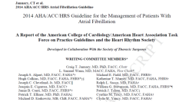
2014 AHA/ACC/HRS Treatment Guidelines to Prevent Thromboembolism in Patients with AF
Assess stroke risk with CHA₂DS₂-VASc score
Score 1: Annual stroke risk 1%, oral anticoagulants or aspirin may be considered
Score ≥2: Annual stroke risk 2%-15%, oral anticoagulants are recommended
Balance benefit vs. bleeding risk
2014 AHA/ACC/HRS Guideline for the Management of Patients with AF
January, CT. et al. 2014 AHA/ACC/HRS Guideline for the Management of Patients With Atrial Fibrillation. JACC. 2014; doi: 10.1016/j.jacc.2014.03.022

Slide 7
Oral Anticoagulation is Standard of Care, but Not Ideal for All
Warfarin
Bleeding risk
Daily regimen
High non-adherence rates
Regular INR monitoring
Food and drug interaction issues
Complicates surgical procedures
Novel Oral Anticoagulants
Bleeding risk
Daily regimen
High non-adherence rates
Complicates surgical procedures
Lack of reversal agents
High cost
Anticoagulation Use Declines with Increased Stroke Risk¹
p < 0.001
(n=27,164)
AF Patients Using
Anticoagulation
CHADS₂ Score
1. Piccini, et al.. Pharmacotherapy in Medicare beneficiaries with atrial fibrillation. Heart Rhythm. 2012;9:1403-1408

Slide 8
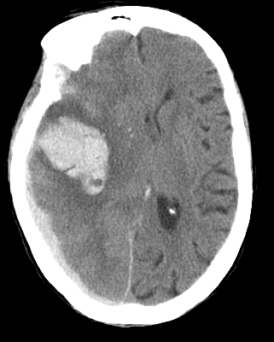
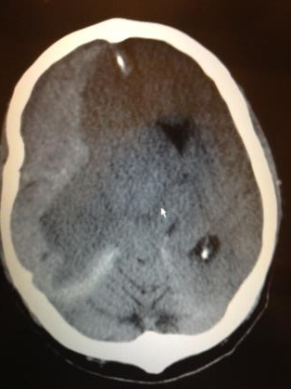
Anticoagulant Therapy Carries Risk of Intracerebral Hemorrhage or Death
Spontaneous intra-parenchymal bleed
Hemorrhagic transformation

Slide 9
Despite Increasing NOAC Adoption, Overall Rate of Anticoagulation in High Risk NVAF Patients has Not Improved
Anticoagulant Use in Patients with NVAF and CHADS₂ ≥ 2
Total on Oral Anticoagulation
Warfarin
NOACs
n=25719
n=29194
n=31582
n=36490
n=67102
n=70667
n=70320
n=71396
Results from the NCDR PINNACLE Registry¹
1. Jani, et al. Uptake of Novel Oral Anticoagulants in Patients with Non-Valvular and Valvular Atrial Fibrillation: Results from the NCDR-Pinnacle Registry. ACC 2014

Slide 10
Discontinuation and Major Bleeding Rates with NOACs
Treatment | Study Drug Discontinuation Rate | Major Bleeding (rate/year)
Rivaroxaban¹ | 24% | 3.6%
Apixaban² | 25% | 2.1%
Dabigatran³ (150 mg) | 21% | 3.3%
Edoxaban⁴ (60 mg / 30 mg) | 33 % / 34% | 2.8% / 1.6%
Warfarin¹⁻⁴ | 17 – 28% | 3.1 – 3.6%
There is an unmet need of stroke risk reduction for patients with AF who are seeking an alternative to long-term OACs
¹Connolly, S. NEJM 2009; 361:1139-1151 – 2 yrs follow-up (Corrected) ²Patel, M. NEJM 2011; 365:883-891 – 1.9 yrs follow-up, ITT ³Granger, C NEJM 2011; 365:981-992 – 1.8 yrs follow-up, ⁴Giugliano, R. NEJM 2013; 369(22): 2093-2104 – 2.8 yrs follow-up.
Notes:
Click to add notes

Slide 11
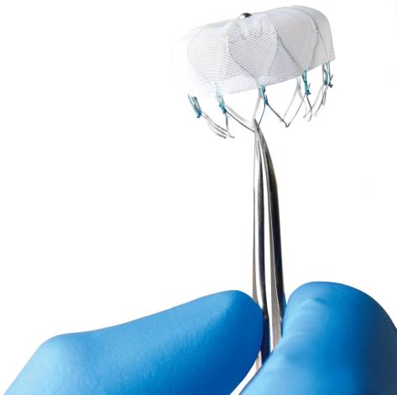
WATCHMANTM Left Atrial Appendage Closure Device
First-of-its-Kind, Proven Alternative to Long-Term Warfarin Therapy for Stroke Risk Reduction in Patients with Non-Valvular Atrial Fibrillation
The most studied LAAC device, and the only one proven with long-term data from randomized trials or multi-center registries
Commercially available internationally since 2009, with over 10,000 implants worldwide
Registered in over 70 countries
SH 286002 AB MAR 2015

Slide 12
Favorable Procedural Safety Profile: 7-Day Safety Events
Patients with Safety Event
(%)
Learning Curve
PROTECT AF
n=232
n=231
n=566
n=269
n=579
1st Half
2nd Half
~50% New Operators in PREVAIL
All Device and/or procedure-related serious adverse events within 7 Days
Source: FDA Oct 2014 Panel Sponsor Presentation.

Slide 13
Implant Success & Warfarin Cessation
p = 0.04
Implant success defined as deployment and release of the device into the left atrial appendage
PREVAIL Implant Success
No difference between new and experienced operators
Experienced Operators
n=26
96%
New Operators
n=24
93%
Warfarin Cessation
Study | 45-day | 12-month
PROTECT AF | 87% | >93%
CAP | 96% | >96%
PREVAIL | 92% | >99%
p = 0.28
PROTECT AF and CAP: Reddy, VY et al. Circulation. 2011;123:417-424.
PREVAIL: Holmes, DR et al. JACC 2014; 64(1):1-12.

Slide 14
Most Studied LAAC Device. Only One with Long-Term Clinical Data
 | PROTECT AF | CAP Registry | PREVAIL | CAP2 Registry | Totals
Enrollment | 2005-2008 | 2008-2010 | 2010-2012 | 2012-2014
Enrolled | 800 | 566 | 461 | 579 | 2406
Randomized | 707 | --- | 407 | --- | 1114
WATCHMAN: warfarin (2:1) | 463 : 244 | 566 | 269 :138 | 579 | 1877: 382
Mean Follow-up (years) | 4.0 | 3.7 | 2.2 | 0.58 | N/A
Patient-years | 2717 | 2022 | 860 | 332 | 5931
Source: FDA Oct 2014 Panel Sponsor Presentation.

Slide 15
Majority of Patients at High Stroke Risk, All Eligible for Anti-coagulation
Anticoagulation Eligible¹
CHA₂DS₂-VASc Score ≥2²
93%
High Risk¹
 | PROTECT AF
 | CAP
 | PREVAIL
 | CAP2
96%
100%
100%
Patients
(%)
CHA₂DS₂-VASc Score
Source: Holmes, DR et al. JACC 2015. In Press.
1. AHA/ACC/HRS Guidelines (2014).

Slide 16
Patient Risk Factors Across Trials
Characteristic | PROTECT AF N=707 | CAP N=566 | PREVAIL N=407 |  | CAP2 N=579 | p-value
CHADS₂ Score | 2.2 ± 1.2 | 2.5 ± 1.2 | 2.6 ± 1.0 |  | 2.7 ± 1.1 | <0.0001
CHADS₂ Risk Factors (% of Patients)
CHF | 26.9 | 23.3 | 19.1 | 27.1 |  | 0.004
Hypertension | 89.8 | 91.4 | 88.8 | 92.5 |  | 0.15
Age ≥ 75 | 43.1 | 53.6 | 51.8 | 59.7 |  | <0.001
Diabetes | 26.2 | 32.4 | 24.9 | 33.7 |  | 0.001
Stroke/TIA | 18.5 | 27.8 | 30.4 | 29.0 |  | <0.0001
CHA₂DS₂-VASc | 3.5 ± 1.6 | 3.9 ± 1.5 | 4.0 ± 1.2 | 4.5 ± 1.3 |  | <0.0001
Source: FDA Oct 2014 Panel Sponsor Presentation.

Slide 17
Majority of Patients in the Trial were at Moderate to High Bleeding Risk¹
Patients
(%)
HAS BLED* Score
1. Estimated HAS BLED score. Labile INR and liver function were not collected and given a score of zero
Source: Holmes DR, et al. Holmes, DR et al. JACC 2015;

Slide 18
WATCHMAN™ PROTECT AF Study Overview Long-Term, Final 5-Year Results
Study Design & Objective | Prospective, randomized (2:1), non-inferiority trial of LAA closure vs. warfarin in non-valvular AF patients for prevention of stroke
Primary Endpoint | Efficacy: Composite end point of stroke, cardiovascular death or systemic embolization Safety: Major bleeding, device embolization or pericardial effusion
Statistical Plan | All analyses by intention-to-treat Bayesian (stratified for CHADS₂ score) : Primary Efficacy and Safety endpoints Cox Proportional: All Secondary Analyses
Patient Population | n = 707 Mean CHADS₂= 2.2, CHA₂DS₂-VASc = 3.5
Key Inclusion Criteria | Paroxysmal / Persistent / Permanent AF CHADS ≥ 1 (93% had a CHA₂DS₂-VASc Score ≥2) Eligible for long-term warfarin therapy
Mean Follow-Up | 2,717 patient-years, 48 months
Number of Sites | 59 in the United States and Europe Enrollment Feb 2005 – June 2008

Slide 19
PROTECT AF: Final, 5-Year Primary Efficacy Events Consistent with 4-Year Results
 | Event Rate (per 100 Pt-Yrs) |  | Rate Ratio (95% CrI) | Posterior Probability
 | WATCHMAN | Warfarin |  | Non-inferiority | Superiority
Primary efficacy | 2.2 | 3.7 | 0.61 (0.42, 1.07) | >99.9% | 95.4%
Stroke (all) | 1.5 | 2.2 | 0.68 (0.42, 1.37) | 99.9% | 83%
Systemic embolism | 0.2 | 0.0 | N/A | -- | --
Death (CV/unexplained) | 1.0 | 2.3 | 0.44 (0.26, 0.90) | >99.9% | 98.9%
Source: FDA Oct 2014 Panel Sponsor Presentation.
Notes:
Consistent with 4-yr rates from JAMA publication
39% reduction in Primary Efficacy
32% reduction in Stroke (all-cause)
56% reduction in CV/Unexplained Death

Slide 20
Meta-Analysis Shows Comparable Primary Efficacy Results to Warfarin
 | HR | p-value
Efficacy | 0.79 | 0.22
All stroke or SE | 1.02 | 0.94
Ischemic stroke or SE | 1.95 | 0.05
Hemorrhagic stroke | 0.22 | 0.004
Ischemic stroke or SE >7 days | 1.56 | 0.21
CV/unexplained death | 0.48 | 0.006
All-cause death | 0.73 | 0.07
Major bleed, all | 1.00 | 0.98
Major bleeding, non procedure-related | 0.51 | 0.002
Favors WATCHMAN ←
→ Favors warfarin
Hazard Ratio (95% CI)
Source: Holmes DR, et al. Holmes, DR et al. JACC 2015; In Press. Combined data set of all PROTECT AF and PREVAIL WATCHMAN patients versus chronic warfarin patients

Slide 21
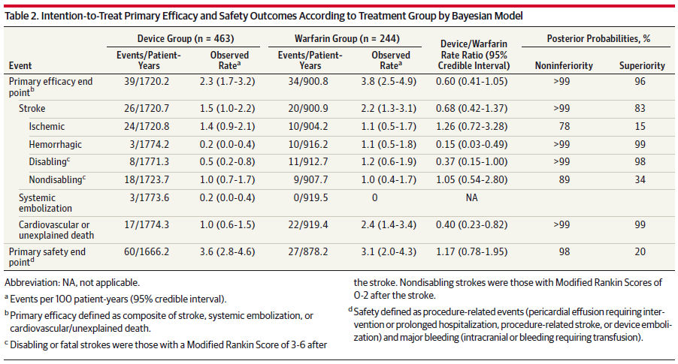
PROTECT AF 4-Year Results in JAMA
WATCHMANTM Met Criteria for both Noninferiority and Superiority for the Primary Composite Endpoint Compared to Warfarin
Reddy, VY et al. JAMA. 2014;312(19):1988-1998.
Notes:
Note the 85% reduction in hemorrhagic stroke and the 63% reduction in disabling stroke compared to warfarin
40% reduction in Primary Efficacy
32% reduction in Stroke (all-cause)
60% reduction in CV/Unexplained Death

Slide 22
WATCHMANTM Device Reduces Ischemic Stroke Over No Therapy
Ischemic Stroke Risk
(Events/100 Patient-Years)
79%
Relative Reduction
67%
Relative Reduction
83%
Relative Reduction
Baseline
CHA₂DS₂-VASc = 3.4
Baseline
CHA₂DS₂-VASc = 3.8
Baseline
CHA₂DS₂-VASc = 3.9
* Imputation based on published rate with adjustment for CHA₂DS₂-VASc score (3.0); Olesen JB. Thromb Haemost (2011)
FDA Oct 2014 Panel Sponsor Presentation. Hanzel G, et al. TCT 2014 (abstract)

Slide 23
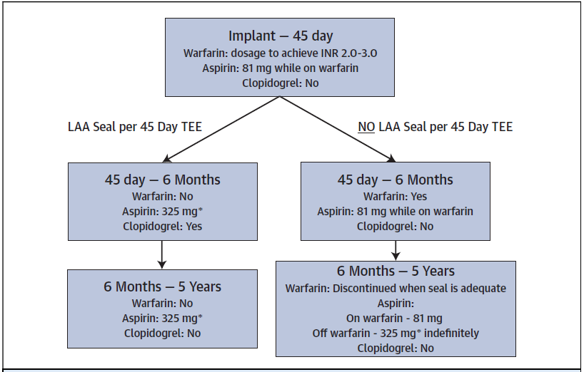
Clinical Trial Device Arm Drug Protocol
*
*
*Cessation of warfarin is at physician discretion provided that any peri-device flow demonstrated by TEE is ≤ 5mm. Before 6 months, when seal is adiquate, patients can cease warfarin and should begin clopidogrel 75 mg daily and increase aspirin dosage to 300-325 mg daily. This regimen should continue until a total of 6 months have elapsed after implantation
Holmes, DR et al. JACC 2014; 64(1):1-12. WATCHMAN DFU.
Notes:
Per WATCHMAN DFU: Post-procedure warfarin therapy is required in ALL patients receiving a WATCHMAN Device. Patients should remain on 81-100 mg of aspirin and warfarin for a minimum of 45 days post implant (INR 2.0-3.0). At 45 days post implant perform WATCHMAN Device assessment with TEE. Cessation of warfarin is at physician discretion provided that any peri-device flow demonstrated by TEE is ≤ 5mm. Subsequent warfarin cessation decisions are contingent on demonstrating adequate seal (flow ≤ 5mm). At the time patients cease warfarin, patients should begin clopidogrel 75 mg daily and increase aspirin dosage to 300-325 mg daily. This regimen should continue until 6 months have elapsed after implantation. Patients should then remain on aspirin 300-325 mg indefinitely. If a patient remains on warfarin and aspirin 81-100mg for at least 6 months after implantation, and then ceases warfarin, the patient should does not require clopidogrel, but should increase to aspirin 300-325mg indefinitely.

Slide 24
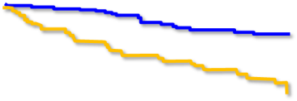
PROTECT AF/PREVAIL Pooled Analysis: Less Bleeding with WATCHMANTM Device 6 Months Post-Implant
Free of Major Bleeding Event (%)
WATCHMAN
Warfarin
HR = 0.29
p<0.001
71%
Relative Reduction
In Major Bleeding after cessation of anti-thrombotics
Aspirin
Warfarin +Aspirin
Warfarin +Aspirin
WATCHMAN Device Arm Drug Protocol
Aspirin+ Clopidogrel
Time (days)
Time (months)
Definition of bleeding: Serious bleeding event that required intervention or hospitalization according to adjudication committee
Price, MJ. Avoidance of Major Bleeding with WATCHMAN Left Atrial Appendage Closure Compared with Long-Term Oral Anticoagulation : Pooled Analysis of the PROTECT-AF and PREVAIL RCTs. TCT 2014 (abstract)
Notes:
This landmark analysis demonstrates the bleeding risk associated with implant, the period when the patients are on anti-thrombotic therapy and when the WATCHMAN Device patients are off of warfarin and clopidogrel and on aspirin alone.

Slide 25
Back Up
SH 286002 AC JUN 2015

Slide 26
WATCHMANTM Ischemic Stroke Rate Aligns with Expected Rate Based on Risk Score
Untreated AF
Treated with Anticoagulants
Ischemic Stroke Risk (events per 100 pt-yrs)
WATCHMAN Arm
PREVAIL
PROTECT AF
CAP
Baseline CHA₂DS₂-VASc Score
Source: Friberg L. et al. Evaluation of risk stratification schemes for ischaemic stroke and bleeding in 182,678 patients with atrial fibrillation: the Swedish Atrial Fibrillation cohort study. Eur Heart J (2012). NICE UK (2014)
Notes:
The dotted line represents the estimated ischemic stroke risk based on CHA₂DS₂-VASc score of patients with AF - who were not being treated with oral anticoagulants - as derived from the NICE analysis of the data from the 2012 Swedish Atrial Fibrillation cohort study. The solid line represents the estimated ischemic stroke risk for AF patients who are receiving oral anticoagulants. The PROTECT AF, CAP and PREVAIL device event rates are plotted on the “Treated with OAT” line along with the confidence intervals around them. This illustrates that the WATCHMAN Device ischemic stroke rates are in line the expected rates for AF patients treated with OAT.

Slide 27
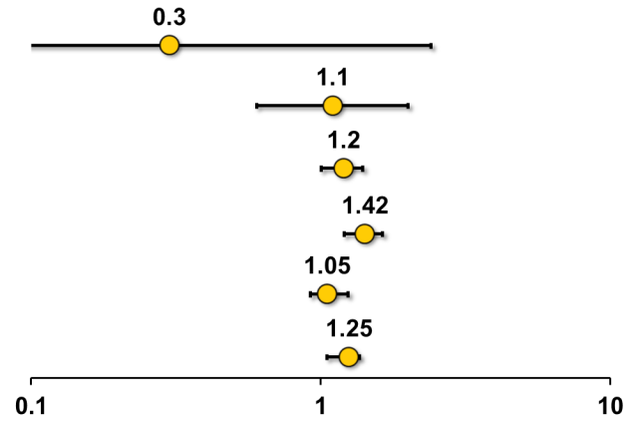
PREVAIL: Warfarin Ischemic Stroke Rate Differs from Other Trials
Trial (Warfarin Arm) | Ischemic Stroke Rate per 100 pt-yrs | Mean CHADS₂
PREVAIL¹ |  | 2.6
PROTECT AF¹ |  | 2.2
RE-LY² |  | 2.1
ROCKET AF² |  | 3.5
ARISTOTLE² |  | 2.1
ENGAGE³ |  | 2.8
Rate per Patient-years
1. FDA Oct 2014 Panel Sponsor Presentation. 2. Miller. AJC (2012) 3. Giugliano. NEJM (2013)
Notes:
The warfarin patients in PREVAIL are not performing in line with what we have seen from warfarin patients in other contemporary randomized trials

Slide 28
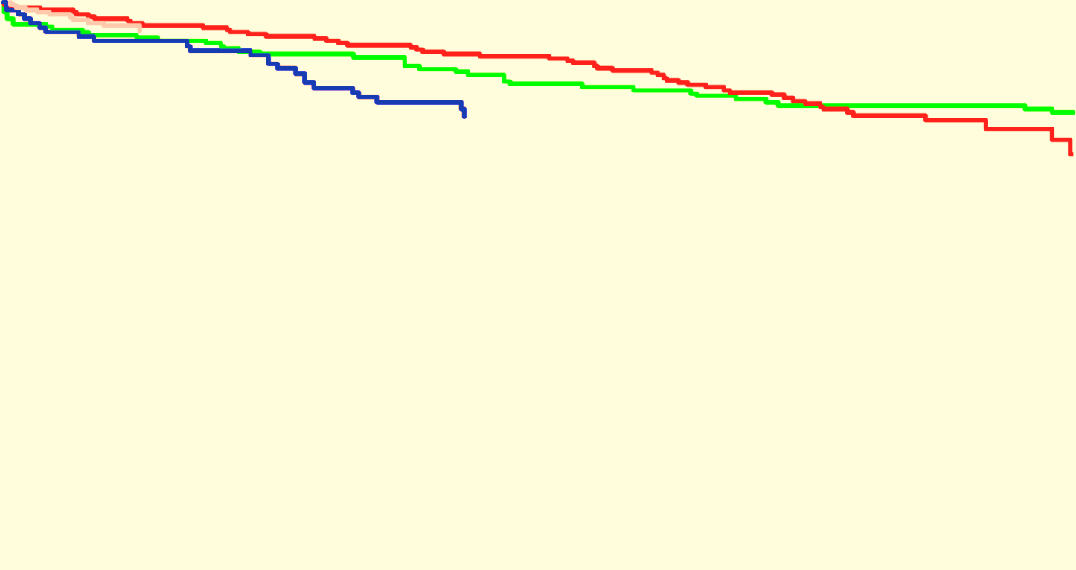
WATCHMAN Performance Consistent Across All 4 Data Sets
Freedom from Event
(%)
PROTECT AF
CAP
PREVAIL
CAP2
Time (years)
PROTECT AF
463 | 382 | 360 | 337 | 321 | 235
566 | 503 | 468 | 435 | 293 | 59
269 | 234 | 182 | 37 | 0
579 | 116 | 0
CAP
PREVAIL
CAP2
Source: Holmes DR, et al. Holmes, DR et al. JACC 2015; In Press. Combined data set of all PROTECT AF, CAP, PREVAIL and CAP 2 WATCHMAN patients

Slide 29
Rate of Major Bleeding in NOAC Trials
3.6
3.6
3.3
3.4
3.1
2.1
Major Bleeding Rate (%/year)
1
2
3
¹Connolly, S. NEJM 2009; 361:1139-1151 – 2 yrs f-up (Corrected) 150 mg ²Patel, M. NEJM 2011; 365:883-891 – 1.9 yrs f-up, ITT ³Granger, C NEJM 2011; 365:981-992 – 1.8 yrs f-up
Notes:
Alternate slide to #10

Slide 30
Rate of Discontinuation in NOAC Trials
28
25
Discontinuation Rate (%)
24
22
21
17
1
2
3
¹Connolly, S. NEJM 2009; 361:1139-1151 – 2 yrs f-up (Corrected), 150 mg ²Patel, M. NEJM 2011; 365:883-891 – 1.9 yrs f-up, ITT ³Granger, C NEJM 2011; 365:981-992 – 1.8 yrs f-up
Notes:
Alternate slide to #10

Slide 31
ABBREVIATED STATEMENT WATCHMANTM Left Atrial Appendage Closure Device with Delivery System and WATCHMAN Access System
Indications for use
The WATCHMAN Device is indicated to reduce the risk of thromboembolism from the left atrial appendage in patients with non-valvular atrial fibrillation who:
Are at increased risk for stroke and systemic embolism based on CHADS₂ or CHA₂DS₂-VASc scores and are recommended for anticoagulation therapy;
Are deemed by their physicians to be suitable for warfarin; and
Have an appropriate rationale to seek a non-pharmacologic alternative to warfarin, taking into account the safety and effectiveness of the device compared to warfarin.
The WATCHMAN Access System is intended to provide vascular and transseptal access for all WATCHMAN Left Atrial Appendage Closure Devices with Delivery Systems.
Contraindications
Do not use the WATCHMAN Device if:
Intracardiac thrombus is visualized by echocardiographic imaging.
An atrial septal defect repair or closure device or a patent foramen ovale repair or closure device is present.
The LAA anatomy will not accommodate a device. See Table 46 in the DFU.
Any of the customary contraindications for other percutaneous catheterization procedures (e.g., patient size too small to accommodate TEE probe or required catheters) or conditions (e.g., active infection, bleeding disorder) are present.
There are contraindications to the use of warfarin, aspirin, or clopidogrel.
The patient has a known hypersensitivity to any portion of the device material or the individual components (see Device Description section) such that the use of the WATCHMAN Device is contraindicated.
Warnings
Device selection should be based on accurate LAA measurements obtained using fluoro and ultrasound guidance (TEE recommended) in multiple angles (e.g., 0º, 45º, 90º, 135º).
Do not release the WATCHMAN Device from the core wire if the device does not meet all release criteria.
If thrombus is observed on the device, warfarin therapy is recommended until resolution of thrombus is demonstrated by TEE.
The potential for device embolization exists with cardioversion <30 days following device implantation. Verify device position post-cardioversion during this period.
Administer appropriate endocarditis prophylaxis for 6 months following device implantation. The decision to continue endocarditis prophylaxis beyond 6 months is at physician discretion.
For single use only. Do not reuse, reprocess, or resterilize.
Precautions
The safety and effectiveness (and benefit-risk profile) of the WATCHMAN Device has not been established in patients for whom long-term anticoagulation is determined to be contraindicated.
The LAA is a thin-walled structure. Use caution when accessing the LAA and deploying the device.
Use caution when introducing the WATCHMAN Access System to prevent damage to cardiac structures.
Use caution when introducing the Delivery System to prevent damage to cardiac structures.
To prevent damage to the Delivery Catheter or device, do not allow the WATCHMAN Device to protrude beyond the distal tip of the Delivery Catheter when inserting the Delivery System into the Access Sheath.
If using a power injector, the maximum pressure should not exceed 100 psi.
In view of the concerns that were raised by the RE-ALIGN¹ study of dabigatran in the presence of prosthetic mechanical heart valves, caution should be used when prescribing oral anticoagulants other than warfarin in patients treated with the WATCHMAN Device. The WATCHMAN Device has only been evaluated with the use of warfarin post-device implantation.
ADVERSE EVENTS
Potential adverse events (in alphabetical order) which may be associated with the use of a left atrial appendage closure device or implantation procedure include but are not limited to:
Air embolism, Airway trauma, Allergic reaction to contrast media/medications or device materials, Altered mental status, Anemia requiring transfusion, Anesthesia risks, Angina, Anoxic encephalopathy, Arrhythmias, Atrial septal defect , AV fistula , Bruising, hematoma or seroma, Cardiac perforation , Chest pain/discomfort, Confusion post procedure, Congestive heart failure, Contrast related nephropathy, Cranial bleed, Decreased hemoglobin, Deep vein thrombosis, Death, Device embolism, Device fracture, Device thrombosis, Edema, Excessive bleeding, Fever, Groin pain, Groin puncture bleed, Hematuria, Hemoptysis, Hypotension, Hypoxia, Improper wound healing, Inability to reposition, recapture, or retrieve the device, Infection / pneumonia, Interatrial septum thrombus, Intratracheal bleeding, Major bleeding requiring transfusion, Misplacement of the device / improper seal of the appendage / movement of device from appendage wall, Myocardia erosion, Nausea, Oral bleeding, Pericardial effusion / tamponade, Pleural effusion, Prolonged bleeding from a laceration, Pseudoaneurysm, Pulmonary edema, Renal failure, Respiratory insufficiency / failure, Surgical removal of the device, Stroke – Ischemic , Stroke – Hemorrhagic, Systemic embolism, TEE complications (throat pain, bleeding, esophageal trauma), Thrombocytopenia, Thrombosis, Transient ischemic attack (TIA), Valvular damage, Vasovagal reactions
There may be other potential adverse events that are unforeseen at this time.
CAUTION: Federal law (USA) restricts this device to sale by or on the order of a physician. Rx only. Prior to use, please see the complete “Directions for Use” for more information on Indications, Contraindications, Warnings, Precautions, Adverse Events, and Operator’s Instructions.
© 2015 Boston Scientific Corporation or its affiliates. All rights reserved.
¹Eikelboom JW, Connolly SJ, Brueckmann M, et al. N Engl J Med 2013;369:1206-14.

