Slide 1
Documentation Best Practices for the Intracept™ Procedure

Slide 2

The Why……
You already know how to find patients and get them excited about Intracept! But did you know…
Poor documentation results in denials
Denials are frustrating for you and your patients
Approvals increase chances for obtaining and maintaining positive payor policy!

Slide 3
Documentation – Life Blood To Authorization
If it wasn’t documented, it wasn’t done.
Insurers’ decisions about authorization are based upon clinical notes submitted.
Build a base template or dot phrases that includes common medical criteria.
Know the policy specifics – use your checklists to understand additional policy requirements.

Slide 4
Positive vs. Negative Intracept Policies
Positive Policies
  Have specific requirements for coverage
  Generate approvals when provider notes include all requirements
  Generate denials when provider notes lack these requirements
  Checklists are available in the Resource Center and from the Intracept team
  To assist, we have developed Common Coverage Criteria that will meet most policies
Negative Policies
  Are when payors find Intracept to be Investigational and Experimental
  Submissions should focus on meeting FDA indications – at a minimum
  Denials can still happen even if FDA indications or Common Coverage Criteria criteria are met
  Meeting Common Coverage Criteria increases odds of approval at IRO or ALJ

Slide 5
Common Coverage Policy Criteria
Intracept™ Procedure Criteria | Detailed Basic Note
Dx of Vertebrogenic pain (M54.51) & specific VB to be treated | ✓
CLBP 6+ month (be specific) * exception: 12+ months for some payers | ✓
Failed 6+ months non-surgical/conservative medical mgmt. | ✓
MRI Modic Type I or II (L3-S1) or descriptors on MRI report | ✓
VAS score | ✓
ODI | ✓
Mental Health Statement by treating provider *exception: By an outside provider as indicated in some policies | ✓
Description of multi-disciplinary team evaluating and treating patient (Ex: PCP, PT, etc.) | ✓
Absence of non-vertebrogenic pathology | ✓
See each medical policy for list of LIMITATIONS/Exclusions

Slide 6
Diagnosis of Vertebrogenic Pain
M54.51 – vertebrogenic low back pain
  The most specific code for the Intracept™ Procedure
  Issued in 2021 to describe a diagnosis not previously defined
Certain policies limit ICD-10 codes for the Intracept™ Procedure – all policies will include M54.51

Slide 7
Failed 6+ months non-surgical/conservative treatment
Be specific about timeframe & results of treatments
Clinic notes should do more than list past treatments
      What was tried and failed for low back pain, including but not limited to:
        Physical Therapy, Injection (ESI, MBBs, SI joints), Facet/SI joint RFAs, other interventional pain therapies, medications, acupuncture, chiropractic, Cognitive Behavioral Therapy, Home Exercise Program.
        List tried and failed medications – including opioids - current or past use - if applicable.

Slide 8
Modic or descriptors on MRI
Treating provider documents Modic Type 1 or Type 2 changes and which vertebral bodies.
MRI report by radiologist corroborates treating provider’s findings. Acceptable documentation.
  Modic type 1 and/or type 2 at vertebral bodies to be treated
  *Descriptors include:
    Active Schmorl’s Node
    Endplate changes, edema, inflammation, disruption and/or fissuring
    Fibrovascular bone marrow changes or fatty bone marrow changes and the affected vertebral bodies

Slide 9
VAS Score and ODI
Many coverage policies require VAS and/or ODI
Clinic note should include:
  Visual Analog Scale (VAS) 1-10 score
    Many require VAS > 4 (used in clinical studies)
  Functional capacity score, (e.g. Oswestry Disability Index (ODI))
    Many require ODI > 30 (used in clinical studies)
  Consider using Intracept™ Procedure Intake Form to capture these

Slide 10
Mental Health Statement
A mental health statement is NOT a psychological evaluation!
Most payors will allow the treating physician to provide a mental health statement*
Attest to the following, are there:
  Alcohol or substance abuse issues that would preclude the patient from benefiting from the Intracept™ Procedure? If yes, explain.
  Psychological issues that would preclude the patient from benefiting from the Intracept Procedure? If yes, explain.
If the physician is not comfortable providing the mental health statement, the patient can be referred.
Some payors may occasionally request a full psychological evaluation. If needed our team will let you know.

Slide 11
Cognitive Behavioral Therapy
Very few payors require 3 sessions of Cognitive Behavioral Therapy (CBT) to include:
  Disease education
  Activity and lifestyle modification
  Stress management (stress management typically also includes
  Strategies to deal with emotions such as fear, anxiety, sadness that can interfere with pain management)
Currently only:
  BCBS SC
  BCBS KS
Consider Advantage Point Behavioral referral for telehealth visits that satisfy requirement
  Send a referrals to referrals@advantagepointbehavioral.com or via fax@ 844-583-5633 with the following information:
    Practice Name / phone
    Physician Name
    Patient Demographics
    Procedure Information: Please list 3 CBT sessions and Mental Health screening

Slide 12
Multi-disciplinary Team
Many payors want a detailed history and physical showing a team of providers have assessed and treated the patient.
Most patients have already seen a multi-disciplinary team – it’s a matter of documenting this in clinic note.
An example statement:
  The patient has undergone careful screening by a multi-disciplinary team that includes, the following: PCP, physical therapist, chiropractor, massage therapist, our advanced practice providers, surgeon, pain management physician in addition to me.

Slide 13
Documenting non-vertebrogenic pathology
Payor policies and LCDs are concerned that there may be another cause for the LBP.
Document the patient’s primary or predominant source of pain is vertebrogenic low back pain based on patient complaints, physical exam and radiology report (presence of Modic changes).
Therefore, address any conditions identified in the MRI report and whether they are pertinent to the patient’s complaints or physical exam and if they have already been treated.
Be careful of EMR carry-over of other diagnoses*. Especially those that are resolved!
  Radiculopathy
  Spinal stenosis
  Facet disease
* Become a reason for authorization denial

Slide 14
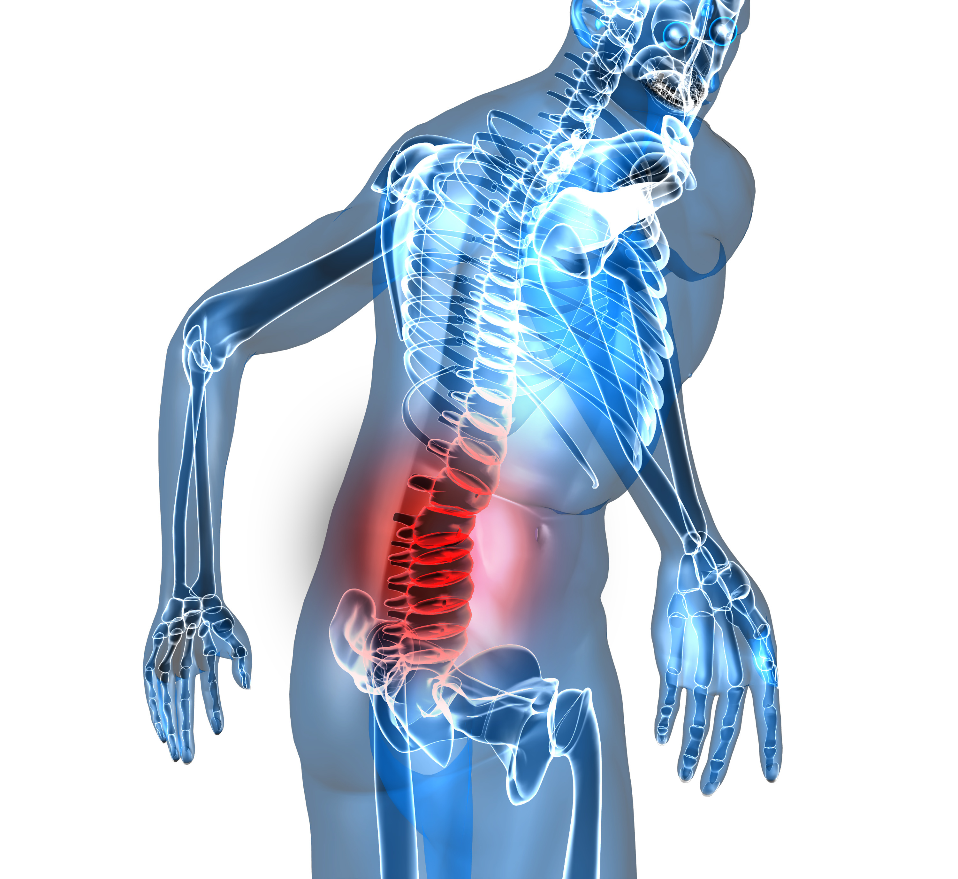
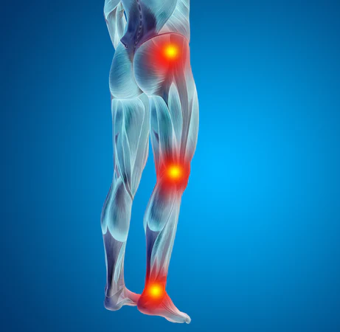
Multi-factorial Pain: Low Back Pain vs. Leg Pain
Vertebrogenic Pain
Discogenic Pain
Spondylolysis
Facet Arthropathy
SI joint Arthropathy
Spondylolisthesis
Herniated Nucleus Pulposus
Spinal Stenosis

Slide 15
Documenting non-vertebrogenic pathology
Addressing MRI findings
Medical Directors place great emphasis on the MRI report and x-rays
  MRIs are sensitive and not specific except when Modic changes are present
Explain radiographic findings that could cause LBP and why they have been ruled-out – not pertinent
  Facet arthropathy – provide treatments performed, outcomes – is it pertinent?
  Disc bulges/herniations – provide treatments performed, outcome and why HNP* not pertinent
  Spondylolisthesis (>2 mm) – does the patient have radicular complaints – is it pertinent?
  Spondylolysis (at any level) – can be a cause of LBP – need to explain why it isn’t pertinent
  Scoliosis (>10 degrees) – explain why it’s not pertinent
*HNP – herniated nucleus pulposus

Slide 16
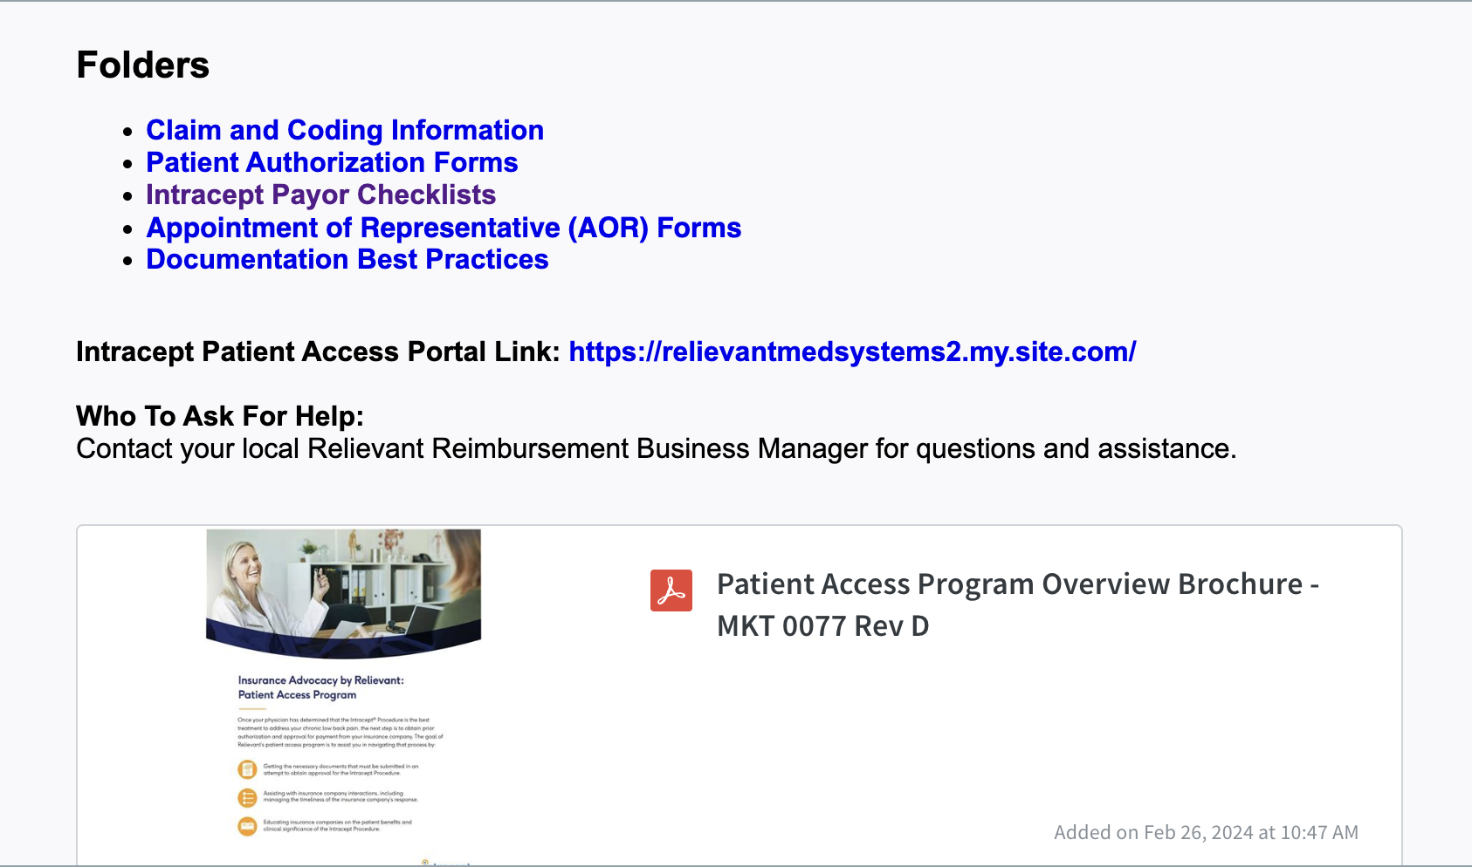
Coverage & Reimbursement Resource Center
Newly created customer reimbursement resource center
One location for all reimbursement tools
Reimbursement Business Manager can send you an access link
Notes:
RBM to have medical policies for their current geography readily available to discuss

Slide 17
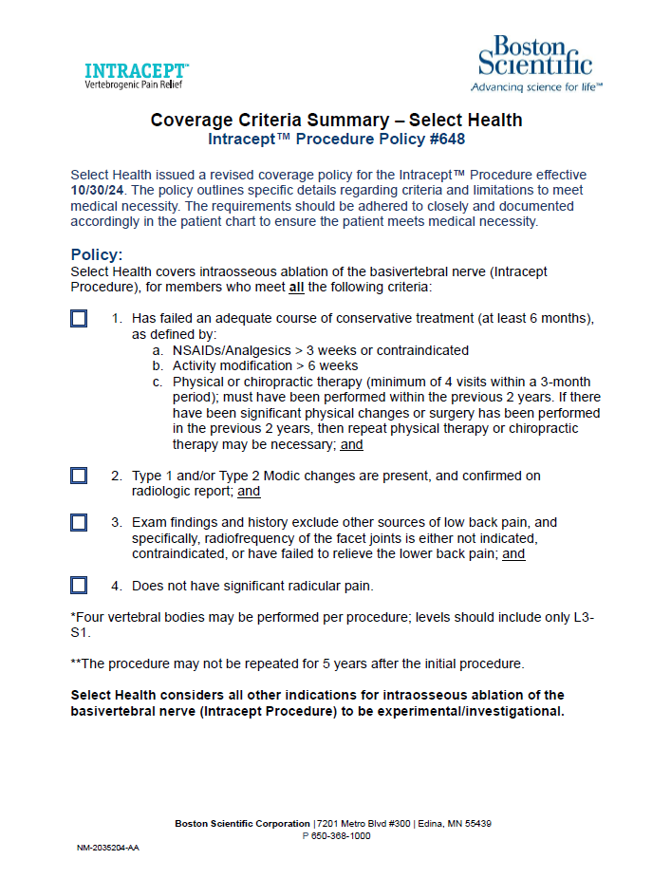
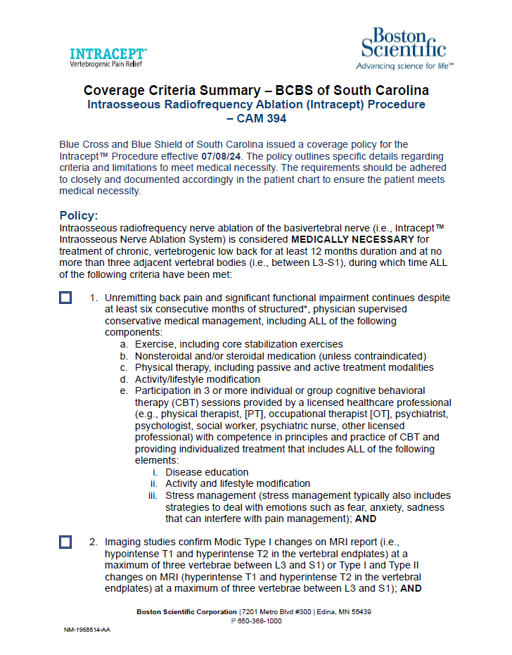
Coverage Criteria Summary

Slide 18
Indications
Indications for Use: The Intracept™ Intraosseous Nerve Ablation System is intended to be used in conjunction with radiofrequency (RF) generators for the ablation of basivertebral nerves of the L3 through S1 vertebrae for the relief of chronic low back pain of at least six months duration that has not responded to at least six months of conservative care, and is also accompanied by features consistent with Type 1 or Type 2 Modic changes on an MRI such as inflammation, edema, vertebral endplate changes, disruption and fissuring of the endplate, vascularized fibrous tissues within the adjacent marrow, hypointensive signals (Type 1 Modic change), and changes to the vertebral body marrow including replacement of normal bone marrow by fat, and hyperintensive signals (Type 2 Modic change).
Contraindications - Use of the Intracept Intraosseous Nerve Ablation System is contraindicated in: Patients with severe cardiac or pulmonary compromise, patients with active implantable pulse generators (e.g. pacemakers, defibrillators), patients where the targeted ablation zone is < 10 mm away from a sensitive structure not intended to be ablated, including the vertebral foramen (spinal canal), patients with active systemic infection or local infection in the area to be treated, patients who are pregnant, and/or skeletally immature patients (generally ≤ 18 years of age). Refer to the Instructions for Use provided with the Intracept Procedure or www.relievant.com/intracept/ for potential adverse effects, warnings, and precautions prior to using this product.
Caution: U.S. Federal law restricts this device to sale by or on the order of a physician.
Copyright © 2025 by Boston Scientific Corporation or its affiliates. All rights reserved.
Disclaimer: Health economic and reimbursement information provided by Boston Scientific Corporation is gathered from third-party sources and is subject to change without notice as a result of complex and frequently changing laws, regulations, rules and policies. This information is presented for illustrative purposes only and does not constitute reimbursement or legal advice. Boston Scientific encourages providers to submit accurate and appropriate claims for services. It is always the provider’s responsibility to determine medical necessity, the proper site for delivery of any services and to submit appropriate codes, charges, and modifiers for services that are rendered. Boston Scientific recommends that you consult with your payers, reimbursement specialists and/or legal counsel regarding coding, coverage and reimbursement matters. Boston Scientific does not promote the use of its products outside their FDA-approved label.
NM-2073006-AB

Slide 19
Q&A

Slide 20
Addendum

Slide 21
Medicare Local Coverage Determination
MAC | Jurisdiction & States Covered | LCD
CGS (A Celerian Group Company) | J15: KY, OH | No
First Coast Services Options, Inc. | JN: FL, PR US Virgin Island | No
NGS (National Government Serices) | J6: IL, MN, WI JK: CT, ME, MA, NH, NY, RI, VT | No
Noridian | JE: CA, HI, NV JF: AK, AZ, ID, MT, ND, OR, SD, UT, WA, WY | Yes
Novitas Solutions | JH: AR, CO, LA, MS, NM, OK, TX JL: DE, DC, MD, NJ, PA | No
Palmetto | JM: NC, SC, VA, WV JJ: AL, GA, TN | Yes
WPS (Wisconsin Physician Services) | J5: IA, KS, MO, NE J8: IN, MI | No
* Rates above are Medicare national averages subject to geographic adjustment. Commercial rates are generally higher than Medicare.

