Slide 1

©2022 Boston Scientific Corporation or its affiliates. All rights reserved. IC-1403502-AA

Slide 2
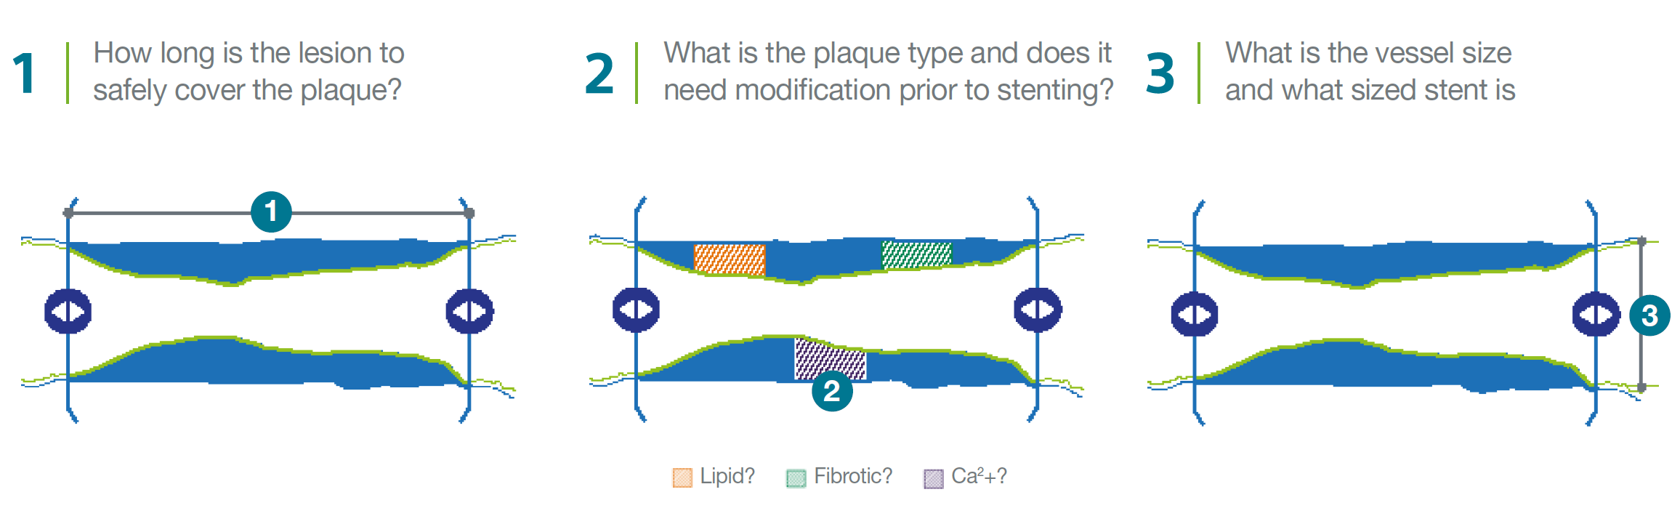
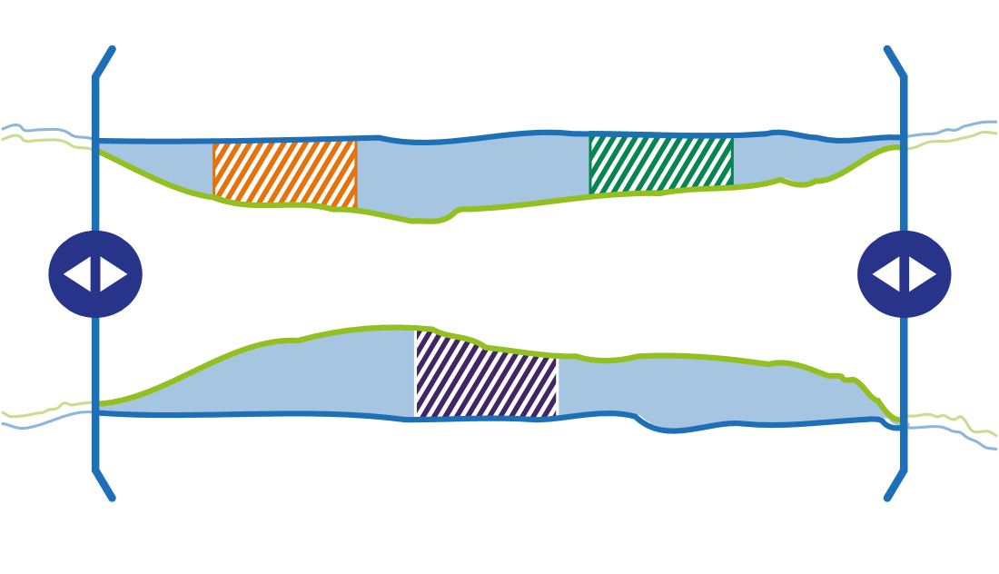
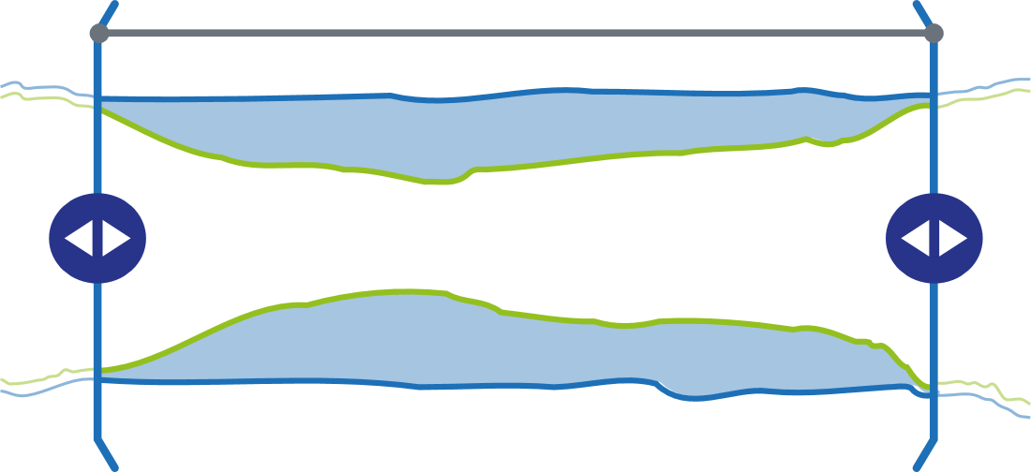
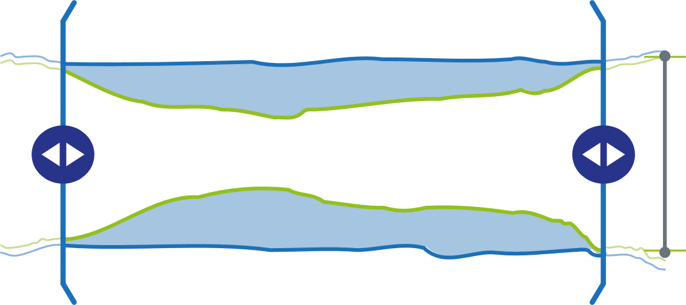
What are the problems to be solved?
1
3
2
©2022 Boston Scientific Corporation or its affiliates. All rights reserved. IC-1403502-AA

Slide 3
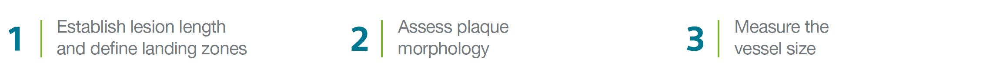
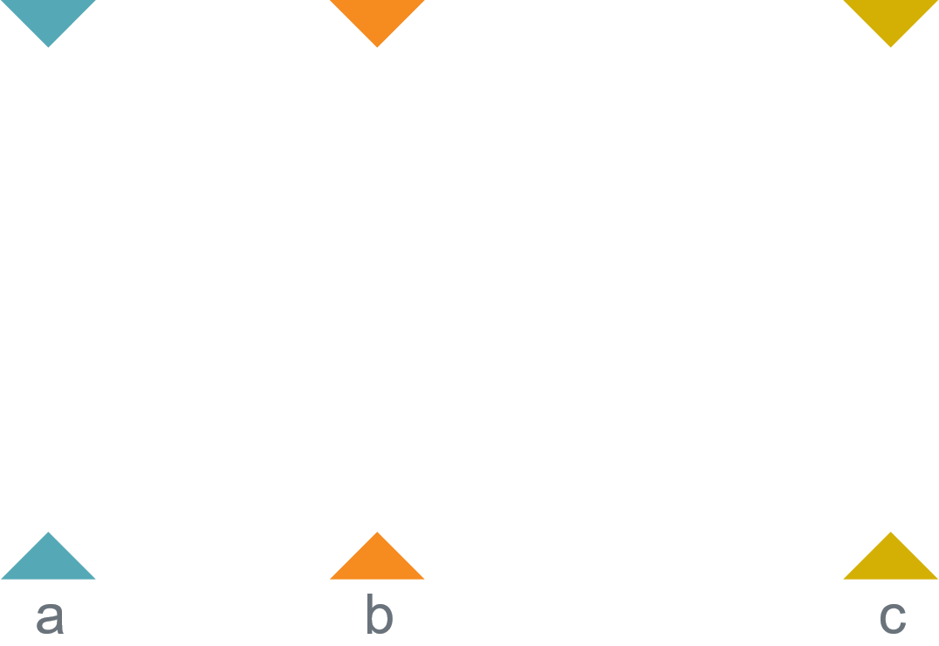
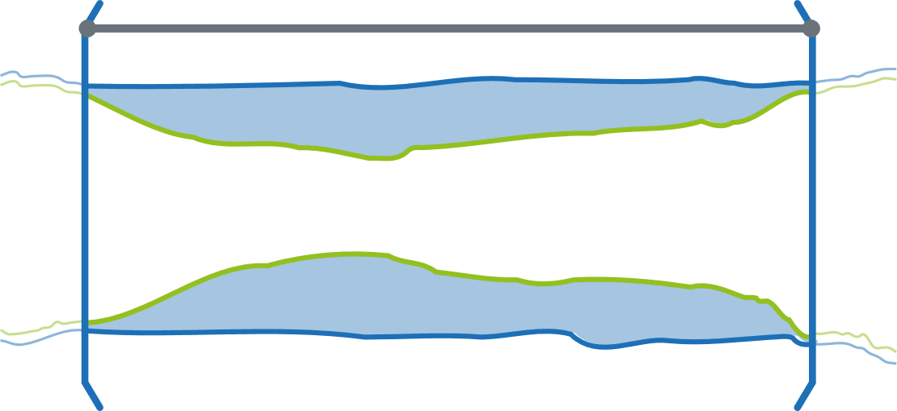
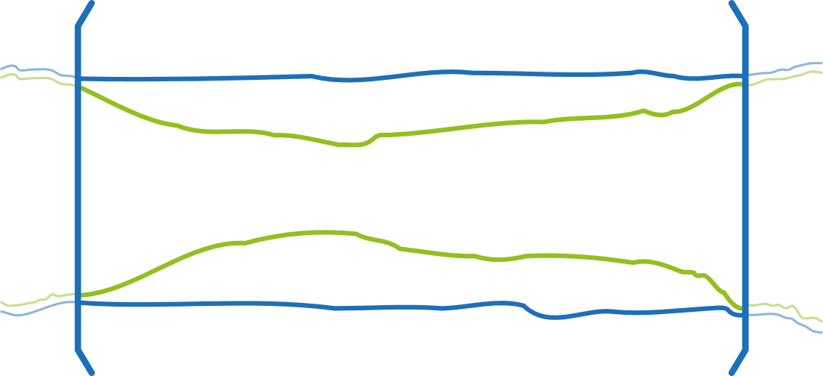
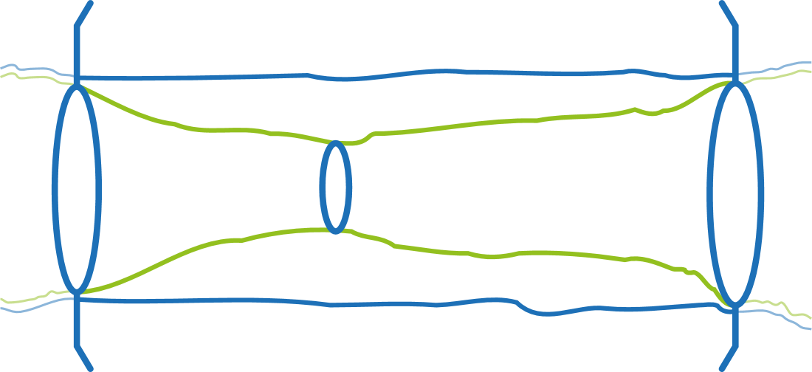
Pre-stent workflow
1
3
2
©2022 Boston Scientific Corporation or its affiliates. All rights reserved. IC-1403502-AA

Slide 4
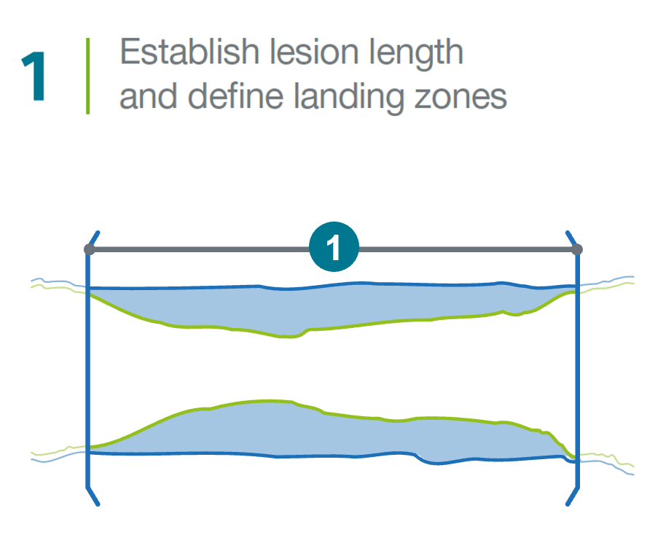
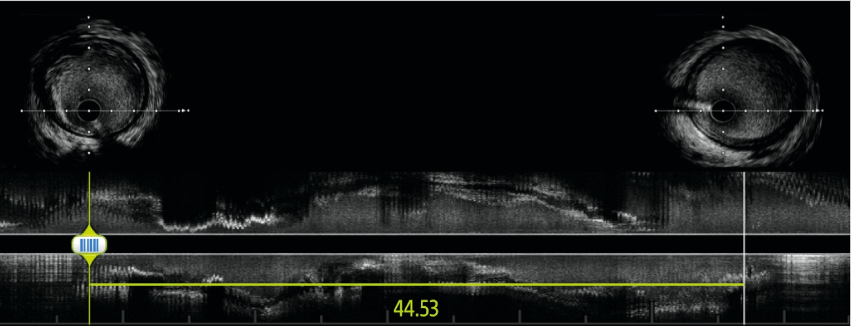
Pre-stent workflow
©2022 Boston Scientific Corporation or its affiliates. All rights reserved. IC-1403502-AA

Slide 5
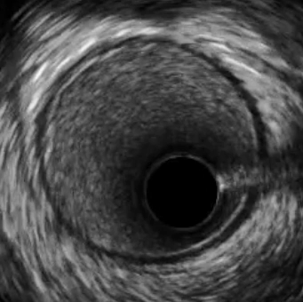
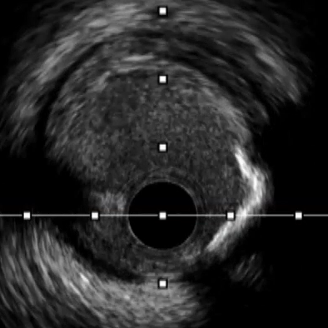
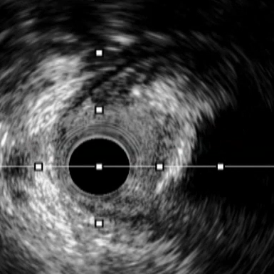
Pre-stent workflow
Normal
<50% Plaque burden
Diseased
©2022 Boston Scientific Corporation or its affiliates. All rights reserved. IC-1403502-AA

Slide 6
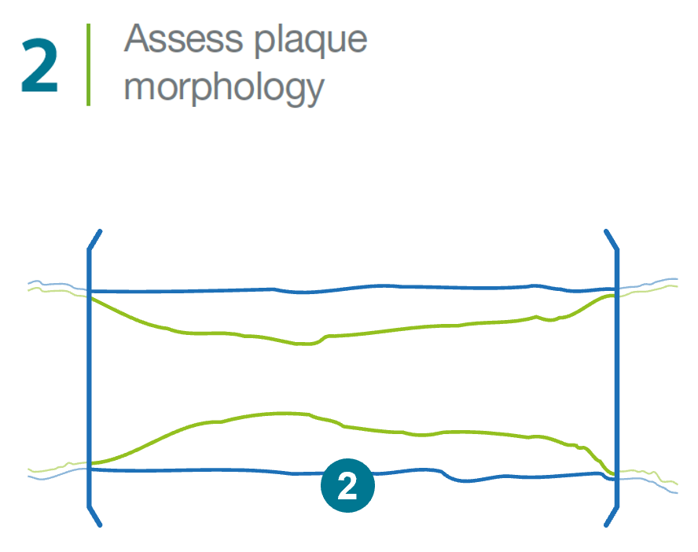
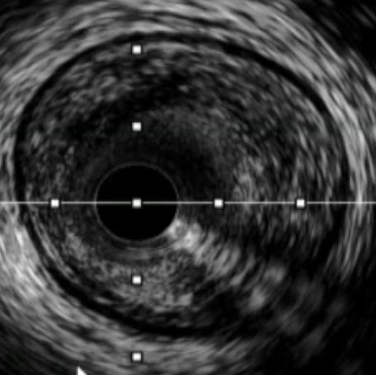
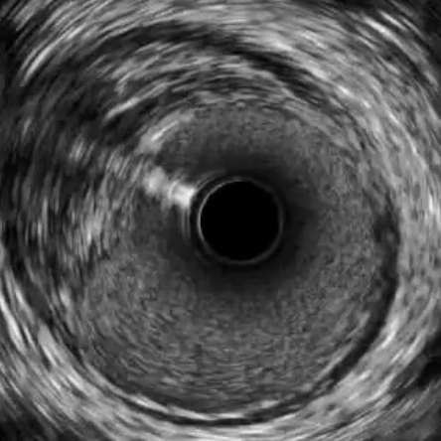
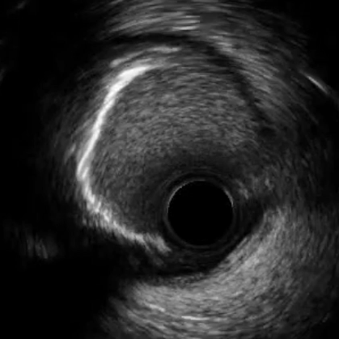
Pre-stent workflow
Lipidic
Fibrotic
Calcium
©2022 Boston Scientific Corporation or its affiliates. All rights reserved. IC-1403502-AA

Slide 7
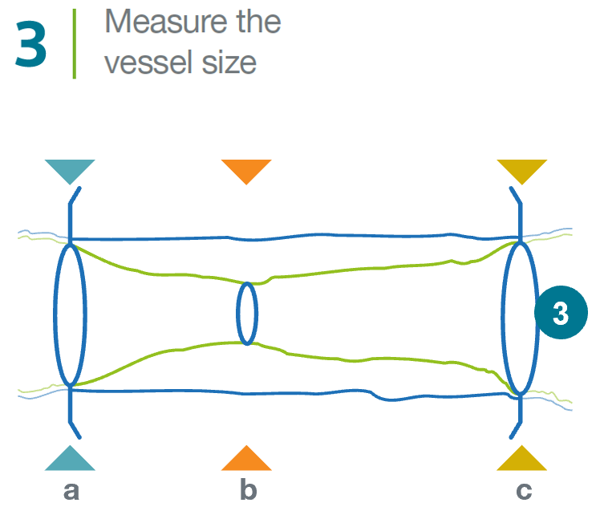
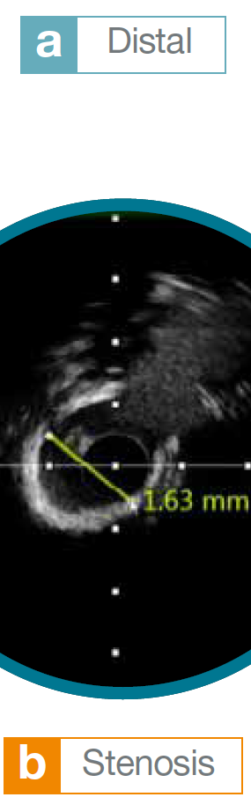

Pre-stent workflow
©2022 Boston Scientific Corporation or its affiliates. All rights reserved. IC-1403502-AA

Slide 8
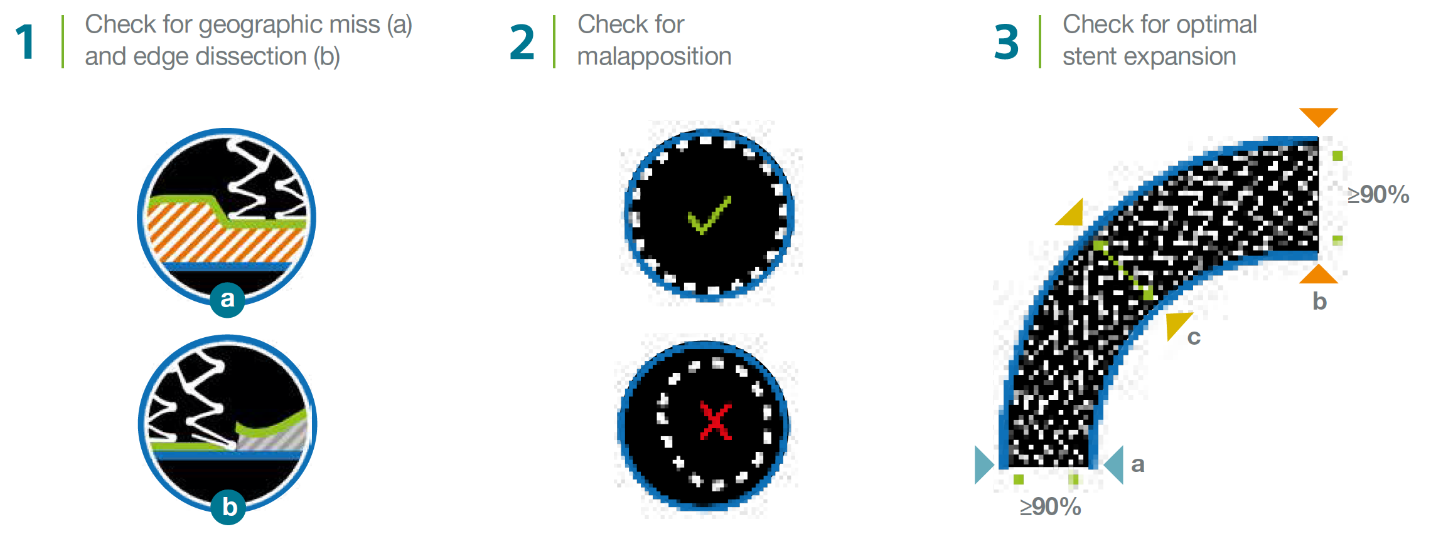
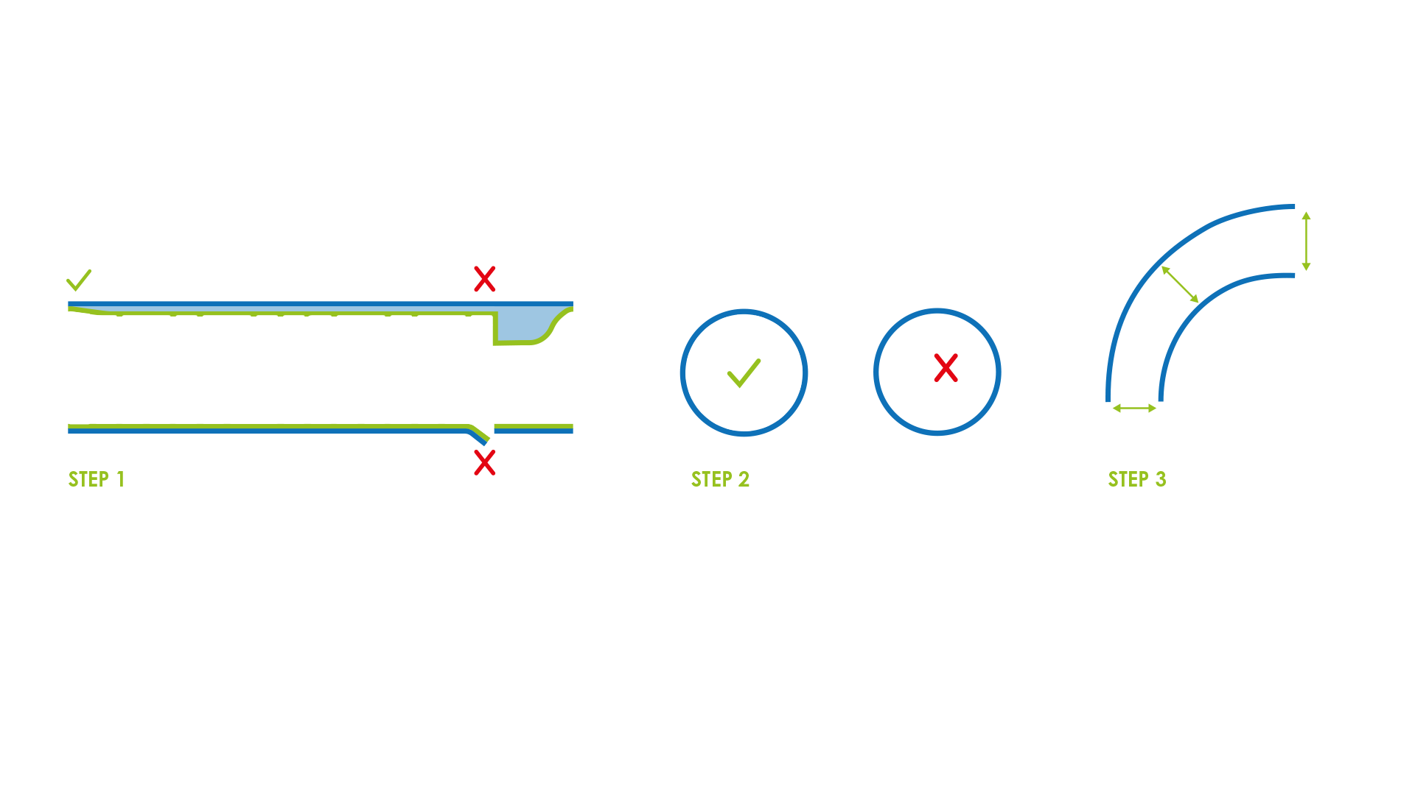
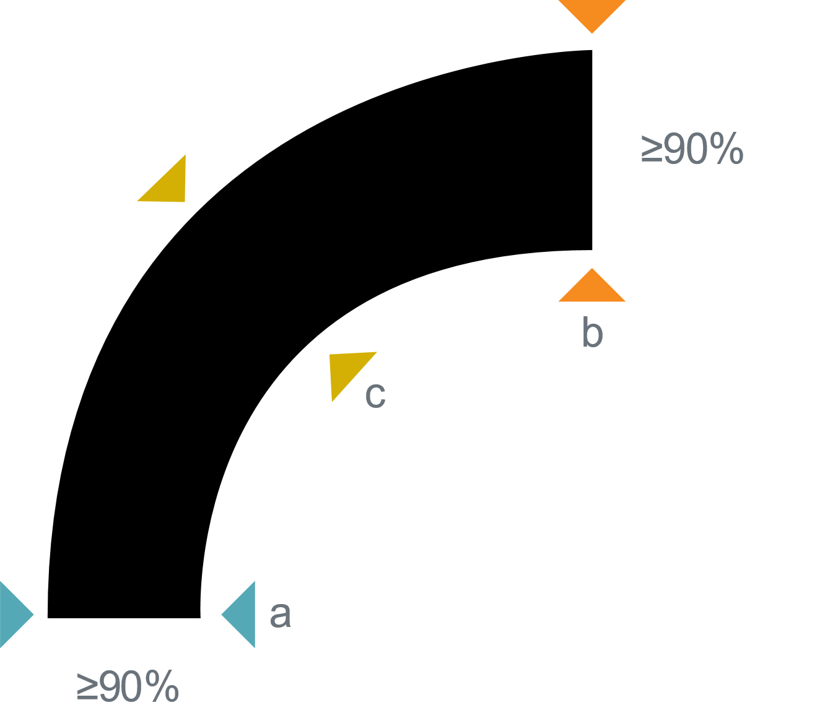
Post-stent workflow
©2022 Boston Scientific Corporation or its affiliates. All rights reserved. IC-1403502-AA

Slide 9
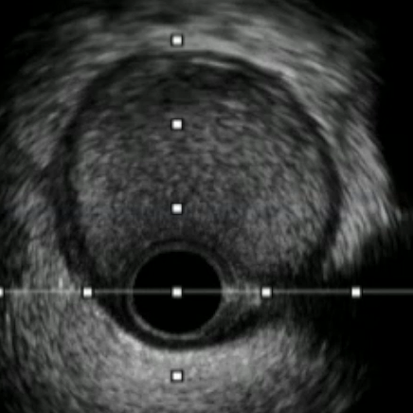
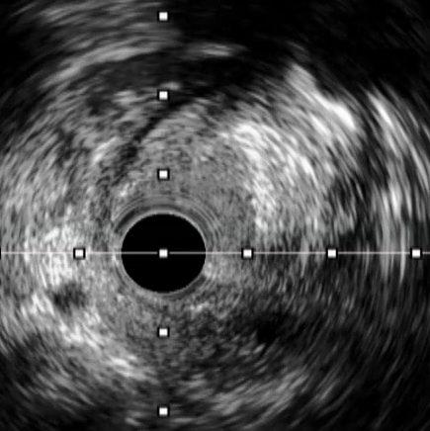
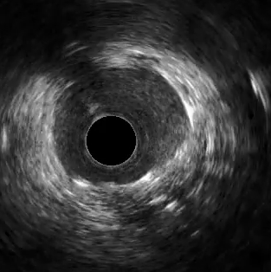
Post-stent workflow
Optimal landing zone
Geographic miss (a)
Edge
©2022 Boston Scientific Corporation or its affiliates. All rights reserved. IC-1403502-AA

Slide 10
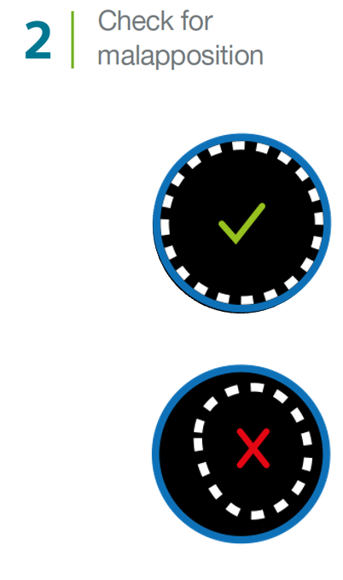
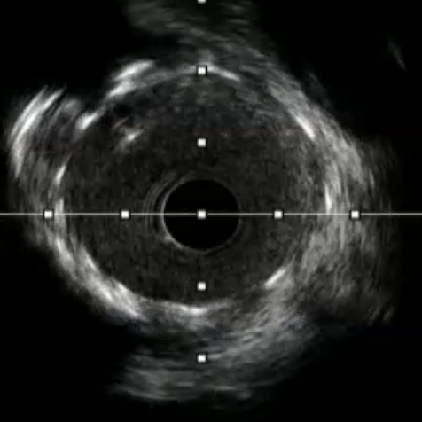
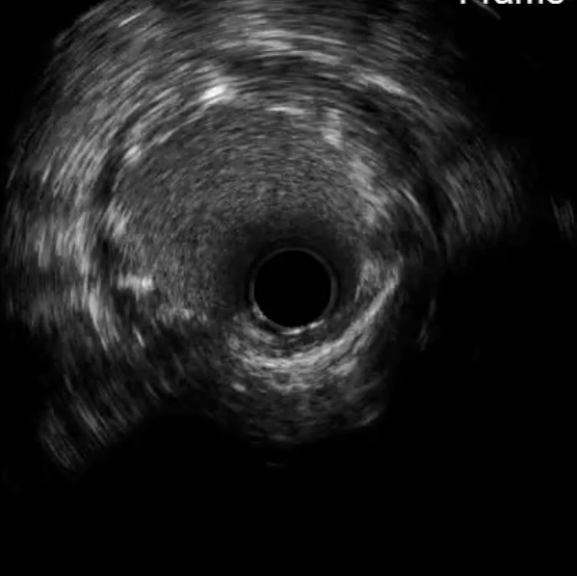
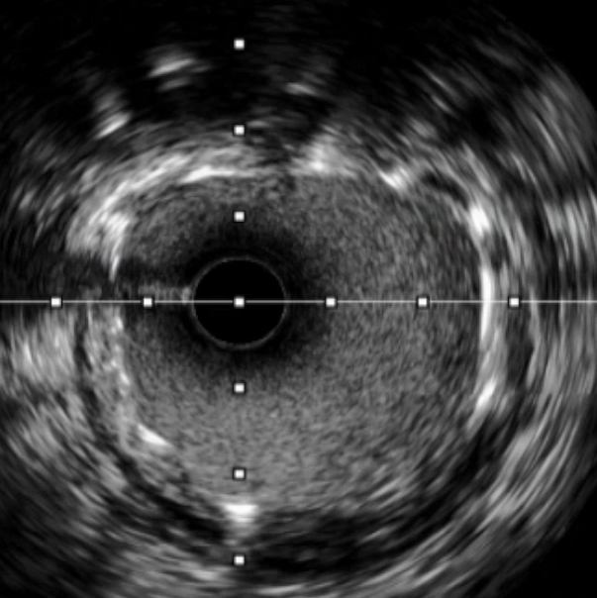


Post-stent workflow
Side branch
©2022 Boston Scientific Corporation or its affiliates. All rights reserved. IC-1403502-AA

Slide 11

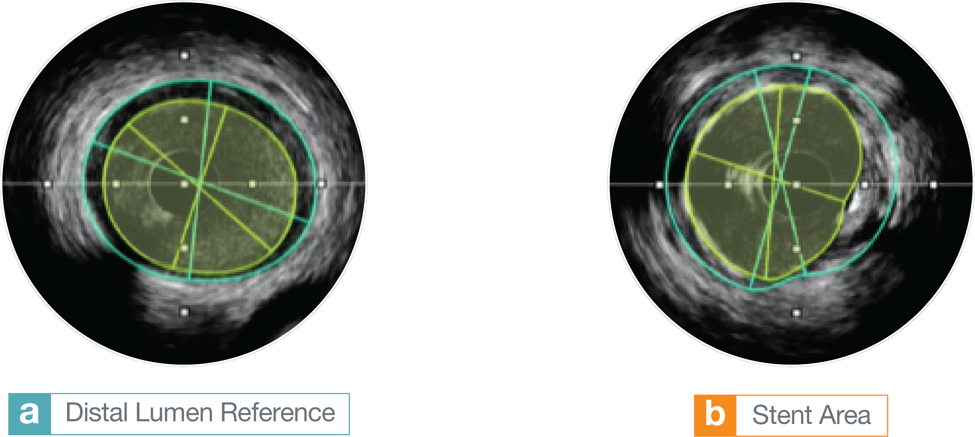
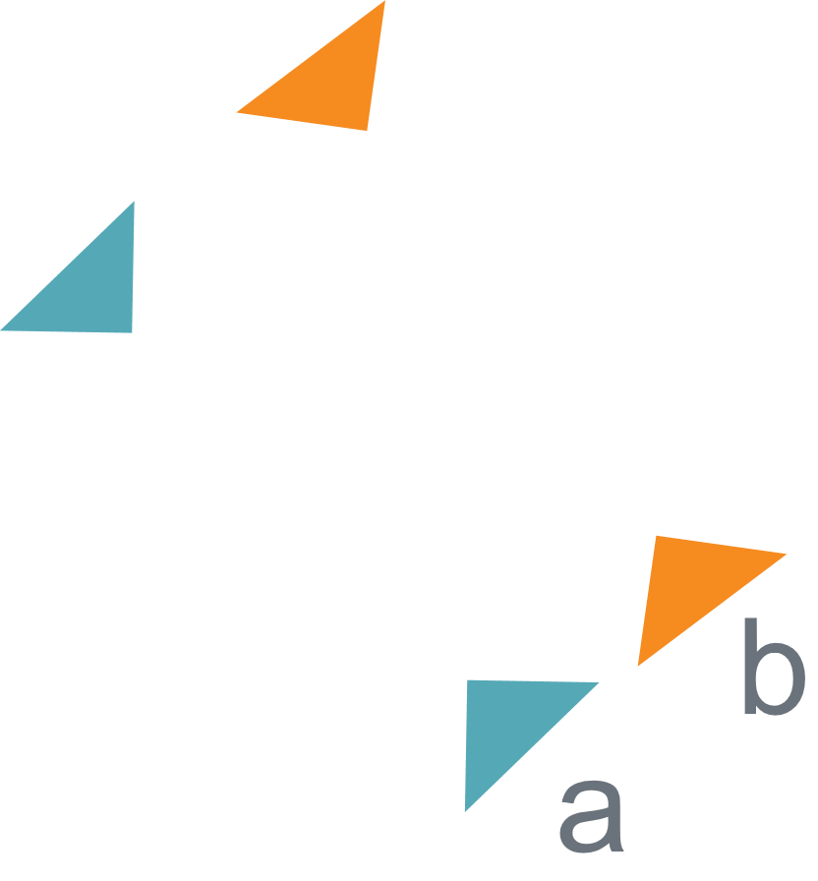
Post-stent workflow
93%
Stent expansion
©2022 Boston Scientific Corporation or its affiliates. All rights reserved. IC-1403502-AA

Slide 12
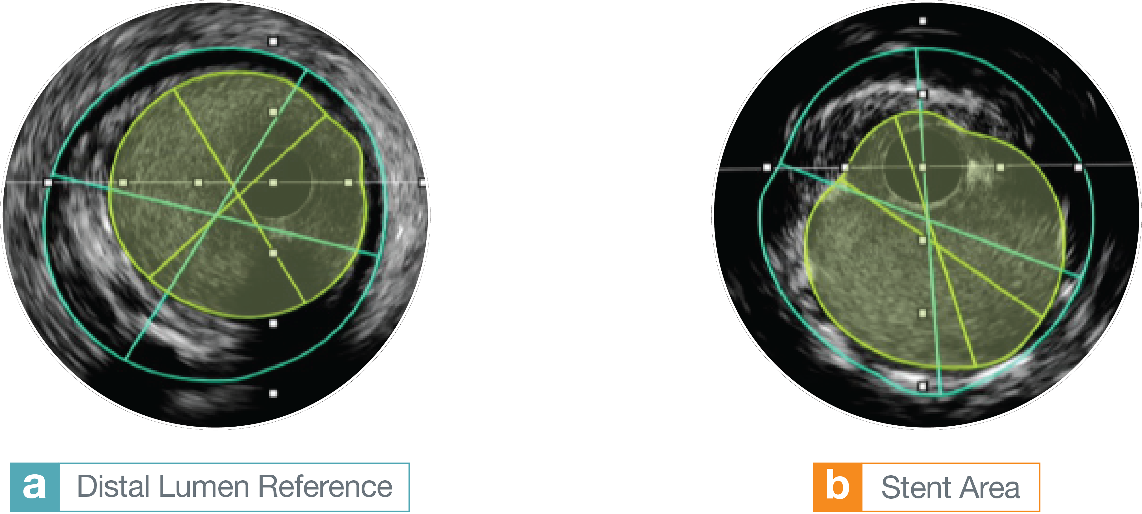


Post-stent workflow
95%
Stent expansion
©2022 Boston Scientific Corporation or its affiliates. All rights reserved. IC-1403502-AA

Slide 13
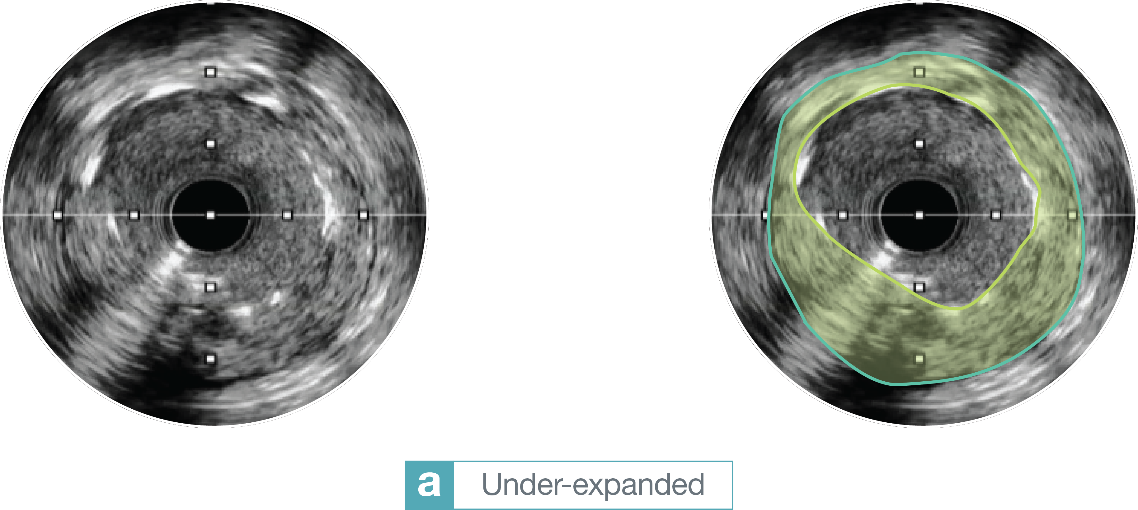

Post-stent workflow
©2022 Boston Scientific Corporation or its affiliates. All rights reserved. IC-1403502-AA

Slide 14

Results from different clinical investigations are not directly comparable. Information provided for educational purposes only. Results from case studies are not necessarily predictive of results in other cases. Results in other cases may vary.
CAUTION: The law restricts these devices to sale by or on the order of a physician. Indications, contraindications, warnings, and instructions for use can be found in the product labelling supplied with each device or at www.IFU-BSCI.com. Products shown for INFORMATION purposes only and may not be approved or for sale in certain countries. This material not intended for use in France.
IC-1403503-AA

