Slide 1
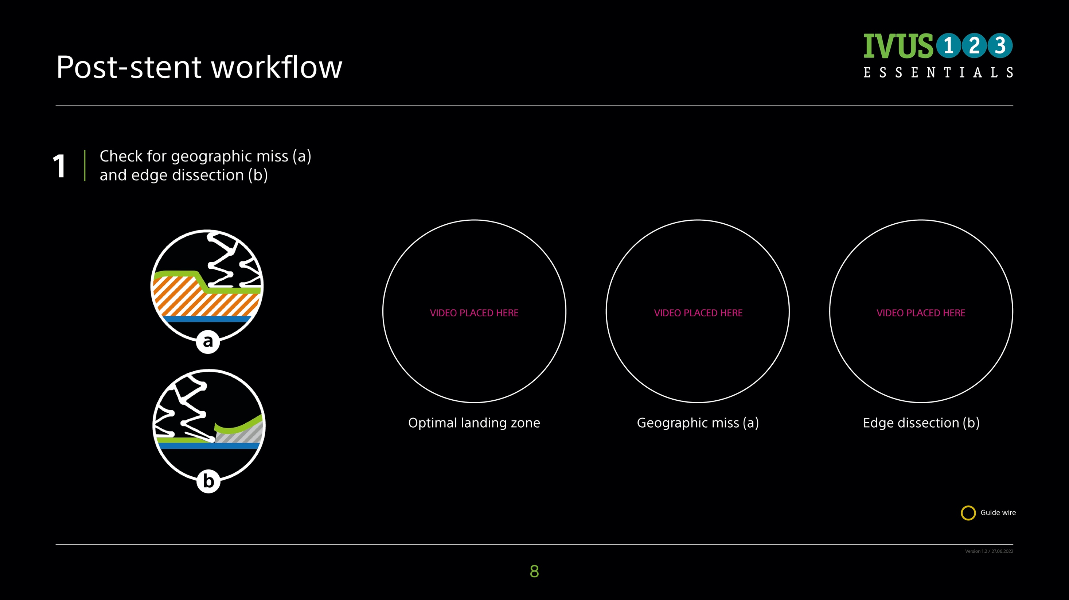
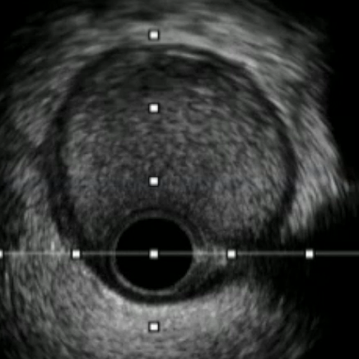
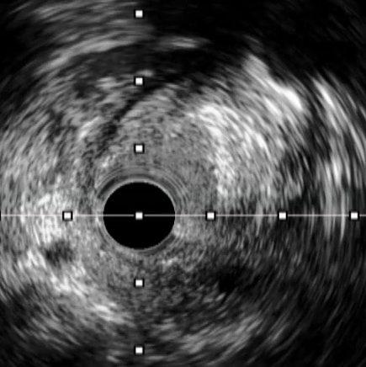
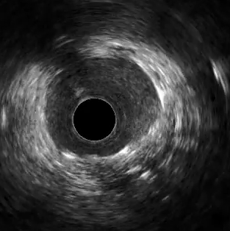

©2022 Boston Scientific Corporation or its affiliates. All rights reserved. IC-1385708-AA

Slide 2
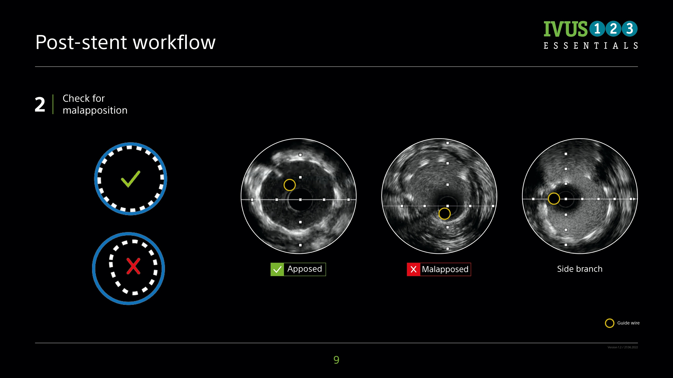
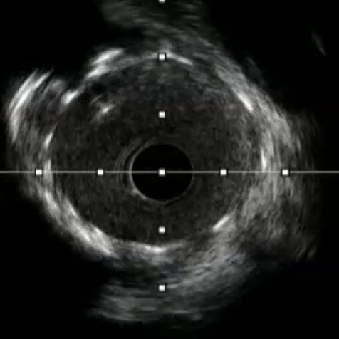
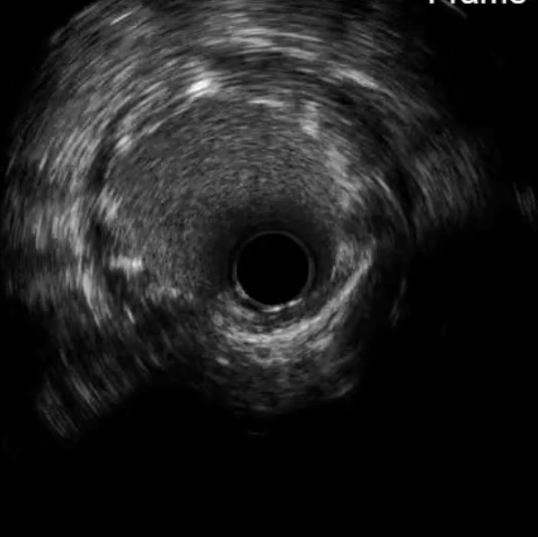
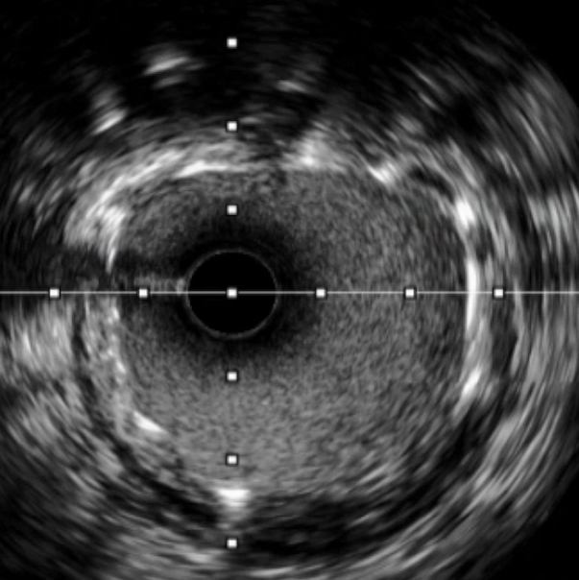
©2022 Boston Scientific Corporation or its affiliates. All rights reserved. IC-1385708-AA

Slide 3
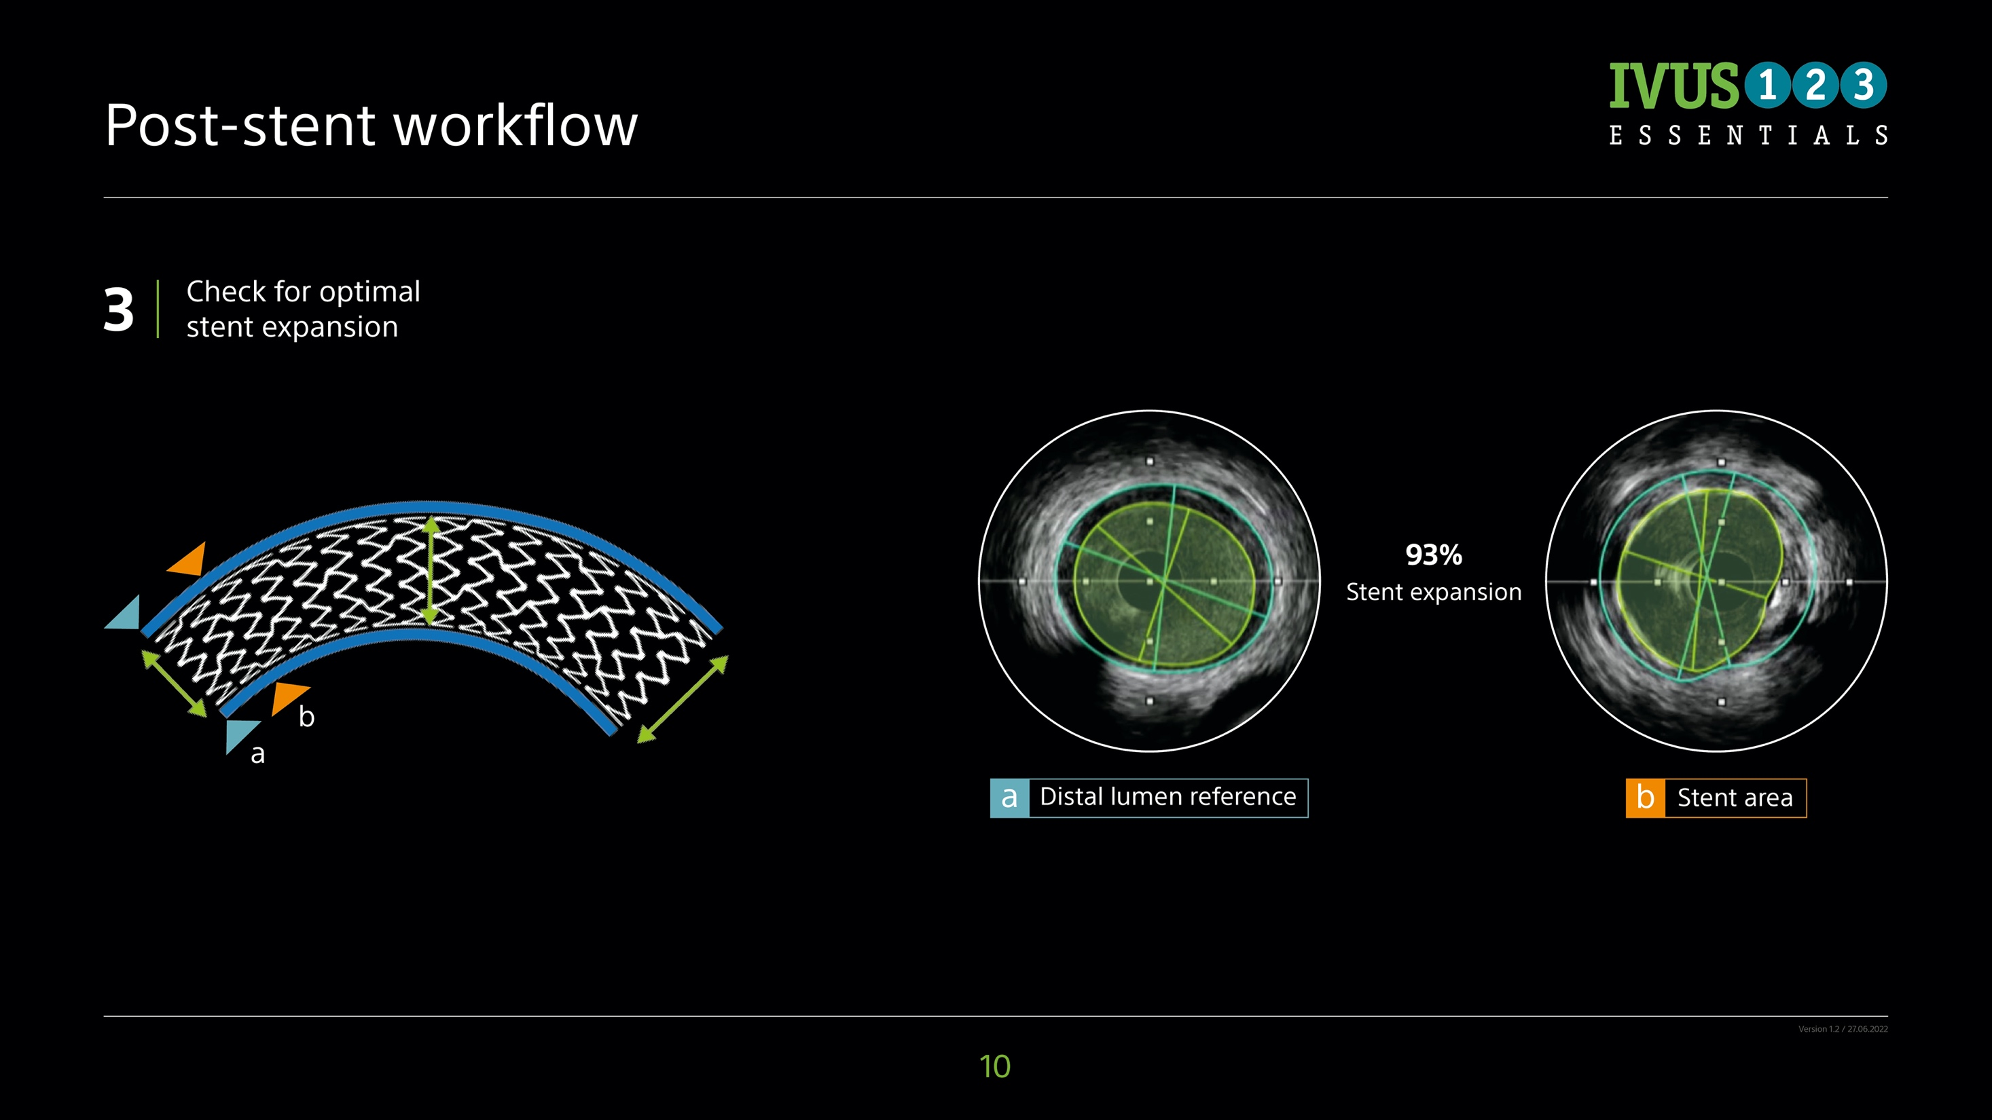
©2022 Boston Scientific Corporation or its affiliates. All rights reserved. IC-1385708-AA

Slide 4
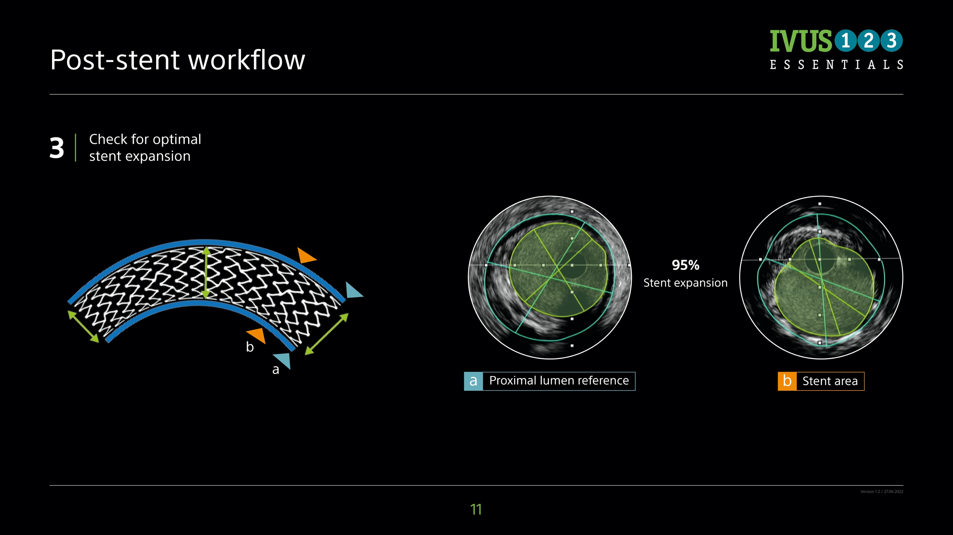
©2022 Boston Scientific Corporation or its affiliates. All rights reserved. IC-1385708-AA

Slide 5
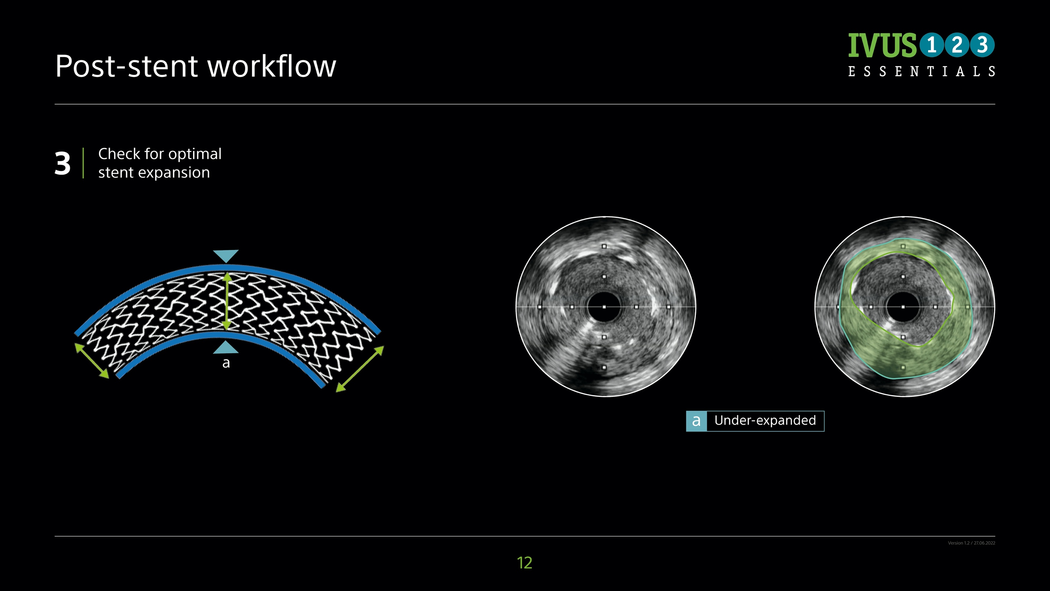
©2022 Boston Scientific Corporation or its affiliates. All rights reserved. IC-1385708-AA

Slide 6
OPTICROSS 6 MDU5 PLUS Sterile Bag
INTENDED USE/INDICATIONS FOR USE This catheter is intended for ultrasound examination of coronary intravascular pathology only. Intravascular ultrasound imaging is indicated in patients who are candidates for transluminal coronary interventional procedures. The MDU5 PLUS Sterile Bag is intended to cover the motordrive during intravascular ultrasound procedures to maintain the sterile field and prevent transfer of microorganisms, body fluids and particulate material to the patient and healthcare worker. CONTRAINDICATIONS Use of this Imaging Catheter is contraindicated where introduction of any catheter would constitute a threat to patient safety. The contraindications also include the following: • Bacteremia or sepsis • Major coagulation system abnormalities • Patients diagnosed with coronary artery spasm • Patients disqualified for CABG surgery • Patients disqualified for PTCA • Severe hemodynamic instability or shock • Use of the imaging catheter to cross a total occlusion WARNINGS • Intravascular ultrasound examination of coronary anatomy should be performed only by physicians fully trained in interventional cardiology or interventional radiology and in the techniques of intravascular ultrasound, and in the specific approach to be used, in a fully-equipped cardiac catheterization lab. • The catheter has no user serviceable parts. Do not attempt to repair or to alter any component of the catheter assembly as provided. • No modification of this equipment is allowed. • Do not pinch, crush, kink or sharply bend the catheter at any time. An insertion angle greater than 45° is considered excessive. • Do not advance the catheter if resistance is encountered. The catheter should never be forcibly inserted into lumens narrower than the catheter body or forced through a tight stenosis. • When advancing the catheter through a stented vessel, catheters that do not completely encapsulate the guidewire may engage the stent between the junction of the catheter and guidewire, resulting in entrapment of catheter/guidewire, catheter tip separation, and/or stent dislocation • If resistance is met upon withdrawal of the catheter, verify resistance using fluoroscopy, then remove the entire system simultaneously. • When readvancing a catheter after deployment of stent(s), at no time should a catheter be advanced across a guidewire that may be passing between one or more stent struts. A guidewire may exit between one or more stent struts when recrossing stent(s). Subsequent advancement of the catheter could cause entanglement between the catheter and the stent(s), resulting in entrapment of catheter/guidewire, catheter tip separation and/or stent dislocation. Use caution when removing the catheter from a stented vessel. • Inadequately apposed stents, overlapping stents, and/or small stented vessels with distal angulation may lead to entrapment of the catheter with the stent upon retraction. When retracting the catheter, separation of a guidewire from an imaging catheter or bending of the guidewire may result in kinking of the guidewire, damage to the catheter distal tip, and/or vessel injury. The looped guidewire or damaged tip may catch on the stent strut resulting in entrapment. PRECAUTIONS • Do not attempt to connect the catheter to electronic equipment other than the designated Systems. • Never attempt to attach or detach the catheter while the motor is running. To do so may damage the connector. • Never advance the imaging catheter without guidewire support because it can cause difficulty in reaching the intended region of interest or can cause the distal catheter tip to kink. • During and after the procedure, inspect the catheter carefully for any damage which may have occurred during use. Multiple insertions may lead to catheter exit port dimension change/distortion which could increase the chance of the catheter catching on the stent. Care should be taken when re-inserting and/or retracting catheter to prevent exit port damage. • Turn the MDU5 PLUS “OFF” before withdrawing the imaging catheter. ADVERSE EVENTS The risks and discomforts involved in vascular imaging include those associated with all catheterization procedures. These risks or discomforts may occur at any time with varying frequency or severity. Additionally, these complications may necessitate additional medical treatment including surgical intervention and, in rare instances, result in death. • Allergic reaction •Angina • Cardiac arrest • Cardiac arrhythmias including, but not limited to ventricular tachycardia, atrial/ventricular fibrillation and complete heart block • Cardiac tamponade/Pericardial effusion • Death • Device entrapment requiring surgical intervention • Embolism (air, foreign body, tissue or thrombus) • Hemorrhage/Hematoma • Hypotension • Infection • Myocardial infarction • Myocardial Ischemia • Stroke and Transient Ischemic Attack • Thrombosis • Vessel occlusion and abrupt closure • Vessel trauma including, but not limited to dissection and perforation
CAUTION: Federal law (USA) restricts this device to sale by or on the order of a physician. Rx only. Prior to use, please see the complete “Directions for Use” for more information on Indications, Contraindications, Warnings, Precautions, Adverse Events, and Operator’s Instructions
91130373 AA

Slide 7
OPTICROSS HD, 6 HD 60 MHz Coronary Imaging Catheters & MDU5 PLUS Bag
INTENDED USE/INDICATIONS FOR USE OptiCross HD, 6 HD: This catheter is intended for ultrasound examination of coronary intravascular pathology only. Intravascular ultrasound imaging is indicated in patients who are candidates for transluminal coronary interventional procedures. MDU5 PLUS Sterile Bag: The MDU5 PLUS Sterile Bag is intended to cover the motordrive during intravascular ultrasound procedures to maintain the sterile field and prevent transfer of microorganisms, body fluids and particulate material to the patient and healthcare worker CONTRAINDICATIONS Use of this imaging catheter is contraindicated where introduction of any catheter would constitute a threat to patient safety. The contraindications also include the following: • Bacteremia or sepsis • Major coagulation system abnormalities • Patients diagnosed with coronary artery spasm • Patients disqualified for CABG surgery • Patients disqualified for PTCA • Severe hemodynamic instability or shock • Use of the imaging catheter to cross a total occlusion WARNINGS • Intravascular ultrasound examination of coronary anatomy should be performed only by physicians fully trained in interventional cardiology or interventional radiology and in the techniques of intravascular ultrasound, and in the specific approach to be used, in a fully-equipped cardiac catheterization lab. • The catheter has no user serviceable parts. Do not attempt to repair or to alter any component of the catheter assembly as provided. Using an altered catheter can result in poor image quality or patient complications. • No modification of this equipment is allowed. • Do not pinch, crush, kink or sharply bend the catheter at any time. An insertion angle greater than 45° is considered excessive. • Do not advance the catheter if resistance is encountered. The catheter should never be forcibly inserted into lumens narrower than the catheter body or forced through a tight stenosis. • When advancing the catheter through a stented vessel, catheters that do not completely encapsulate the guidewire may engage the stent between the junction of the catheter and guidewire, resulting in entrapment of catheter/ guidewire, catheter tip separation, and/or stent dislocation. • If resistance is met upon withdrawal of the catheter, verify resistance using fluoroscopy, then remove the entire system simultaneously. • When readvancing a catheter after deployment of stent(s), at no time should a catheter be advanced across a guidewire that may be passing between one or more stent struts. A guidewire may exit between one or more stent struts when recrossing stent(s). Subsequent advancement of the catheter could cause entanglement between the catheter and the stent(s), resulting in entrapment of catheter/guidewire, catheter tip separation and/or stent dislocation. Use caution when removing the catheter from a stented vessel. • Inadequately apposed stents, overlapping stents, and/or small stented vessels with distal angulation may lead to entrapment of the catheter with the stent upon retraction. When retracting the catheter, separation of a guidewire from an imaging catheter or bending of the guidewire may result in kinking of the guidewire, damage to the catheter distal tip, and/or vessel injury. The looped guidewire or damaged tip may catch on the stent strut resulting in entrapment. PRECAUTIONS • Do not attempt to connect the catheter to electronic equipment other than the designated Systems. • Never attempt to attach or detach the catheter while the motor is running. • If difficulty is encountered when backloading the guidewire into the distal end of the catheter, inspect the guidewire exit port for damage before inserting the catheter into the vasculature. • Never advance the imaging catheter without guidewire support. • Never advance the distal tip of the imaging catheter near the very floppy end of the guidewire. • Never advance or withdraw the imaging catheter without the imaging core assembly being positioned at the most distal position of the imaging window. • During and after the procedure, inspect the catheter carefully for any damage which may have occurred during use. Multiple insertions may lead to catheter exit port dimension change/distortion which could increase the chance of the catheter catching on the stent. Care should be taken when re-inserting and/or retracting catheter to prevent exit port damage. • Turn the MDU5 PLUS “OFF” before withdrawing the imaging catheter. ADVERSE EVENTS The risks and discomforts involved in vascular imaging include those associated with all catheterization procedures. These risks or discomforts may occur at any time with varying frequency or severity. Additionally, these complications may necessitate additional medical treatment including surgical intervention and, in rare instances, result in death. • Allergic reaction • Angina • Cardiac arrest • Cardiac arrhythmias including, but not limited to ventricular tachycardia, atrial/ventricular fibrillation and complete heart block • Cardiac tamponade/Pericardial effusion • Death • Device entrapment requiring surgical intervention • Embolism (air, foreign body, tissue or thrombus) • Hemorrhage/Hematoma • Hypotension • Infection • Myocardial infarction • Myocardial Ischemia • Stroke and Transient Ischemic Attack • Thrombosis • Vessel occlusion and abrupt closure • Vessel trauma including, but not limited to dissection and perforation
CAUTION: Federal law (USA) restricts this device to sale by or on the order of a physician. Rx only. Prior to use, please see the complete “Directions for Use” for more information on Indications, Contraindications, Warnings, Precautions, Adverse Events, and Operator’s Instructions
92201920 AA

Slide 8
OPTICROSS MDU5 PLUS Sterile
INTENDED USE/INDICATIONS FOR USE This catheter is intended for ultrasound examination of coronary intravascular pathology only. Intravascular ultrasound imaging is indicated in patients who are candidates for transluminal coronary interventional procedures. CONTRAINDICATIONS Use of this Imaging Catheter is contraindicated where introduction of any catheter would constitute a threat to patient safety. The contraindications also include the following patient characteristics: • Bacteremia or sepsis • Major coagulation system abnormalities • Patients diagnosed with coronary artery spasm • Patients disqualified for CABG surgery • Patients disqualified for PTCA • Severe hemodynamic instability or shock • Total occlusion WARNINGS • Intravascular ultrasound examination of coronary anatomy should be performed only by physicians fully trained in interventional cardiology or interventional radiology and in the techniques of intravascular ultrasound, and in the specific approach to be used, in a fully-equipped cardiac catheterization lab. • The catheter has no user serviceable parts. Do not attempt to repair or to alter any component of the catheter assembly as provided. • No modification of this equipment is allowed. • Do not pinch, crush, kink or sharply bend the catheter at any time. An insertion angle greater than 45° is considered excessive. • Do not advance the catheter if resistance is encountered. The catheter should never be forcibly inserted into lumens narrower than the catheter body or forced through a tight stenosis. • When advancing the catheter through a stented vessel, catheters that do not completely encapsulate the guidewire may engage the stent between the junction of the catheter and guidewire, resulting in entrapment of catheter/guidewire, catheter tip separation, and/or stent dislocation. • If resistance is met upon withdrawal of the catheter, verify resistance using fluoroscopy, then remove the entire system simultaneously. A catheter that is forcibly removed may cause vessel injury or patient complications. • When readvancing a catheter after deployment of stent(s), at no time should a catheter be advanced across a guidewire that may be passing between one or more stent struts. A guidewire may exit between one or more stent struts when recrossing stent(s). Subsequent advancement of the catheter could cause entanglement between the catheter and the stent(s), resulting in entrapment of catheter/guidewire, catheter tip separation and/or stent dislocation. Use caution when removing the catheter from a stented vessel.
• Inadequately apposed stents, overlapping stents, and/or small stented vessels with distal angulation may lead to entrapment of the catheter with the stent upon retraction. When retracting the catheter, separation of a guidewire from an Imaging Catheter or bending of the guidewire may result in kinking of the guidewire, damage to the catheter distal tip, and/or vessel injury. The looped guidewire or damaged tip may catch on the stent strut resulting in entrapment. PRECAUTIONS • Do not attempt to connect the catheter to electronic equipment other than the designated Systems. • Never attempt to attach or detach the catheter while the motor is running. To do so may damage the connector. • During and after the procedure, inspect the catheter carefully for any damage which may have occurred during use. Multiple insertions may lead to catheter exit port dimension change/distortion which could increase the chance of the catheter catching on the stent. Care should be taken when re-inserting and/or retracting catheter to prevent exit port damage. • Turn the MDU5 PLUS™ “OFF” before withdrawing the Imaging. ADVERSE EVENTS The risks and discomforts involved in vascular imaging include those associated with all catheterization procedures. These risks or discomforts may occur at any time with varying frequency or severity. Additionally, these complications may necessitate additional medical treatment including surgical intervention and, in rare instances, result in death. • Allergic reaction
•Angina • Cardiac arrest • Cardiac arrhythmias including, but not limited to ventricular tachycardia, atrial/ventricular fibrillation and complete heart block • Cardiac tamponade/Pericardial effusion • Death • Device entrapment requiring surgical intervention • Embolism • Hemorrhage/Hematoma • Hypotension • Infection • Myocardial infarction • Myocardial Ischemia • Stroke and Transient Ischemic Attack • Thrombosis • Vessel occlusion and abrupt closure • Vessel trauma including, but not limited to dissection and perforation
CAUTION: Federal law (USA) restricts this device to sale by or on the order of a physician. Rx only. Prior to use, please see the complete “Directions for Use” for more information on Indications, Contraindications, Warnings, Precautions, Adverse Events, and Operator’s Instructions
90960358 AB

