Slide 1
Prostate cancer & treatment options {Presenter name} {Presenter title and affiliation}

Slide 2
[Dr. Name, Credentials]
[insert practice logo here if relevant]
[Practice name]
[Practice location]
[Practice number]
[Practice email and/or website]
[Medical school]
[Residency]
[Fellowship]

Slide 3
Agenda
Prostate cancer overview
Treatment options
Radiation therapy and SpaceOAR™ Hydrogel
Next steps

Slide 4
Prostate cancer overview

Slide 5
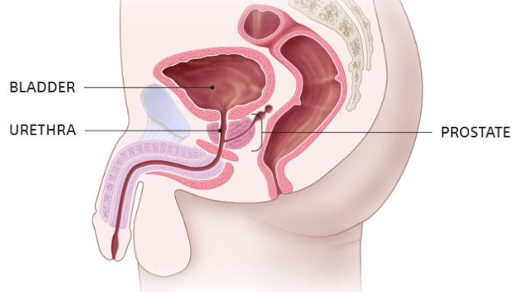
What is the prostate?^{1,2}
Walnut-sized gland at the base of male bladder, next to rectum
Part of the male reproductive and urinary systems
Surrounds the urethra
Supplies fluid that transports sperm during ejaculation
American Cancer Society. What Is Prostate Cancer? https://www.cancer.org/cancer/prostate-cancer/about/what-is-prostate-cancer.html. Accessed May 11, 2022.
Prostate Cancer Foundation. Prostate Gland. Available at: https://www.pcf.org/about-prostate-cancer/what-is-prostate-cancer/prostate-gland/. Accessed May 11, 2022.

Slide 6
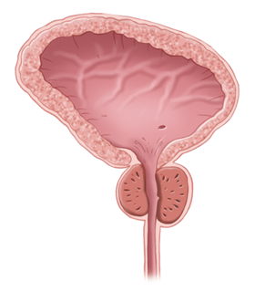
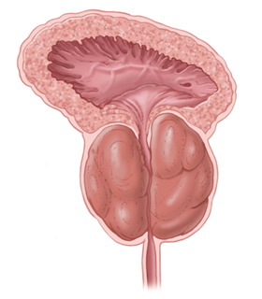
Enlarged prostate vs. prostate cancer ³⁻⁷
Benign prostatic hyperplasia, or BPH, is commonly known as an enlarged prostate.
As men age, the prostate grows in size and can press against the urethra, causing bothersome symptoms.
BPH is not cancer
BPH may exist with cancer
Having an enlarged prostate does not mean you’re at higher risk of developing cancer
Similar symptoms between BPH and prostate cancer include: weak urine flow, difficulty starting and stopping, and increased PSA (prostate-specific antigen) levels
Normal prostate
Enlarged prostate
Barry M, Roehrborn C. Management of benign prostatic hyperplasia. Ann Rev Med. 1997 Feb;48:77-189.
Carter HB. Prostate Disorders: the Johns Hopkins White Papers. Baltimore, MD: Johns Hopkins Medicine. 2010:1-24.
Benign Prostatic Enlargement/Hyperplasia (BPE/BPH). Cleveland Clinic. https://my.clevelandclinic.org/health/diseases/9100-benign-prostatic-enlargement-bph. Last accessed May 11, 2022.
Prostate Cancer. Mayo Clinic. https://www.mayoclinic.org/diseases-conditions/prostate-cancer/symptoms-causes/syc-20353087. Last accessed May 11, 2022.
PSA test. Mayo Clinic. https://www.mayoclinic.org/tests-procedures/psa-test/about/pac-20384731. Last accessed May 11, 2022.

Slide 7
Prostate cancer is the most common cancer among men, after skin cancer.⁸
And five-year survival rates are 98%.⁹
Key Statistics for Prostate Cancer. American Cancer Society. https://www.cancer.org/cancer/prostate-cancer/about/key-statistics.html. Accessed May 11, 2022.
Survival Rates for Prostate Cancer. American Cancer Society. https://www.cancer.org/cancer/prostate-cancer/detection-diagnosis-staging/survival-rates.html. Accessed May 11, 2022.

Slide 8
Prostate cancer statistics⁸⁻¹⁰
Prostate cancer in the United States in 2022:
Estimated new cases
268,490
Estimated deaths
34,500
5-year relative survival rate for localized stage
>99%
5-year relative survival rate for all stages combined
98%
About 1 in 8 men will be diagnosed with prostate cancer during his lifetime.
Key Statistics for Prostate Cancer. American Cancer Society. https://www.cancer.org/cancer/prostate-cancer/about/key-statistics.html. Accessed May 11, 2022.
Survival Rates for Prostate Cancer. American Cancer Society. https://www.cancer.org/cancer/prostate-cancer/detection-diagnosis-staging/survival-rates.html. Accessed May 11, 2022.
Cancer Stat Facts: Prostate Cancer. National Cancer Institute. https://seer.cancer.gov/statfacts/html/prost.html. Accessed May 11, 2022.

Slide 9
Prostate cancer risk factors^{8,11-13}
Age
The chance of having prostate cancer rises rapidly after age 50
Over half of prostate cancer cases are found in men older than 65
Genetics
Most prostate cancer occurs in men without a family history
But having a father or brother with prostate cancer more than doubles risk
Race & Ethnicity
Compared to white men in the U.S.,
Black men are 1.7 times more likely to be diagnosed with prostate cancer
Latino and Hispanic men are 21% less likely to receive treatment
Behaviors & Lifestyle
Some studies suggest chemical exposures, prostatitis and STIs (sexually transmitted infections) may increase risk
Key Statistics for Prostate Cancer. American Cancer Society. https://www.cancer.org/cancer/prostate-cancer/about/key-statistics.html. Accessed May 11, 2022.
ZERO – The End of Prostate Cancer. African Americans and Prostate Cancer. Available at: https://zerocancer.org/learn/about-prostate-cancer/risks/african-americans-prostate-cancer/. Accessed May 11, 2022.
Lichtensztajn D, Leppert JY, Brooks JD, et al. Under-treatment of high-risk localized prostate cancer in the California Latino population. J Natl Compr Canc Netw. 2018 Nov;16(11):1353-60.
Prostate Cancer Risk Factors. American Cancer Society. https://www.cancer.org/cancer/prostate-cancer/causes-risks-prevention/risk-factors.html. Accessed May 11, 2022.

Slide 10
Early detection^{14,15}
Most prostate cancers are first found as a result of screening.
Start talking to your doctor about screening at:
Age 50 | for men at average risk of prostate cancer
Age 45 | for men at high risk of developing prostate cancer (ex. Black men or men with a father or brother who have been diagnosed)
Age 40 | for men at even higher risk (ex. men with several relatives who have been diagnosed)
Screening Tests for Prostate Cancer. American Cancer Society. https://www.cancer.org/cancer/prostate-cancer/detection-diagnosis-staging/tests.html. Accessed May 11, 2022.
Tests to Diagnose and Stage Prostate Cancer. American Cancer Society. https://www.cancer.org/cancer/prostate-cancer/detection-diagnosis-staging/how-diagnosed.html. Accessed May 11, 2022.

Slide 11
Screening for prostate cancer¹⁴
Screening (detection in a patient without symptoms)
The two most common ways we screen:
Prostate-specific antigen (PSA) blood test – tests for elevated PSA in the blood
Digital rectal examination (DRE) – tests for irregularities in the surface of the prostate*
If the results of either of these tests are abnormal, further testing may include:
MRI or transrectal ultrasound – imaging tests of the prostate
Genetic testing – for patients at high genetic risk
Non-screen detected prostate cancer
Patients may be diagnosed without screening during the workup of symptoms (pain, urinary obstruction, bleeding, etc.)
* DRE is shown to be less effective than a PSA test but can sometimes find cancers in men with normal PSA levels
Screening Tests for Prostate Cancer. American Cancer Society. https://www.cancer.org/cancer/prostate-cancer/detection-diagnosis-staging/tests.html. Accessed May 11, 2022.

Slide 12
Diagnosing prostate cancer¹⁵
A prostate biopsy is the only way to confirm the presence and severity of prostate cancer.
In a transrectal or transperineal biopsy, a urologist takes samples of the prostate using a thin, hollow needle
The pathology report will advise your doctor whether any cancerous cells were found
Tests to Diagnose and Stage Prostate Cancer. American Cancer Society. https://www.cancer.org/cancer/prostate-cancer/detection-diagnosis-staging/how-diagnosed.html. Accessed May 11, 2022.

Slide 13
Determining the severity^{15,16}
After diagnosis, your cancer will be graded and staged.
Grading non-metastatic disease:
TNM staging – common cancer staging measuring extent of tumor
Gleason score – a measure specific to prostate cancer
Other factors include:
PSA testing
Imaging
Clinical exam results
Genomic testing
Volume of tumor
Additional risk assessment models and labs
Tests to Diagnose and Stage Prostate Cancer. American Cancer Society. https://www.cancer.org/cancer/prostate-cancer/detection-diagnosis-staging/how-diagnosed.html. Accessed May 11, 2022.
Cancer Staging System. American College of Surgeons. https://www.facs.org/quality-programs/cancer/ajcc/cancer-staging. Accessed May 11, 2022.

Slide 14
TNM cancer staging¹⁶
The TNM staging system is the most used staging system around the world. It determines your cancer stage (0, I, II, III, IV) by measuring:
The extent of the tumor
The extent of spread to the lymph nodes
The presence of metastasis
For prostate cancer, urologists also use the Gleason grading system.
Cancer Staging System. American College of Surgeons. https://www.facs.org/quality-programs/cancer/ajcc/cancer-staging. Accessed May 11, 2022.

Slide 15
Understanding the Gleason score^{15,17}
Prostate cancer is commonly graded by the Gleason score, which assesses abnormal cell growth in the tumor.
Risk Group* | Gleason score
Low/very low | Gleason score < 6
Intermediate | Gleason score 7 (3 + 4)
 | Gleason score 7 (4 + 3)
High/very high | Gleason score 8
 | Gleason score 9-10
A Gleason score of 6 or less is low to very low grade, 7 is intermediate grade, and a score of 8 to 10 is high to very high grade cancer.
* Risk Groups are defined by the Grade Group of the cancer and other measures, including PSA, clinical tumor stage (T stage), PSA density, and number of positive biopsy cores.
Tests to Diagnose and Stage Prostate Cancer. American Cancer Society. https://www.cancer.org/cancer/prostate-cancer/detection-diagnosis-staging/how-diagnosed.html. Accessed May 11, 2022.
Grading Your Cancer. Prostate Cancer Foundation. https://www.pcf.org/about-prostate-cancer/diagnosis-staging-prostate-cancer/gleason-score-isup-grade/. Accessed May 11, 2022.

Slide 16
Treatment options

Slide 17
Treatment options¹⁸⁻²⁰
Most common:
Monitoring the cancer closely over time | Remove prostate tissue surgically | High energy rays or particles to kill cancer cells
Active surveillance | Surgery | Radiation therapy
Other treatments include:
Hormone therapy
Chemotherapy
Cryotherapy
HIFU
Immunotherapy
Targeted therapy
Observation or Active Surveillance for Prostate Cancer. American Cancer Society. https://www.cancer.org/cancer/prostate-cancer/treating/watchful-waiting.html. Accessed May 11, 2022.
Surgery for Prostate Cancer. American Cancer Society. https://www.cancer.org/cancer/prostate-cancer/treating/surgery.html. Accessed May 11, 2022.
Radiation Therapy for Prostate Cancer. American Cancer Society. https://www.cancer.org/cancer/prostate-cancer/treating/radiation-therapy.html. Accessed March 4, 2022.

Slide 18
Active surveillance¹⁸
What is it?
Monitoring the cancer and symptoms closely
Methods of monitoring can include:
PSA tests every 6 months, DREs annually, regular imaging and biopsies
Potential side effects
None known
Not an ideal option for a fast-growing or metastasized cancer
—
—
—
General anesthesia?
Overnight at hospital?
Invasive?
This is not a complete list of all side effects associated with each treatment. You should speak with your doctor about the risks associated with each treatment option.
Active surveillance is not a procedure, and patient experience will differ depending on methods of monitoring.
Observation or Active Surveillance for Prostate Cancer. American Cancer Society. https://www.cancer.org/cancer/prostate-cancer/treating/watchful-waiting.html. Accessed May 11, 2022.

Slide 19
Surgery¹⁹
What is it?
A radical prostatectomy is a procedure to remove part or all of the prostate
Types include:
Open radical prostatectomy – prostate removed through incision in lower abdomen, or less commonly through the perineum
Laparoscopic radical prostatectomy – prostate removed through small incisions, generally robotic-assisted
Potential side effects
Urinary incontinence (ex. urinating more often or leaking)
Sexual dysfunction (ex. erectile and ejaculatory dysfunction)
Loss of fertility
Risks are much like those of any major surgery
Yes
Yes
Yes
General anesthesia?
Overnight at hospital?
Invasive?
This is not a complete list of all side effects associated with each treatment. You should speak with your doctor about the risks associated with each treatment option.
Surgery for Prostate Cancer. American Cancer Society. https://www.cancer.org/cancer/prostate-cancer/treating/surgery.html. Accessed May 11, 2022.

Slide 20
Radiation therapy – EBRT²⁰
What is it?
High-energy rays or particles kill cancer cells
With external beam radiation therapy (EBRT), radiation is delivered from a machine outside of the body
Several types of EBRT are available and commonly used
Treatments are generally outpatient, can take a few minutes and typically painless
Potential side effects
Urinary incontinence (ex. urinating more often or leaking)
Sexual dysfunction (ex. erectile and ejaculatory dysfunction)
Bowel dysfunction (ex. diarrhea, blood in stool, rectal leakage)
Side effects may be reduced by rectal spacer
No
No
No
General anesthesia?
Overnight at hospital?
Invasive?
This is not a complete list of all side effects associated with each treatment. You should speak with your doctor about the risks associated with each treatment option.
Radiation Therapy for Prostate Cancer. American Cancer Society. https://www.cancer.org/cancer/prostate-cancer/treating/radiation-therapy.html. Accessed March 4, 2022.

Slide 21
Radiation therapy – brachytherapy²⁰
What is it?
High-energy rays or particles kill cancer cells
With brachytherapy (internal radiation therapy), radiation is delivered from implanted radioactive pellets, or “seeds,” placed directly into the prostate
Generally used in men with low-grade prostate cancer
Not as commonly available as EBRT
Potential side effects
Urinary incontinence (ex. urinating more often or leaking)
Sexual dysfunction (ex. erectile and ejaculatory dysfunction)
Bowel dysfunction (ex. diarrhea, blood in stool, rectal leakage)
Side effects may be reduced by rectal spacer
Yes*
Yes*
Yes*
General anesthesia?
Overnight at hospital?
Invasive?
This is not a complete list of all side effects associated with each treatment. You should speak with your doctor about the risks associated with each treatment option.
* Only in initial procedure to place the seeds
Radiation Therapy for Prostate Cancer. American Cancer Society. https://www.cancer.org/cancer/prostate-cancer/treating/radiation-therapy.html. Accessed March 4, 2022.

Slide 22
Options in radiation therapy²⁰
OPTIONAL
Presenter may choose to hide or skip slide if not relevant
Remove this notice prior to presenting.
External Beam Radiation Therapy (EBRT)
3-D conformal radiation therapy
Intensity-modulated radiation therapy (IMRT)
Image-guided radiation therapy (IGRT)
Stereotactic body radiation therapy (SBRT)
Proton therapy
Brachytherapy, or internal radiation therapy
Low-dose rate (LDR) implants
High-dose rate (HDR) implants
Permanent implants
Radiation therapy offered will depend on the facility and physician.
Radiation Therapy for Prostate Cancer. American Cancer Society. https://www.cancer.org/cancer/prostate-cancer/treating/radiation-therapy.html. Accessed March 4, 2022.

Slide 23
Other prostate cancer treatment options²¹⁻²⁶
OPTIONAL
Presenter may choose to hide or skip slide if not relevant
Remove this notice prior to presenting.
Cryotherapy
Cold gasses freeze and kill cancer cells under general or epidural anesthesia
Hormone therapy
Aims to reduce levels of male hormones in the body to slow cancer growth
Chemotherapy
Anti-cancer drugs are delivered by IV or taken orally to reach cancer cells through the bloodstream
Immunotherapy
Uses drugs to stimulate the immune system to target and destroy cancerous cells (note: has not been shown to cure prostate cancer)
Targeted therapy
Uses drugs to identify and attack the way a cancer cell grows, divides, repairs itself or interacts with other cells
HIFU
A probe in the rectum delivers high-intensity treatment to targeted areas of the prostate under general anesthesia
You should speak with your doctor about the risks associated with each treatment option.
High-intensity focused ultrasound for the treatment of prostate cancer. Mayo Clinic. https://www.mayoclinic.org/medical-professionals/urology/news/high-intensity-focused-ultrasound-for-the-treatment-of-prostate-cancer/mqc-20519431. Accessed May 11, 2022.
Cryotherapy for Prostate Cancer. American Cancer Society. https://www.cancer.org/cancer/prostate-cancer/treating/cryosurgery.html. Accessed May 11, 2022.
Hormone Therapy for Prostate Cancer. American Cancer Society. https://www.cancer.org/cancer/prostate-cancer/treating/hormone-therapy.html. Accessed May 11, 2022.
Chemotherapy for Prostate Cancer. American Cancer Society. https://www.cancer.org/cancer/prostate-cancer/treating/chemotherapy.html. Accessed May 11, 2022.
Immunotherapy for Prostate Cancer. American Cancer Society. https://www.cancer.org/cancer/prostate-cancer/treating/vaccine-treatment.html. Accessed May 11, 2022.
Targeted Therapy for Prostate Cancer. American Cancer Society. https://www.cancer.org/cancer/prostate-cancer/treating/targeted-therapy.html. Accessed May 11, 2022.

Slide 24
Radiation therapy and SpaceOAR™ Hydrogel
Notes:
Radiation therapy and SpaceOAR™ Hydrogel

Slide 25
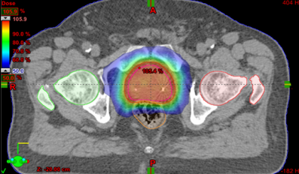
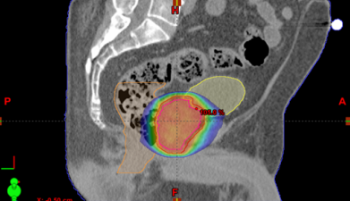
Understanding radiation side effects^{20,27,28}
Prostate proximity to surrounding organs
Possible side effects include urinary, sexual and bowel dysfunction
Rectum is “organ at risk” (OAR) of receiving unintentional radiation
“Rectal toxicity” side effects can include diarrhea, pain, bleeding, frequency/urgency
Rectum
Prostate
Bladder
Urethra
Anal sphincter
Penile bulb
Images courtesy of Varian Medical Systems, Inc. All rights reserved.
Radiation Therapy for Prostate Cancer. American Cancer Society. https://www.cancer.org/cancer/prostate-cancer/treating/radiation-therapy.html. Accessed March 4, 2022.
Prostate Cancer Side Effects. Prostate Cancer Foundation. https://www.pcf.org/about-prostate-cancer/prostate-cancer-side-effects/. Accessed May 11, 2022.
Zelefsky MJ, Pinitpatcharalert A, Kollmeier M, et al. Early tolerance and tumor control outcomes with high-dose ultrahypofractionated radiation therapy for prostate cancer. Eur Urol Oncol. 2020 Dec;3(6):748-55.

Slide 26
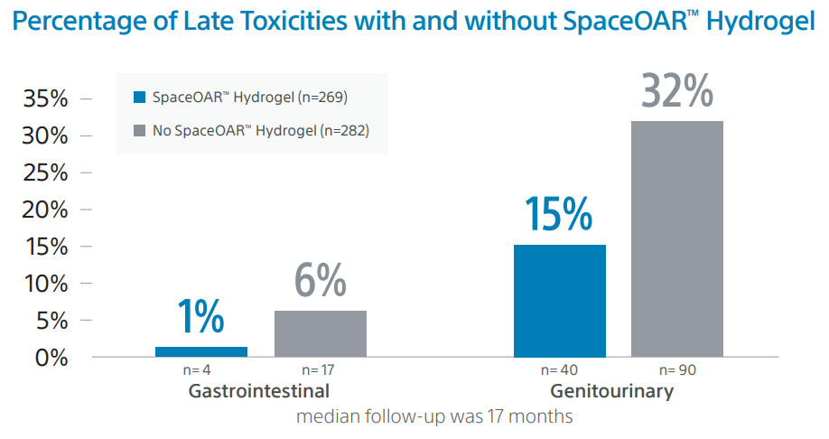
Rectal spacing for radiation therapy²⁸
Results:
In one study on radiation effects to gastrointestinal (digestive) and genitourinary (reproductive & urinary) systems:
551 patients underwent radiation therapy for prostate cancer
269 received SpaceOAR™ Hydrogel as a pre-treatment
“ The use of a hydrogel rectal spacer was significantly associated with reduced late GI toxicity and lower odds of developing late GU toxicity.”
Zelefsky MJ, Pinitpatcharalert A, Kollmeier M, et al. Early tolerance and tumor control outcomes with high-dose ultrahypofractionated radiation therapy for prostate cancer. Eur Urol Oncol. 2020 Dec;3(6):748-55.

Slide 27
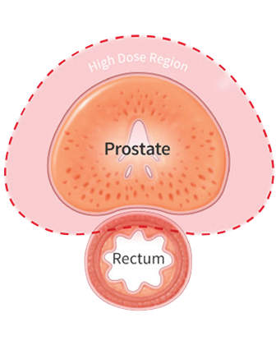
Introducing SpaceOAR™ Hydrogel
SpaceOAR Hydrogel is an absorbable hydrogel that temporarily creates space between the prostate and rectum, designed to reduce radiation dose to the rectum to help minimize the side effects of radiation therapy.²⁹⁻³²
Creates approx. 1.3cm of space between prostate and rectum³⁰
Soft gel material mostly made of water and polyethylene glycol (PEG), which is commonly used in other medical implants²⁹
Brief, outpatient procedure using local or general anesthesia
Stays in place for 3 months, and after approx. 6 months, is naturally absorbed and leaves your body through urine²⁹
There are risks associated with all medical procedures. Please talk to you doctor about the risks and benefits associated with SpaceOAR Hydrogel.
Data on file with Boston Scientific.
Mariados N, Sylvester J, Shah D, et al. Hydrogel spacer prospective multicenter randomized controlled pivotal trial: Dosimetric and clinical effects of perirectal spacer application in men undergoing prostate image guided intensity modulated radiation therapy. Int J Radiat Oncol Biol Phys. 2015 Aug 1;92(5):971-7.
Hamstra DA, Mariados N, Sylvester J, et al. Continued benefit to rectal separation for prostate radiation therapy: Final results of a phase III trial. Int J Radiat Oncol Biol Phys. 2017 Apr 1;97(5):976-85.
Karsh LI, Gross ET, Pieczonka CM, et al. Absorbable hydrogel spacer use in prostate radiotherapy: A comprehensive review of phase 3 clinical trial published data. Urology. 2018 May;115:39-44.

Slide 28
Clinically proven^{31,33}
More space can mean better quality of life.
FEWER BOWEL COMPLICATIONS
FEWER URINARY COMPLICATIONS
FEWER SEXUAL COMPLICATIONS
Three years following treatment, patients experienced 75% less Grade 1 rectal toxicity (ex. urgency, loose stools and frequency)
The use of SpaceOAR Hydrogel reduced the likelihood of a decline in urinary quality of life by 60%
67% of SpaceOAR patients who were potent at baseline had erections sufficient for sex at three years
More than 500 cancer centers around the world purchase SpaceOAR™ Hydrogel, with 220,000 patients to date and growing.^{*29}
Hamstra DA, Mariados N, Sylvester J, et al. Continued benefit to rectal separation for prostate radiation therapy: Final results of a phase III trial. Int J Radiat Oncol Biol Phys. 2017 Apr 1;97(5):976-85.
Hamstra D, Shah D, Kurtzman S, et al. Evaluation of sexual function on a randomized trial of a prostate rectal spacer. J Clin Oncol. 2017 February 20;35(Suppl 6):69.
* Number of patients is based on units shipped and a BSC proprietary algorithm

Slide 29
Dr. Gray: a practitioner and a patient
OPTIONAL
Presenter may choose to hide or skip slide if not relevant
Remove this notice prior to presenting.

Slide 30
Summary^{20,29-31}
Radiation therapy can be extremely effective in treating prostate cancer, but as with any procedure, there are potential side effects.
The prostate is next to the rectum. Due to the proximity, prostate radiation therapy can unintentionally cause damage to the rectum, which can lead to issues with bowel function.
SpaceOAR Hydrogel is designed to temporarily create space between the prostate and the rectum, reducing the radiation dose delivered to the rectum during prostate radiation therapy which may lessen damage to the rectum.
Radiation Therapy for Prostate Cancer. American Cancer Society. https://www.cancer.org/cancer/prostate-cancer/treating/radiation-therapy.html. Accessed March 4, 2022.
Data on file with Boston Scientific.
Mariados N, Sylvester J, Shah D, et al. Hydrogel spacer prospective multicenter randomized controlled pivotal trial: Dosimetric and clinical effects of perirectal spacer application in men undergoing prostate image guided intensity modulated radiation therapy. Int J Radiat Oncol Biol Phys. 2015 Aug 1;92(5):971-7.
Hamstra DA, Mariados N, Sylvester J, et al. Continued benefit to rectal separation for prostate radiation therapy: Final results of a phase III trial. Int J Radiat Oncol Biol Phys. 2017 Apr 1;97(5):976-85.

Slide 31
Next steps
Know your risk level
Talk to your doctor about screening
Learn more about treatment options
Resources:
American Cancer Society: cancer.org
ZERO Prostate: zerocancer.org
The Prostate Health Education Network: prostatehealthed.org
Learn more about SpaceOAR:
Text “spaceoar” to 73771
Speak to a patient education coordinator at (781) 527-4675
Visit SpaceOAR.com

Slide 32
Questions?

Slide 33
References
American Cancer Society. What Is Prostate Cancer? https://www.cancer.org/cancer/prostate-cancer/about/what-is-prostate-cancer.html. Accessed May 11, 2022.
Prostate Cancer Foundation. Prostate Gland. Available at: https://www.pcf.org/about-prostate-cancer/what-is-prostate-cancer/prostate-gland/. Accessed May 11, 2022.
Barry M, Roehrborn C. Management of benign prostatic hyperplasia. Ann Rev Med. 1997 Feb;48:77-189.
Carter HB. Prostate Disorders: the Johns Hopkins White Papers. Baltimore, MD: Johns Hopkins Medicine. 2010:1-24.
Benign Prostatic Enlargement/Hyperplasia (BPE/BPH). Cleveland Clinic. https://my.clevelandclinic.org/health/diseases/9100-benign-prostatic-enlargement-bph. Last accessed May 11, 2022.
Prostate Cancer. Mayo Clinic. https://www.mayoclinic.org/diseases-conditions/prostate-cancer/symptoms-causes/syc-20353087. Last accessed May 11, 2022.
PSA test. Mayo Clinic. https://www.mayoclinic.org/tests-procedures/psa-test/about/pac-20384731. Last accessed May 11, 2022.
Key Statistics for Prostate Cancer. American Cancer Society. https://www.cancer.org/cancer/prostate-cancer/about/key-statistics.html. Accessed May 11, 2022.
Survival Rates for Prostate Cancer. American Cancer Society. https://www.cancer.org/cancer/prostate-cancer/detection-diagnosis-staging/survival-rates.html. Accessed May 11, 2022.
Cancer Stat Facts: Prostate Cancer. National Cancer Institute. https://seer.cancer.gov/statfacts/html/prost.html. Accessed May 11, 2022.
ZERO – The End of Prostate Cancer. African Americans and Prostate Cancer. Available at: https://zerocancer.org/learn/about-prostate-cancer/risks/african-americans-prostate-cancer/. Accessed May 11, 2022.
Lichtensztajn D, Leppert JY, Brooks JD, et al. Under-treatment of high-risk localized prostate cancer in the California Latino population. J Natl Compr Canc Netw. 2018 Nov;16(11):1353-60.
Prostate Cancer Risk Factors. American Cancer Society. https://www.cancer.org/cancer/prostate-cancer/causes-risks-prevention/risk-factors.html. Accessed May 11, 2022.
Screening Tests for Prostate Cancer. American Cancer Society. https://www.cancer.org/cancer/prostate-cancer/detection-diagnosis-staging/tests.html. Accessed May 11, 2022.
Tests to Diagnose and Stage Prostate Cancer. American Cancer Society. https://www.cancer.org/cancer/prostate-cancer/detection-diagnosis-staging/how-diagnosed.html. Accessed May 11, 2022.
Cancer Staging System. American College of Surgeons. https://www.facs.org/quality-programs/cancer/ajcc/cancer-staging. Accessed May 11, 2022.
Grading Your Cancer. Prostate Cancer Foundation. https://www.pcf.org/about-prostate-cancer/diagnosis-staging-prostate-cancer/gleason-score-isup-grade/. Accessed May 11, 2022.
Observation or Active Surveillance for Prostate Cancer. American Cancer Society. https://www.cancer.org/cancer/prostate-cancer/treating/watchful-waiting.html. Accessed May 11, 2022.
Surgery for Prostate Cancer. American Cancer Society. https://www.cancer.org/cancer/prostate-cancer/treating/surgery.html. Accessed May 11, 2022.
Radiation Therapy for Prostate Cancer. American Cancer Society. https://www.cancer.org/cancer/prostate-cancer/treating/radiation-therapy.html. Accessed March 4, 2022.
High-intensity focused ultrasound for the treatment of prostate cancer. Mayo Clinic. https://www.mayoclinic.org/medical-professionals/urology/news/high-intensity-focused-ultrasound-for-the-treatment-of-prostate-cancer/mqc-20519431. Accessed May 11, 2022.

Slide 34
References
Cryotherapy for Prostate Cancer. American Cancer Society. https://www.cancer.org/cancer/prostate-cancer/treating/cryosurgery.html. Accessed May 11, 2022.
Hormone Therapy for Prostate Cancer. American Cancer Society. https://www.cancer.org/cancer/prostate-cancer/treating/hormone-therapy.html. Accessed May 11, 2022.
Chemotherapy for Prostate Cancer. American Cancer Society. https://www.cancer.org/cancer/prostate-cancer/treating/chemotherapy.html. Accessed May 11, 2022.
Immunotherapy for Prostate Cancer. American Cancer Society. https://www.cancer.org/cancer/prostate-cancer/treating/vaccine-treatment.html. Accessed May 11, 2022.
Targeted Therapy for Prostate Cancer. American Cancer Society. https://www.cancer.org/cancer/prostate-cancer/treating/targeted-therapy.html. Accessed May 11, 2022.
Prostate Cancer Side Effects. Prostate Cancer Foundation. https://www.pcf.org/about-prostate-cancer/prostate-cancer-side-effects/. Accessed May 11, 2022.
Zelefsky MJ, Pinitpatcharalert A, Kollmeier M, et al. Early tolerance and tumor control outcomes with high-dose ultrahypofractionated radiation therapy for prostate cancer. Eur Urol Oncol. 2020 Dec;3(6):748-55.
Data on file with Boston Scientific.
Mariados N, Sylvester J, Shah D, et al. Hydrogel spacer prospective multicenter randomized controlled pivotal trial: Dosimetric and clinical effects of perirectal spacer application in men undergoing prostate image guided intensity modulated radiation therapy. Int J Radiat Oncol Biol Phys. 2015 Aug 1;92(5):971-7.
Hamstra DA, Mariados N, Sylvester J, et al. Continued benefit to rectal separation for prostate radiation therapy: Final results of a phase III trial. Int J Radiat Oncol Biol Phys. 2017 Apr 1;97(5):976-85.
Karsh LI, Gross ET, Pieczonka CM, et al. Absorbable hydrogel spacer use in prostate radiotherapy: A comprehensive review of phase 3 clinical trial published data. Urology. 2018 May;115:39-44.
Hamstra D, Shah D, Kurtzman S, et al. Evaluation of sexual function on a randomized trial of a prostate rectal spacer. J Clin Oncol. 2017 February 20;35(Suppl 6):69.

Slide 35
Disclaimers
Results from case studies are not necessarily predictive of results in other cases. Results in other cases may vary.
Content of this presentation is for Information Purposes only and does not constitute medical advice. BSC strongly recommends that you consult with your physician on all matters pertaining to your health or to address any questions.
SpaceOAR Hydrogel is intended to temporarily move the rectal wall away from the prostate during the course of radiotherapy treatment for prostate cancer, and in creating this space it is the intent of SpaceOAR Hydrogel to reduce the radiation dose affecting the rectum.
SpaceOAR Hydrogel contains polyethylene glycol (PEG). As with any medical treatment, there are some risks involved with the use of SpaceOAR Hydrogel. Potential complications associated with SpaceOAR Hydrogel include, but are not limited to: pain associated with injection, pain or discomfort from the hydrogel, site inflammation, infection (including abscess), inability to urinate, urgent need to urinate, constipation, rectal muscle spasm, damage to lining of rectum, ulcers, fistula (a hole between rectum and bladder, urethra, or skin below the scrotum), perforation (hole in prostate, bladder, urethra, rectum), necrosis (dead tissue), allergic reaction (local reaction or more severe reaction, such as anaphylaxis), embolism (blood vessel blockage is possible and may happen outside of the pelvis, potentially impacting vital organs or legs), fainting, and bleeding. Please talk to your doctor about the risks and benefits related to using SpaceOAR Hydrogel. If one or more of these complications occur, you may need medical treatment or surgery. URO-1288805-AA
Caution: U.S. Federal law restricts this device to sale by or on the order of a physician.
CAUTION: The law restricts these devices to sale by or on the order of a physician. Indications, contraindications, warnings, and instructions for use can be found in the product labelling supplied with each device or at www.IFU-BSCI.com. Products shown for INFORMATION purposes only and may not be approved or for sale in certain countries. This material not intended for use in France.
This material provides links to web sites operated by third parties. Please refer to the separate terms of use, privacy policies, and other rules posted on these linked sites before you use them. Third party links are provided merely as a convenience to you, and the inclusion of any link does not imply affiliation or endorsement by BSC. BSC does not review, monitor or check the accuracy of content published on third party sites, and is not responsible for the availability of, and content provided on, third party sites. If you choose to purchase any products and/or services from a third party, your relationship is directly with the third party, and BSC is not responsible in any way for any loss and/or damage of any sort you may incur from dealing with any third party. Third party web sites may contain information about uses of products that have not been approved or cleared by the U.S. Food and Drug Administration. BSC does not endorse the off-label use of any of our products.
All images are the property of Boston Scientific. All trademarks are the property of their respective owners.
© 2022 Boston Scientific Corporation or its affiliates. All rights reserved. URO-810801-AB JUN 2022

