Slide 1
WATCHMAN™
Device Implant Overview
www.watchmandevice.com

Slide 2
IMPORTANT INFORMATION
These materials are intended to describe common clinical considerations and procedural steps for the on-label use of referenced technologies as well as current standards of care for certain conditions. Of course, patients and their medical circumstances vary, so the clinical considerations and procedural steps described may not be appropriate for every patient or case. As always, decisions surrounding patient care depend on the physician’s professional judgment in light of all available information for the case at hand.
Boston Scientific (BSC) does not promote or encourage the use of its devices outside their approved labeling. Boston Scientific does not have an FDA-approved ablation catheter for the treatment of atrial fibrillation.
The presenter’s experience with BSC products may not be interpreted or relied upon to support clinical claims about BSC devices or product comparison claims regarding BSC and competitive devices. The experiences of other users may vary.
All Images on file with BSCI. All case studies presented are not necessarily representative of clinical outcomes in all cases as individual results may vary. All material, graphs, data and charts sourcing is on file with the presenter and are the property of their respective copyright owner.

Slide 3
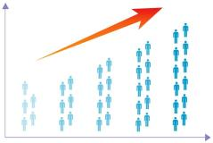
AF is a Growing Problem Associated with Greater Morbidity and Mortality
AF = most common cardiac arrhythmia, and growing
AF increases risk of stroke
  Higher stroke risk for older patients and those with prior stroke or TIA
  15-20% of all strokes are AF-related
  AF results in greater disability compared to non-AF-related stroke
  High mortality and stroke recurrence rate
12M
<
5M
‘15 ‘20 ‘30 ’40 ‘50
~5 M
people with AF in U.S., expected to more than double by 2050¹
5x
greater risk of stroke with AF²
Go AS. et al, Heart Disease and Stroke Statistics—2013 Update: A Report From the American Heart Association. Circulation. 2013; 127: e6-e245.
Holmes DR, Atrial Fibrillation and Stroke Management: Present and Future, Seminars in Neurology 2010;30:528–536.

Slide 4

WATCHMAN™ LAAC Device
WATCHMAN™ LAAC Device:
  Reduces risk of thromboembolism from the left atrial appendage in patients with non-valvular atrial fibrillation
For patients who:
  Are at increased risk for stroke or systemic embolism based on CHADS₂ or CHA₂DS₂-VASc scores and are recommended for anticoagulation therapy
  Are deemed by their physicians to be suitable for warfarin
  Have an appropriate rationale to seek a non-pharmacologic alternative to warfarin, taking into account the safety and effectiveness of the device compared to warfarin

Slide 5
Agenda
WATCHMAN™ Left Atrial Appendage Closure
System Components
WATCHMAN™ Implant Procedure
WATCHMAN™ Post-Implant Follow-Up

Slide 6
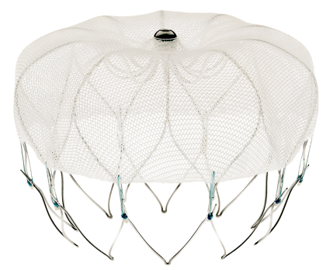
WATCHMAN™ LAAC Closure Device
    Minimally Invasive, Local Solution
Available sizes: 21, 24, 27, 30, 33 mm diameter
Intra-LAA design
    Avoids contact with left atrial wall to help prevent complications
Nitinol Frame
    Conforms to unique anatomy of the LAA to reduce embolization risk
    10 active fixation anchors - designed to engage tissue for stability
  Proximal Face
    Minimizes surface area facing the left atrium to reduce post-implant thrombus formation
    160 micron membrane PET cap designed to block emboli and promote healing
Warfarin Cessation
    92% after 45 days, >99% after 12 months¹
    95% implant success rate¹
160 Micron Membrane
Anchors
1. Holmes, DR et al. JACC 2014; Vol. 64, No. 1

Slide 7
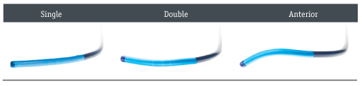
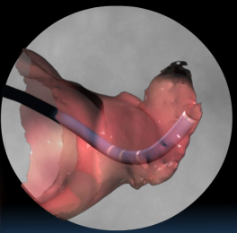
WATCHMAN™ Access Sheath
WATCHMAN™ Access Sheath
14F outer diameter (4.7mm), 12F inner diameter (4mm)
75 cm working length
Preformed access sheath curve shapes guide position in LAA

Slide 8
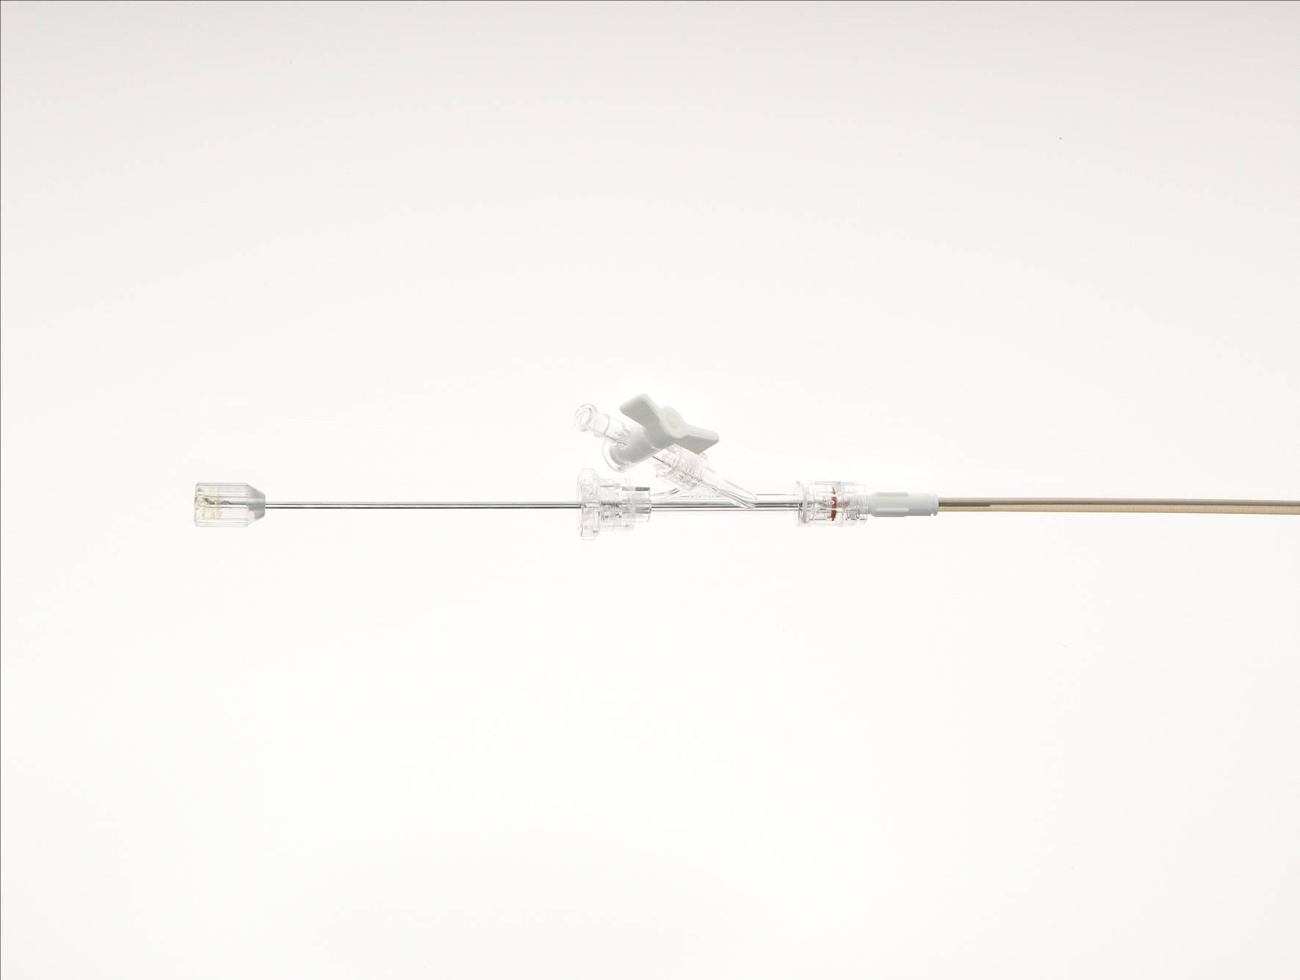
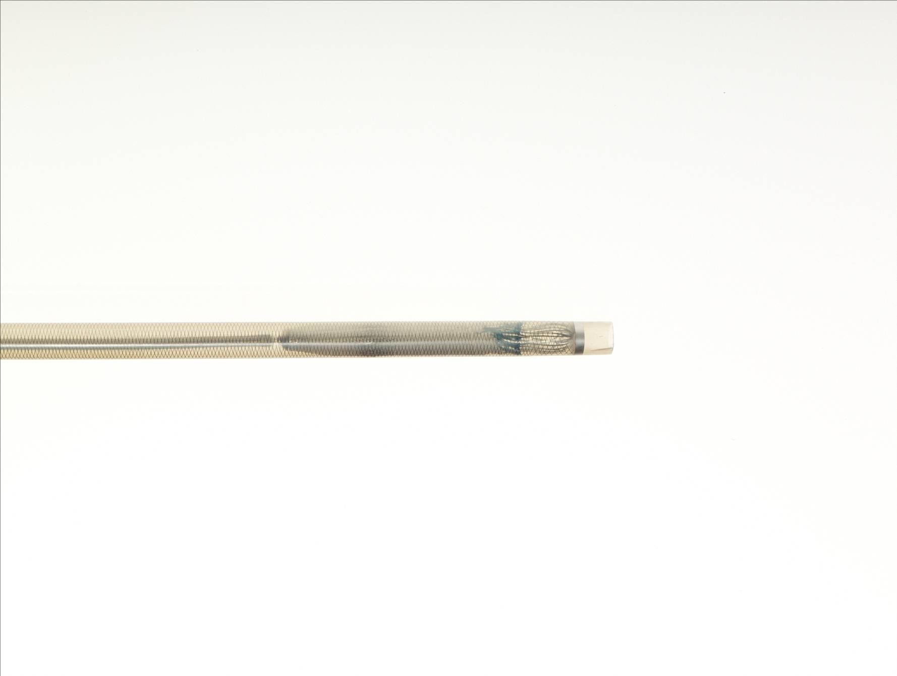
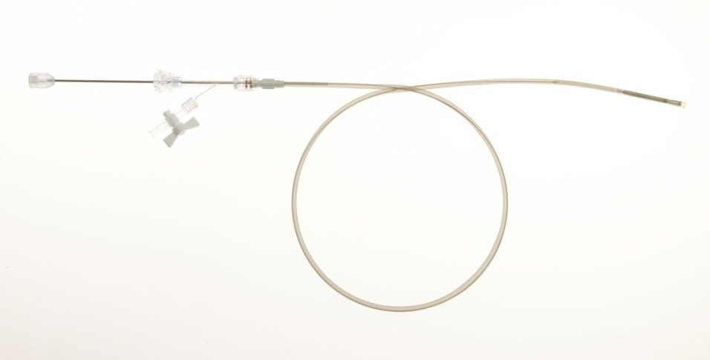
WATCHMAN™ Delivery Sheath
Deployment Knob
Core Wire
Hemostasis Valve
Distal Marker Band
Constrained Device
12F outer diameter
Compatible with all five device sizes

Slide 9
Agenda
WATCHMAN™ Left Atrial Appendage Closure
System Components
WATCHMAN™ Implant Procedure
WATCHMAN™ Post-Implant Follow-Up

Slide 10
WATCHMAN Implant Procedure Review
Procedure Equipment
LAA Anatomy/Assessment
  Ostium size, LAA type, considerations
Transseptal (IAS) Crossing
WATCHMAN™ Access Sheath Navigation/Manipulation
WATCHMAN™ Device Deployment
Device Release Criteria – P.A.S.S.
Device Recapture
Final Device Release

Slide 11

1. WATCHMAN Procedure Equipment
WATCHMAN Delivery System (delivery catheter and pre-loaded LAA closure device)
Venous Introducer (optional)
Standard Transseptal Access System
0.035” Guidewire (exchange length extra support)
5F or 6F angiographic pigtail catheter
WATCHMAN® Access System (which includes the access sheath and dilator)
TEE
Heparin – minimum ACT of 200-300sec throughout procedure
Add’l equipment necessary for complex cardiovascular intervention, per hospital procedure

Slide 12
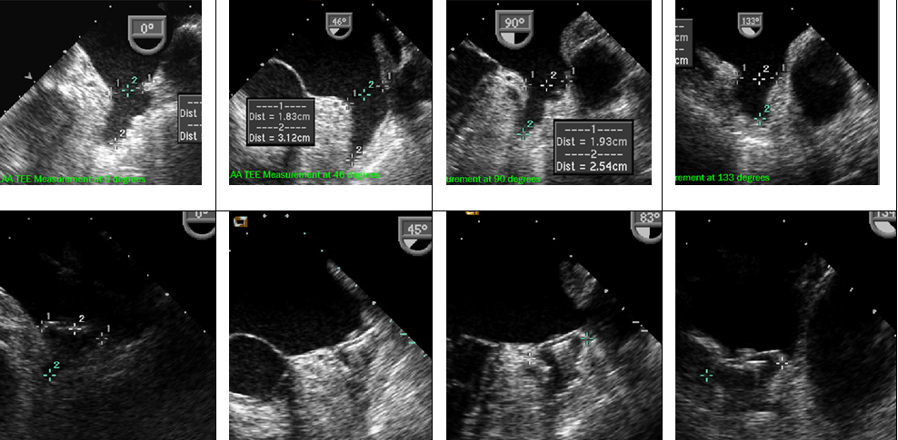

2. LAA Anatomy / Assessment
Ostium size and shape
Assess the following through multiple imaging planes (0 - 135 deg sweep):
  LAA size /shape, number of lobes in LAA and location of lobes relative to ostium
Record LAA ostium and LAA length measurements (0 - 135 deg sweep):
Measure the LAA ostium at approximately these angles:
  at 0º
  at 45º
  at 90º measure from top of the MV annulus to a point 2cm from tip of the “limbus”
  at 135º
Measure the approximate LAA usable length from the ostium line to the apex of the LAA
    measure from coronary artery marker to a point 2cm from tip of the “limbus”

Slide 13
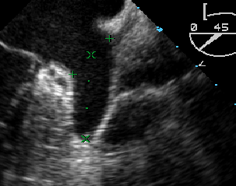
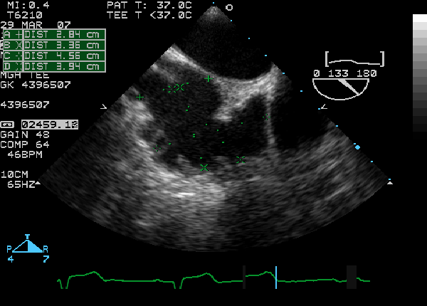
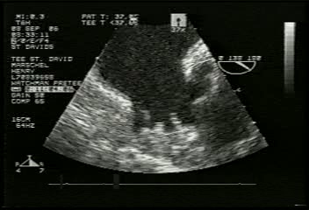
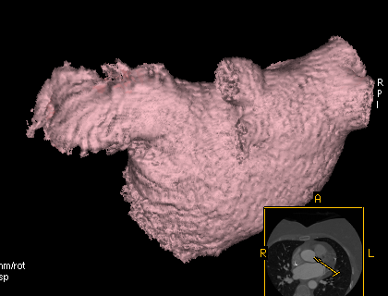
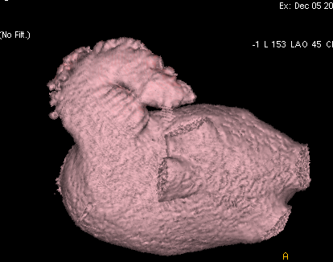
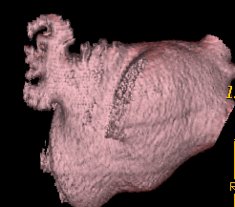
2. LAA Anatomy / Assessment
Morphology
Wind Sock:
An anatomy in which one dominant lobe of sufficient length is the primary structure
Chicken Wing:
An anatomy whose main feature is a sharp bend in the dominant lobe of the LAA at some distance from the perceived LAA ostium
Broccoli:
An anatomy whose main feature is an LAA that has limited overall length with more complex internal characteristics

Slide 14
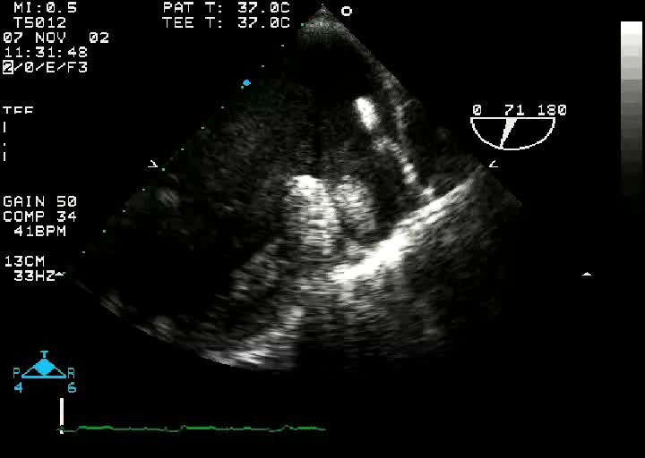
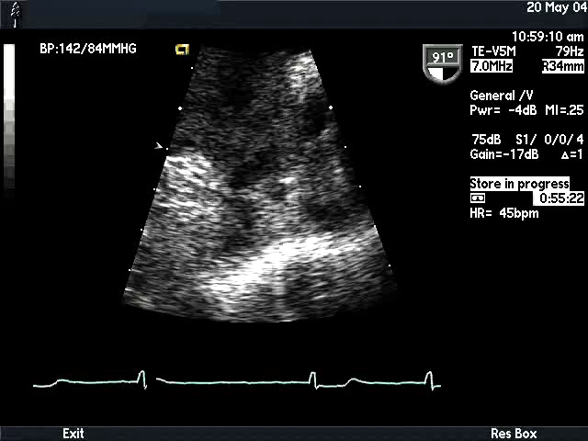
2. LAA Anatomy / Assessment
Absence of Thrombus
  Use Color Doppler and echo contrast as necessary

Slide 15
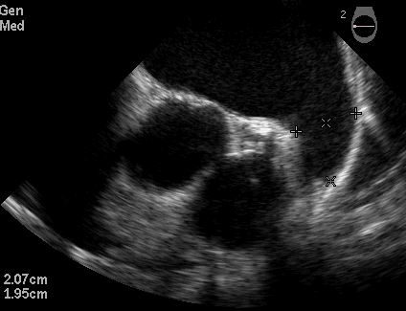
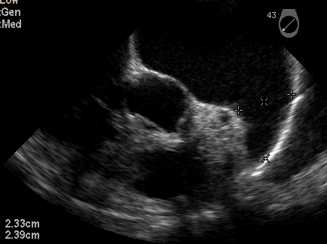
2. LAA Anatomy / Assessment
Proper device sizing
Maximum LAA Ostium (mm) | Device Size (mm)
17-19 | 21
20-22 | 24
23-25 | 27
26-28 | 30
29-31 | 33
  Maximum LAA ostium and LAA depth measurements determine device size selection
  Maximum LAA ostium size should be >17mm or <31mm to accommodate available device sizes
  Available/useable LAA length should be equal to or greater than the ostium

Slide 16
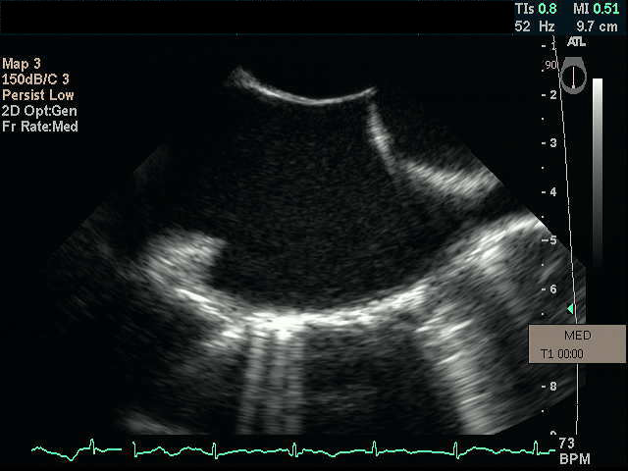
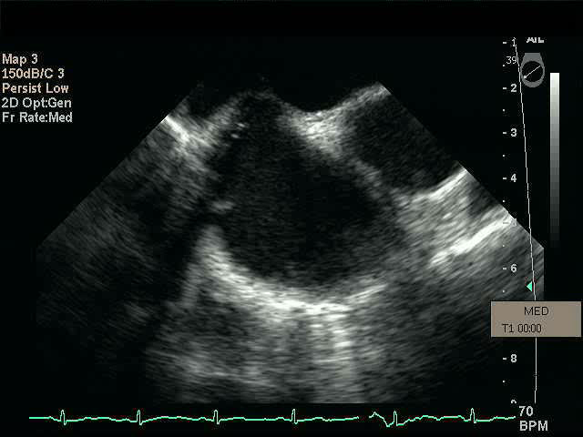
3. Transseptal (IAS) Crossing
Suggested crossing location – posterior and inferior
Preferred use of bicaval and short axis views to confirm position in TEE
  Inferior on short axis, posterior on bicaval
Preferred exchange of guidewire to WATCHMAN™ Access Sheath in LUPV or left atrium
Carefully advance 6F pigtail through Access Sheath into distal portion of LAA under fluoro guidance
Carefully advance Access Sheath over pigtail catheter in multiple angio and echo views
Bicaval view: Poster
Short axis: Inferior

Slide 17
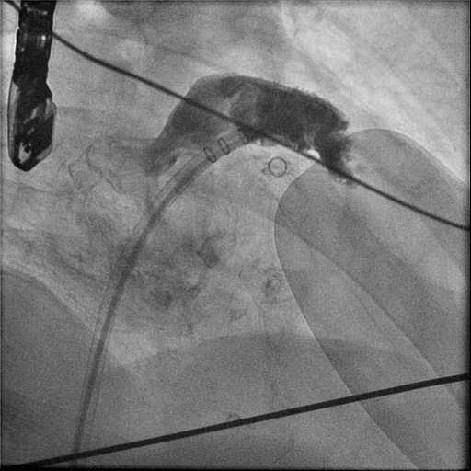
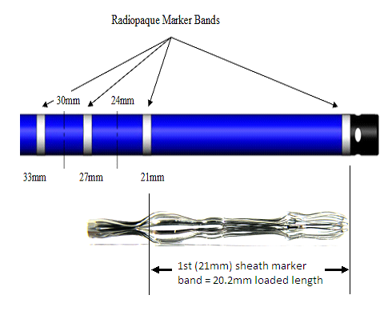
4. WATCHMAN™ Access Sheath Navigation/Manipulation
Access Sheath Marker Band | Loaded Device Length*
21mm | 20.2mm
24mm | 22.9mm
27mm | 26.5mm
30mm | 29.4mm
33mm | 31.5mm
Marker bands
Radiopaque marker bands guide initial sheath placement/depth in the LAA
Align radiopaque marker band corresponding to device size until at or just distal to LAA ostium
To better visualize complex LAA anatomy and verify access sheath tip position:
  Obtain multiple views with:
    Angiography (min. RAO cranial/caudal)
    TEE (min. 0° - 135° sweep)

Slide 18
5. WATCHMAN™ Device Deployment
Maximum LAA Ostium | Device Size (uncompressed diameter) | Maximum (20%) Compression Measured Diameter* | Minimum (8%) Compression Measured Diameter*
17-19 mm | 21 mm | 16.8 mm | 19.3 mm
20-22 mm | 24 mm | 19.2 mm | 22.1 mm
23-25 mm | 27 mm | 21.6 mm | 24.8 mm
26-28 mm | 30 mm | 24.0 mm | 27.6 mm
29-31 mm | 33 mm | 26.4 mm | 30.4 mm
Select device based on maximum LAA ostium width recorded; LAA depth must be at least as long as the LAA ostium width
Confirm distal tip of constrained device aligned with distal marker band of Delivery System
Maintain fluid to fluid connection when inserting Delivery Sheath into Access Sheath
  Switch manifold/contrast to delivery system
*Measure in-situ device diameter at approximate TEE angles of 0, 45, 90 and 135 degrees to accurately assess device compression
Constrained Device
Distal Marker Band

Slide 19
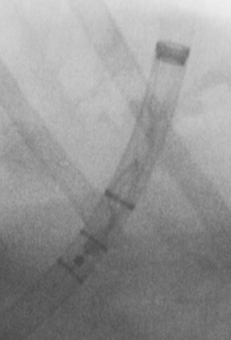
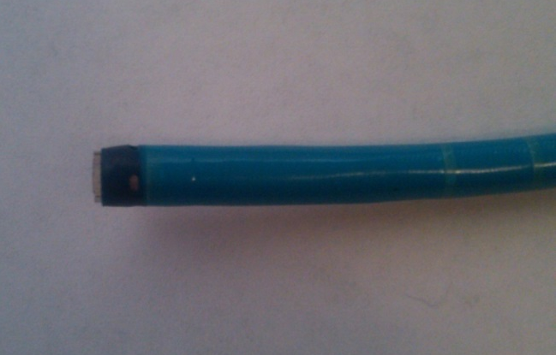
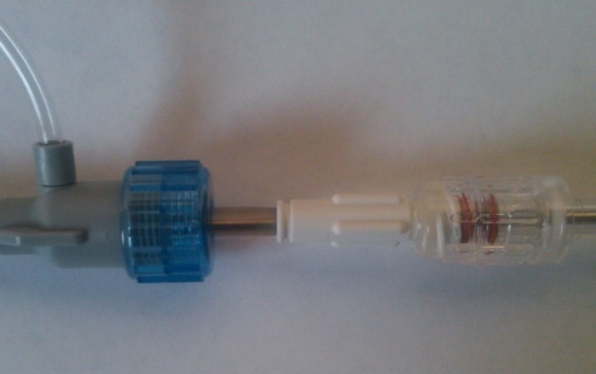
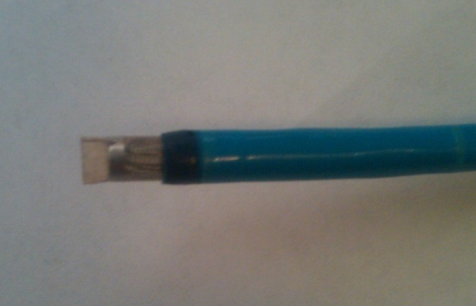
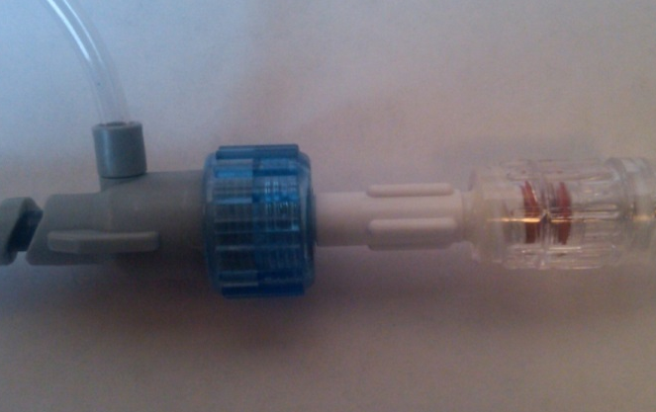
5. WATCHMAN™ Device Deployment
On fluoro, align most distal marker band on Delivery System with most distal marker band on Access Sheath
Stabilize WATCHMAN Delivery System, retract Access Sheath and snap together
=
Disconnected Delivery/Access Sheaths
=
Connected WATCHMAN System

Slide 20
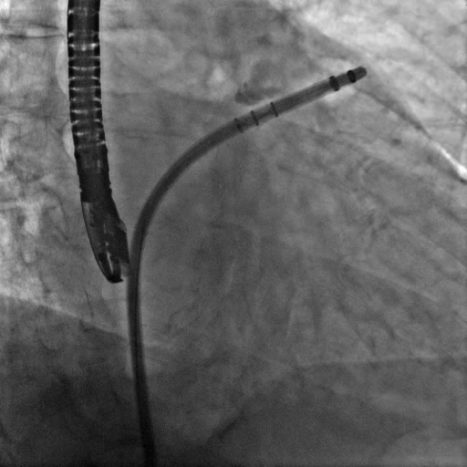
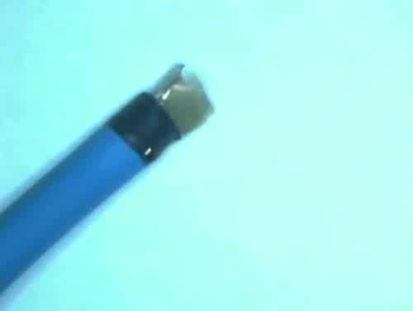
5. WATCHMAN™ Device Deployment
Observe distal end of device to ensure no forward motion (or repositioning relative to ostium) has occurred
  Tactile feel may be decreased, risk of complications may be increased
Loosen hemostasis valve on Delivery System, hold deployment knob stationary, retract Access Sheath/Delivery System assembly to deploy device
Unsheath device using slow stable motion for optimal control (at least 3-5 seconds), ensure distal tip remains in desired position

Slide 21
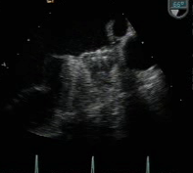
6. Device Release Criteria – P.A.S.S.
WATCHMAN™ Device features one-step deployment
Recapturable and Repositionable
All criteria must be met prior to device release (PASS)
  Position – device is at the ostium of the LAA
  Anchor – fixation anchors engaged / device is stable
  Size – device is compressed 8-20% of original size
  Seal – device spans ostium, all lobes of LAA are covered
Caution: Investigational device limited to investigational use only under US federal law. Not for sale.

Slide 22
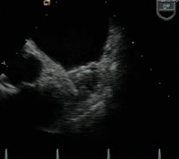
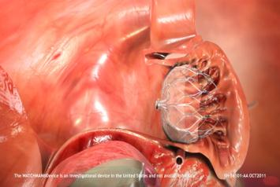
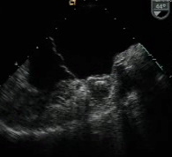
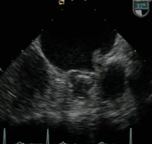
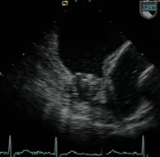
6. Device Release Criteria – Position
Device should be at or just distal to the LAA ostium

Slide 23
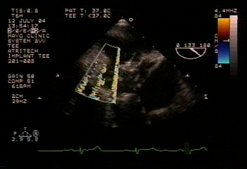
Device Position: TOO DISTAL
Partial Recapture
  Too Distal - possible uncovered lobes, incomplete seal or residual flow in LAA
  Advance tip of Access/Delivery System assembly up to device (do not unsnap)
  Stabilize deployment knob position with right hand and gently advance Access/Delivery System over shoulders of device
    Resistance will be felt as device shoulders collapse
  Continue to advance System up to, but not past, fixation anchors
    When resistance is felt a second time (anchor contact), stop, tighten hemostasis valve
  Reposition Access/Delivery System assembly proximally and re-deploy by holding deployment knob and retracting Access Sheath until device is completely deployed

Slide 24
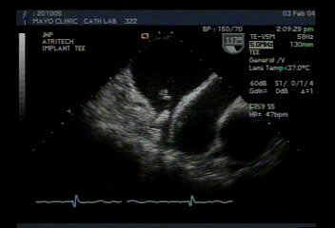
Device Position: TOO PROXIMAL
Full Recapture
  Too Proximal - Device protrudes into LA, low compression or unstable device
  Advance tip of Access/Delivery System up to face of device (do not unsnap)
  Stabilize deployment knob position with right hand and gently advance System until device is completely collapsed
    Resistance will be felt as device shoulders collapse
  Withdraw device until distal anchors are proximal to marker band then tighten hemostasis valve
  Unsnap and remove Delivery System from Access Sheath while maintaining position within LAA
  Insert pigtail catheter to reposition Access Sheath in LAA
  Repeat implant steps with new Delivery System

Slide 25
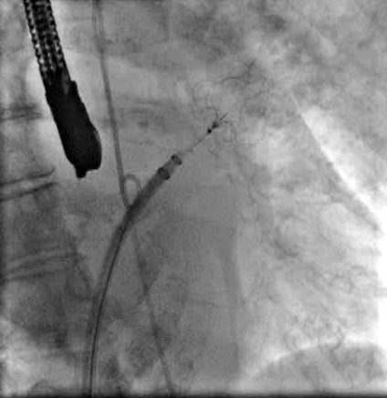
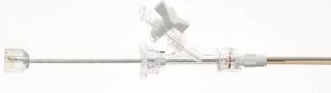
6. Device Release Criteria – Anchor
Tug Test – Pass or Fail
To test stability, gently retract deployment knob and let go, observe device returns to original position
If the device moves to where position is no longer acceptable or the compression is no longer sufficient, the device should be recaptured
Test stability more than once if device stability is questionable
Deployment Knob
Core Wire
Hemostasis Valve

Slide 26
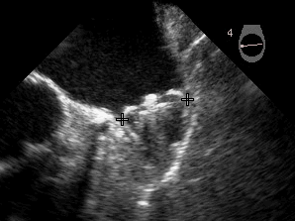
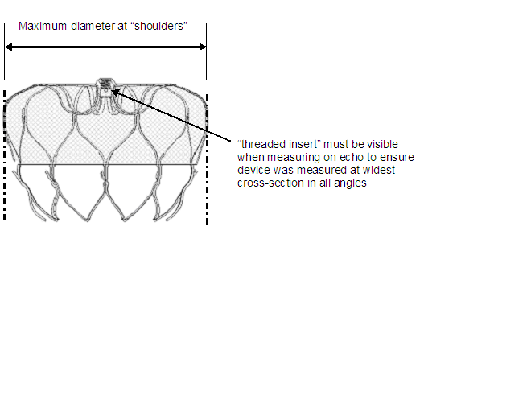
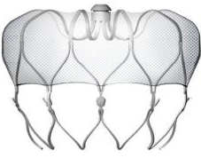
6. Device Release Criteria - Size
Device Compression Table
Maximum LAA Ostium | Device Size (uncompressed diameter) | Maximum (20%) Compression Measured Diameter* | Minimum (8%) Compression Measured Diameter*
17-19 mm | 21 mm | 16.8 mm | 19.3 mm
20-22 mm | 24 mm | 19.2 mm | 22.1 mm
23-25 mm | 27 mm | 21.6 mm | 24.8 mm
26-28 mm | 30 mm | 24.0 mm | 27.6 mm
29-31 mm | 33 mm | 26.4 mm | 30.4 mm
20.8
*Measure in-situ device diameter at approximate TEE angles of 0, 45, 90 and 135 degrees to accurately assess device compression
Caution: Investigational device limited to investigational use only under US federal law. Not for sale.

Slide 27
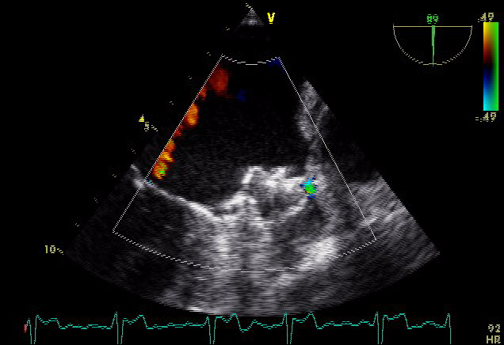
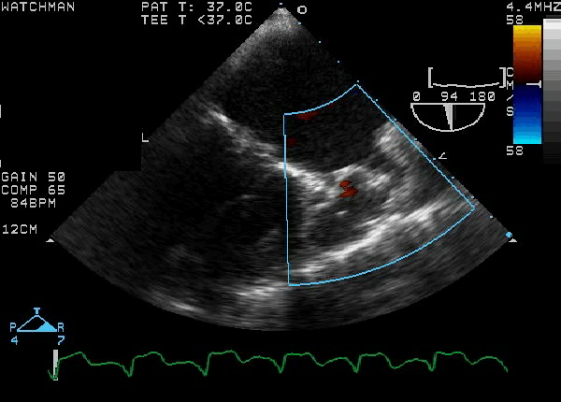
6. Device Release Criteria – Seal
Residual flow around the device of ≤ 3mm acceptable
If residual jet around device noted - re-assess position, size or device orientation
  If device not yet released, partial recapture and reposition or full recapture and replacement are possible

Slide 28
8. Final Device Release
If all four P.A.S.S. release criteria are met, device can be released
Advance WATCHMAN System to face of device, rotate deployment knob counter clockwise 3-5 full turns
Perform final check of the following post device release:
  Device position in all angles
  Device compression and LAA sealing
Perform check for pericardial effusion
Consider performing repeat TTE prior to discharging the patient

Slide 29
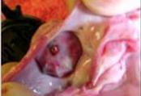
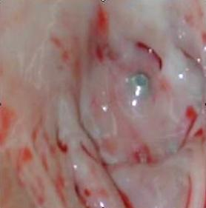
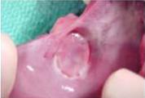
WATCHMAN™ Device Endothelialization
Canine Model – 30 Day
Canine Model – 45 Day
Human Pathology - 9 Months Post-implant
(Non-device related death)
Images on file at Boston Scientific Corporation.
Results in animal models may not necessarily be indicative of clinical outcomes.

Slide 30
Agenda
WATCHMAN™ Left Atrial Appendage Closure
System Components
WATCHMAN™ Implant Procedure
WATCHMAN™ Post-Implant Follow-Up

Slide 31

Post Procedure Information
Post-procedure warfarin therapy is required in ALL patients receiving a Device
  81-100mg of aspirin and warfarin for 45 days min. post implant (INR 2.0-3.0)
At 45 days post-implant, perform device assessment with TEE to assess the presence of LAA blood flow through and/or around the WATCHMAN device
Cessation of warfarin is at physician discretion provided that any peri-device flow demonstrated by TEE is <5mm

Slide 32

Post Procedure Information
If adequate seal is not demonstrated, subsequent warfarin cessation decisions are contingent on demonstrating flow <5mm
Patients ceasing warfarin should begin clopidogrel 75mg daily and increase aspirin dosage to 300-325mg daily for six months post-implant
If LAA closure satisfactory, patient should remain on 300-325mg aspirin daily indefinitely
If a patient remains on warfarin and aspirin 81-100mg for at least six months post-implant, and then ceases warfarin, clopidogrel is not required, but aspirin should be increased to 300-325mg daily, taken indefinitely

Slide 33
Questions?

Slide 34
ABBREVIATED STATEMENT
WATCHMANTM Left Atrial Appendage Closure Device with Delivery System and WATCHMAN Access System
Indications for use
The WATCHMAN Device is indicated to reduce the risk of thromboembolism from the left atrial appendage in patients with non-valvular atrial fibrillation who:
Are at increased risk for stroke and systemic embolism based on CHADS₂ or CHA₂DS₂-VASc scores and are recommended for anticoagulation therapy;
Are deemed by their physicians to be suitable for warfarin; and
Have an appropriate rationale to seek a non-pharmacologic alternative to warfarin, taking into account the safety and effectiveness of the device compared to warfarin.
The WATCHMAN Access System is intended to provide vascular and transseptal access for all WATCHMAN Left Atrial Appendage Closure Devices with Delivery Systems.
Contraindications
Do not use the WATCHMAN Device if:
Intracardiac thrombus is visualized by echocardiographic imaging.
An atrial septal defect repair or closure device or a patent foramen ovale repair or closure device is present.
The LAA anatomy will not accommodate a device. See Table 46 in the DFU.
Any of the customary contraindications for other percutaneous catheterization procedures (e.g., patient size too small to accommodate TEE probe or required catheters) or conditions (e.g., active infection, bleeding disorder) are present.
There are contraindications to the use of warfarin, aspirin, or clopidogrel.
The patient has a known hypersensitivity to any portion of the device material or the individual components (see Device Description section) such that the use of the WATCHMAN Device is contraindicated.
Warnings
Device selection should be based on accurate LAA measurements obtained using fluoro and ultrasound guidance (TEE recommended) in multiple angles (e.g., 0º, 45º, 90º, 135º).
Do not release the WATCHMAN Device from the core wire if the device does not meet all release criteria.
If thrombus is observed on the device, warfarin therapy is recommended until resolution of thrombus is demonstrated by TEE.
The potential for device embolization exists with cardioversion <30 days following device implantation. Verify device position post-cardioversion during this period.
Administer appropriate endocarditis prophylaxis for 6 months following device implantation. The decision to continue endocarditis prophylaxis beyond 6 months is at physician discretion.
For single use only. Do not reuse, reprocess, or resterilize.
Precautions
The safety and effectiveness (and benefit-risk profile) of the WATCHMAN Device has not been established in patients for whom long-term anticoagulation is determined to be contraindicated.
The LAA is a thin-walled structure. Use caution when accessing the LAA and deploying the device.
Use caution when introducing the WATCHMAN Access System to prevent damage to cardiac structures.
Use caution when introducing the Delivery System to prevent damage to cardiac structures.
To prevent damage to the Delivery Catheter or device, do not allow the WATCHMAN Device to protrude beyond the distal tip of the Delivery Catheter when inserting the Delivery System into the Access Sheath.
If using a power injector, the maximum pressure should not exceed 100 psi.
In view of the concerns that were raised by the RE-ALIGN¹ study of dabigatran in the presence of prosthetic mechanical heart valves, caution should be used when prescribing oral anticoagulants other than warfarin in patients treated with the WATCHMAN Device. The WATCHMAN Device has only been evaluated with the use of warfarin post-device implantation.
ADVERSE EVENTS
Potential adverse events (in alphabetical order) which may be associated with the use of a left atrial appendage closure device or implantation procedure include but are not limited to:
Air embolism, Airway trauma, Allergic reaction to contrast media/medications or device materials, Altered mental status, Anemia requiring transfusion, Anesthesia risks, Angina, Anoxic encephalopathy, Arrhythmias, Atrial septal defect , AV fistula , Bruising, hematoma or seroma, Cardiac perforation , Chest pain/discomfort, Confusion post procedure, Congestive heart failure, Contrast related nephropathy, Cranial bleed, Decreased hemoglobin, Deep vein thrombosis, Death, Device embolism, Device fracture, Device thrombosis, Edema, Excessive bleeding, Fever, Groin pain, Groin puncture bleed, Hematuria, Hemoptysis, Hypotension, Hypoxia, Improper wound healing, Inability to reposition, recapture, or retrieve the device, Infection / pneumonia, Interatrial septum thrombus, Intratracheal bleeding, Major bleeding requiring transfusion, Misplacement of the device / improper seal of the appendage / movement of device from appendage wall, Myocardia erosion, Nausea, Oral bleeding, Pericardial effusion / tamponade, Pleural effusion, Prolonged bleeding from a laceration, Pseudoaneurysm, Pulmonary edema, Renal failure, Respiratory insufficiency / failure, Surgical removal of the device, Stroke – Ischemic , Stroke – Hemorrhagic, Systemic embolism, TEE complications (throat pain, bleeding, esophageal trauma), Thrombocytopenia, Thrombosis, Transient ischemic attack (TIA), Valvular damage, Vasovagal reactions
There may be other potential adverse events that are unforeseen at this time.
CAUTION: Federal law (USA) restricts this device to sale by or on the order of a physician. Rx only. Prior to use, please see the complete “Directions for Use” for more information on Indications, Contraindications, Warnings, Precautions, Adverse Events, and Operator’s Instructions.
© 2015 Boston Scientific Corporation or its affiliates. All rights reserved.
¹Eikelboom JW, Connolly SJ, Brueckmann M, et al. N Engl J Med 2013;369:1206-14.

