Slide 1
MADIT Randomized Trial to Reduce Inappropriate Therapy (MADIT-RIT)
Adapted from AHA Late Breaking Trial Results Presented by
Arthur J. Moss, MD
Professor of Medicine
University of Rochester Medical Center
November 6, 2012
Los Angeles, CA USA

Slide 2
MADIT-RIT
Background
ICD is highly effective in reducing mortality in high-risk cardiac pts.¹⁻³
Despite sophisticated device-detection algorithms, 8-40% of ICD therapies are inappropriate with adverse side effects⁴⁻¹⁴
Question: can ICD devices be reprogrammed to reduce inappropriate therapies?

Slide 3
MADIT-RIT
Study Overview
Study Hypothesis: Dual-chamber ICD or CRT-D devices with high-rate cutoff (>200bpm), or duration-delay (initial 60sec monitoring delay @>170bpm) plus Rhythm ID® detection will be associated with fewer 1st inappropriate therapies than standard/conventional programming (2.5sec delay @ >170bpm) without increase in mortality
Study Design: Randomized, 3-arm study of patients randomized 1:1:1 to either conventional, high-rate cutoff, or duration-delay programming
Primary Endpoint: First episode of inappropriate therapy (defined as
shock or ATP)
B arm vs. A arm
C arm vs. A arm
Secondary Endpoints: All-cause mortality
Syncope
Number of Patients: 1500 from 98 centers
US, Canada, Europe, Israel and Japan
Presented By: Arthur J. Moss, MD, AHA 2012

Slide 4
MADIT-RIT
Three Treatment Arms (abbreviated)*
Arm A (Conventional) | Arm B (High-rate) | Arm C (Duration-delay)
Zone 1: | Zone 1: | Zone 1:
>170 bpm, 2.5s delay | 170 bpm | >170 bpm, 60s delay
Onset/Stability Detection Enhancements ON | Monitor only | Rhythm ID® Detection Enhancements ON
ATP + Shock |  | ATP + Shock
SRD 3 min initial |  | SRD Off
Zone 2: | Zone 2: | Zone 2:
>200 bpm, 1s delay | >200 bpm, 2.5s delay | >200 bpm, 12s delay
Quick ConvertTM ATP Shock | Quick ConvertTM ATP Shock | Rhythm ID® Detection Enhancements ON
 |  | ATP + Shock
 |  | SRD Off
 |  | Zone 3 :
 |  | >250 bpm, 2.5s delay
 |  | Quick ConvertTM ATP + Shock
For a complete listing of all programming parameters,
please contact Boston Scientific at 1-800-CARDIAC
*All programming is within approved labeling. Rhythm ID® and Quick ConvertTM are trademarks of Boston Scientific Corporation

Slide 5
MADIT-RIT
Eligibility
Inclusion Criteria
  Primary prevention patients with no Hx of VT/VF
  Sinus rhythm at enrollment; Hx PAF ok
  Pt. on stable, optimal pharmacologic therapy
  Age >21 yrs; informed consent
Exclusion Criteria
  Pt. with pacemaker, ICD or CRT-D device
  CABG or PTCA in past 3 months
  MI (enzyme +) or AF in past 3 months
  2nd or 3rd degree heart block
  NYHA IV
  Chronic AF
  Renal disease: BUN>50mg/dlor Creatinine>2.5mg/dL

Slide 6
MADIT-RIT
Pre-specified End Points
Primary (90% power for hazard ratio 0.5 at p<0.05)
  First episode of inappropriate therapy (defined as shock or ATP)
    B arm vs. A arm
    C arm vs. A arm
  Rationale for first inappropriate therapy (IT)
    Expect reprogramming to be common after IT
    Protocol allows reprogramming after IT
Secondary
  All-cause mortality
  Syncope

Slide 7
Baseline Demographic and Clinical Characteristics
 | Therapy Group
 | A | B | C
 | Conventional ≥170bpm | High-rate ≥200bpm | Duration-Delay ≥170bpm
 | n=514 | n=500 | n=486
Age, yrs | 64 | 63 | 62
Male, % | 70 | 71 | 72
Ischemic, % | 53 | 54 | 52
EF, % | 26 | 26 | 26
No significant differences in 22 variables among the 3 Rx groups
Notes:
no significant differences in 22 variables among the 3 Rx groups)

Slide 8
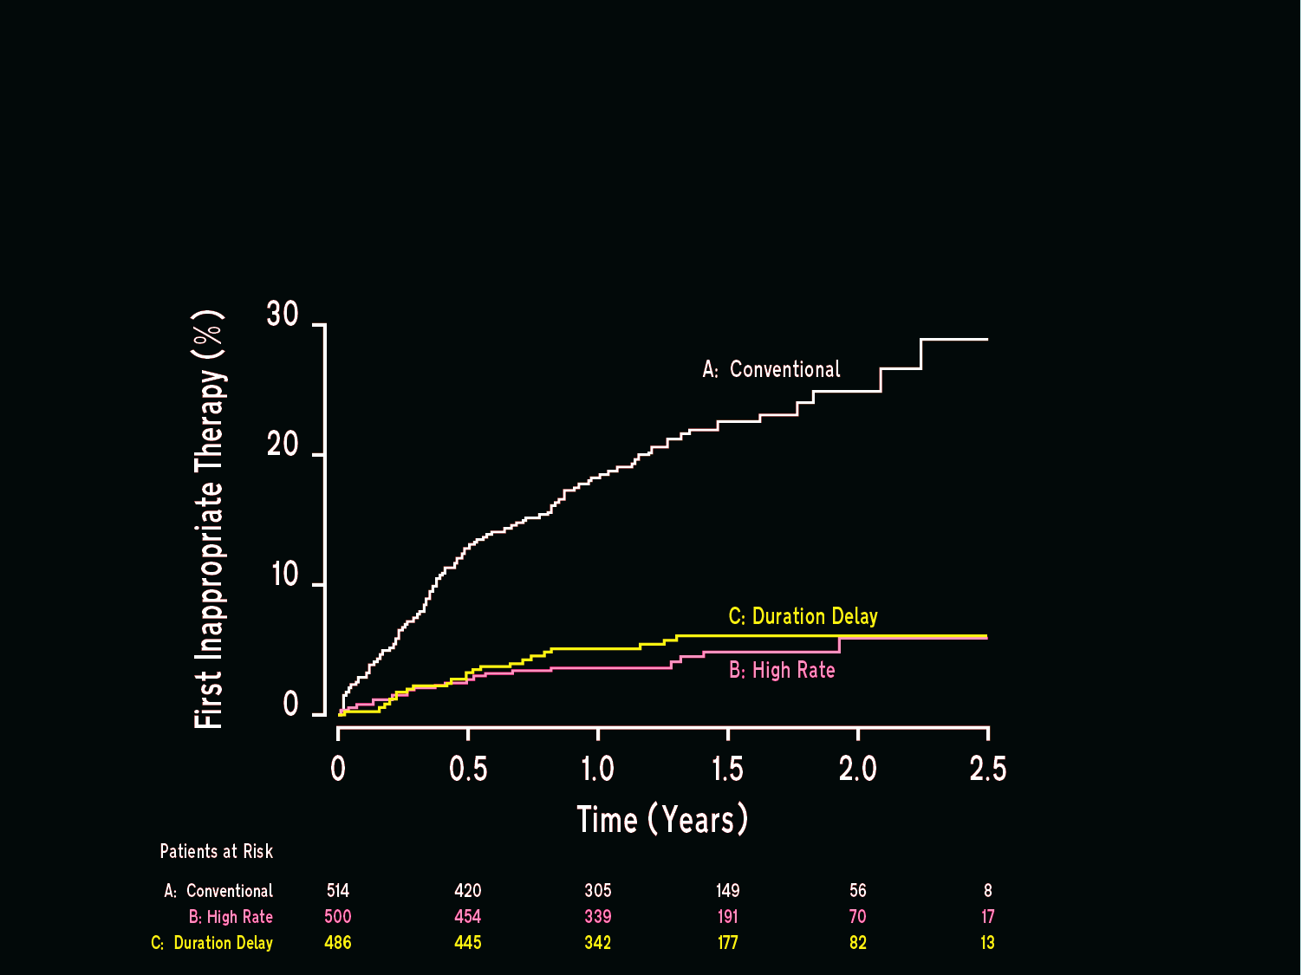
Cumulative Probability of First Inappropriate Therapy by Treatment Group

Slide 9
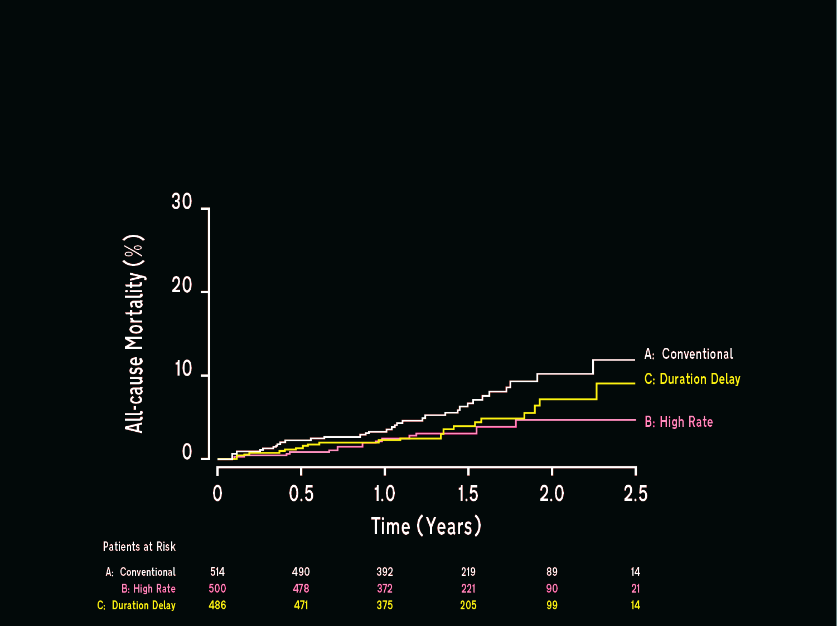
Cumulative Probability of Death by Treatment Group

Slide 10
Frequency and Hazard Ratios for Inappropriate Therapy, Death, and Syncope by Treatment Group
 | Treatment Groups |  |  | Treatment Group Comparisons
 | # of patients |  |  | B vs A |  |  | C vs A
 | A | B | C | Hazard Ratio | P-value |  | Hazard Ratio | P-value
Events | n=514 | n=500 | n=486
1st Inapp Therapy | 105 | 21 | 26 | 0.21 | <0.001 |  | 0.24 | <0.001
Death | 34 | 16 | 21 | 0.45 | 0.01 |  | 0.56 | 0.06
1st Syncope | 23 | 22 | 23 | 1.32 | 0.39 |  | 1.09 | 0.80

Slide 11
Arrhythmias Triggering First Inappropriate Therapies
 | Treatment Group
 | A | B | C
Arrhythmias | # Patients 1st Inappropriate Therapies
At Fib/Flut | 24 | 11 | 5
Regular SVT | 78 | 9 | 17
Other | 3 | 1 | 4
Note: marked reduction in patients with1st inappropriate therapies
in High-rate (B) and Duration-delay (C) groups for At Fib/Flut and
Regular SVT when compared to Conventional therapy (A).

Slide 12
Any Appropriate and Inappropriate Therapy by Treatment Group
 | Treatment Groups
 | # of Patients (% of Rx Group)
 | A | B | C
 | n=514 | n=500 | n=486 | P-Value
Any Appropriate Therapy |  |  |  | B vs A |  | C vs A
Shock | 28 (5) | 26 (5) | 19 (4) | 0.86 |  | 0.25
ATP | 111 (22) | 38 (8) | 20 (4) | <0.001 |  | <0.001
Any Inappropriate Therapy
Shock | 31 (6) | 14 (3) | 15 (3) | 0.01 |  | 0.03
ATP | 104 (20) | 20 (4) | 25 (5) | <0.001 |  | <0.001

Slide 13
MADIT-RIT
Summary
Improved ICD programming to high-rate (>200 bpm) or 60sec duration-delay is associated with:
  ~75% reduction in 1st inappropriate therapy;
  ~50% reduction in all-cause mortality
Dr. Moss and his co-authors speculated that the decrease in mortality in this trial could have been related to the reduction in inappropriate shock and ATP therapies

Slide 14
References
1. Moss AJ, Hall WJ, Cannom DS, et al. Improved survival with an implanted defibrillator in patients with coronary disease at high risk for ventricular arrhythmia. Multicenter Automatic Defibrillator Implantation Trial Investigators. N Engl J Med. 1996;335:1933-1940.
2. Moss AJ, Zareba W, Hall WJ, Klein H, Wilber DJ, Cannom DS, Daubert JP, Higgins SL, Brown MW, Andrews ML. Prophylactic Implantation of a Defibrillator in Patients with Myocardial Infarction and Reduced Ejection Fraction. New Engl J Med. 2002;346:877-883.
3. Bardy GH, Lee KL, Mark DB, et al. Amiodarone or an implantable cardioverter-defibrillator for congestive heart failure. N Engl J Med. 2005;352:225-237.
4. Poole JE, Johnson GW, Hellkamp AS, Anderson J, Callans DJ, RaittMH, Reddy RK, Marchlinski FE, Yee R, Guarnieri T, Talajic M, WilberDJ, Fishbein DP, Packer DL, Mark DB, Lee KL, Bardy GH: Prognosticimportance of defibrillator shocks in patients with heart failure. N EnglJ Med 2008;359:1009-1017.
5. Daubert JP, Zareba W, Cannom DS, McNitt S, Rosero SZ, Wang P, Schuger C, Steinberg JS, Higgins SL, Wilber DJ, Klein H, Andrew ML, Hall WJ, Moss AJ: MADIT II Investigators. Inappropriate implantablecardioverter-defibrillator shocks in MADIT II: Frequency, mechanisms, predictors, and survival impact. J Am Coll Cardiol 2008;51:1357-1365.
6. Ellenbogen KA, Levine JH, Berger RD, Daubert JP, Winters SL, Greenstein E, Shalaby A, Schaechter A, Subacius H, Kadish A: Defibrillatorsin Non-Ischemic Cardiomyopathy Treatment Evaluation (DEFINITE) Investigators. Are implantable cardioverter defibrillator shocks a surrogate for sudden cardiac death in patients with nonischemic cardiomyopathy? Circulation 2006;113:776-782.
7. Wilkoff BL, Williamson BD, Stern RS, Moore SL, Lu F, Lee SW, Birgersdotter-Green UM, Wathen MS, Van Gelder IC, Heubner BM, Brown ML, Holloman KK: PREPARE Study Investigators. Strategic programming of detection and therapy parameters in implantablecardioverter-defibrillators reduces shocks in primary prevention patients: Results from the PREPARE (Primary Prevention Parameters Evaluation) study. J Am Coll Cardiol 2008;52:541-550.
8. Grimm W, Flores BF, Marchlinski FE. Electrocardiographically documented unnecessary, spontaneous shocks in 241 patients with implantable cardioverter defibrillators. Pacing Clin Electrophysiol. 1992;15:1667-1673.
9 Schmitt C, Montero M, Melichercik J. Significance of supraventricular tachyarrhythmias in patients with implanted pacing cardioverter defibrillators. Pacing Clin Electrophysiol. 1994;17:295-302.
10. Theuns DA, Klootwijk AP, Simoons ML, et al. Clinical variables predicting inappropriate use of implantable cardioverter-defibrillator in patients with coronary heart disease or nonischemic dilated cardiomyopathy. American Journal of Cardiology. 2005;95:271-274.
11. Schron EB, Exner DV, Yao Q, et al. Quality of life in the antiarrhythmics versus implantable defibrillators trial: impact of therapy and influence of adverse symptoms and defibrillator shocks. Circulation. 2002;105:589-594.
12. Namerow PB, Firth B, Heywood GM, et al. Quality of life six months after CABG surgery in patients randomized to ICD versus no ICD therapy: findings from the CABG Patch Trial. PACE. 1999;22:1305-1313.
13. Irvine J, Dorian P, Baker BM, et al. Quality of life in the Canadian Implantable Defibrillator Study (CIDS). Am Heart J. 2002;144:282-289.
14. Klein RC, Raitt MH, Wilkoff BL, et al. Analysis of implantable cardioverter defibrillator therapy in the Antiarrhythmics Versus Implantable Defibrillators (AVID) Trial. Journal of Cardiovascular Electrophysiology. 2003;14:940-948.

Slide 15
CRT-D Systems from Boston Scientific
Indications and Usage
These Boston Scientific Cardiac Resynchronization Therapy Defibrillators (CRT-Ds) are indicated for patients with heart failure who receive stable optimal pharmacologic therapy (OPT) for heart failure and who meet any one of the following classifications:
  Moderate to severe heart failure (NYHA Class III-IV) with EF ≤ 35% and QRS duration ≥ 120 ms
  Left bundle branch block (LBBB) with QRS ≥ 130 ms, EF ≤ 30%, and mild (NYHA Class II) ischemic or nonischemic heart failure or asymptomatic (NYHA Class I) ischemic heart failure
Contraindications
There are no contraindications for this device.
Warnings
Read the product labeling thoroughly before implanting the pulse generator to avoid damage to the system. For single patient use only. Do not reuse, reprocess, or resterilize. Program the pulse generator Tachy Mode to Off during implant, explant or postmortem procedures. Always have sterile external and internal defibrillator protection available during implant. Ensure that an external defibrillator and medical personnel skilled in CPR are present during post-implant device testing. Advise patients to seek medical guidance before entering environments that could adversely affect the operation of the active implantable medical device, including areas protected by a warning notice that prevents entry by patients who have a pulse generator. Do not expose a patient to MRI device scanning. Do not subject a patient with an implanted pulse generator to diathermy, Do not use atrial-tracking modes in patients with chronic refractory atrial tachyarrhythmias. Do not use atrial-only modes in patients with heart failure. LV lead dislodgment to a position near the atria can result in atrial oversensing and LV pacing inhibition. Physicians should use medical discretion when implanting this device in patients who present with slow VT. Do not kink, twist or braid the lead with other leads. Do not use defibrillation patch leads with the CRT-D system. Do not use this pulse generator with another pulse generator.
Precautions
For specific information on precautions, refer to the following sections of the product labeling: clinical considerations; sterilization, storage and handling; implant and device programming; follow-up testing; explant and disposal; environmental and medical therapy hazards; hospital and medical environments; home and occupational environments. Advise patients to avoid sources of electromagnetic interference (EMI) because EMI may cause the pulse generator to deliver inappropriate therapy or inhibit appropriate therapy.
Potential Adverse Events
Potential adverse events from implantation of the CRT-D system include, but are not limited to, the following: allergic/physical/physiologic reaction, death, erosion/migration, fibrillation or other arrhythmias, lead or accessory breakage (fracture/insulation/lead tip), hematoma/seroma, inappropriate or inability to provide therapy (shocks/pacing/sensing), infection, procedure related, and component failure. Patients may develop psychological intolerance to a pulse generator system and may experience fear of shocking, fear of device failure, or imagined shocking. In rare cases severe complications or device failures can occur.
Refer to the product labeling for specific indications, contraindications, warnings/precautions and adverse events. Rx only.
(Rev. Q)

Slide 16
CRT-D Systems from Boston Scientific –
PUNCTUA, ENERGEN, and INCEPTA
IIndications and Usage
The PUNCTUATM, ENERGENTM, and INCEPTATM Cardiac Resynchronization Therapy Defibrillators (CRT-Ds) are indicated for patients with heart failure who receive stable optimal pharmacologic therapy (OPT) for heart failure and who meet any one of the following classifications:
  Moderate to severe heart failure (NYHA Class III-IV) with EF ≤ 35% and QRS duration ≥ 120 ms
  Left bundle branch block (LBBB) with QRS ≥ 130 ms, EF ≤ 30%, and mild (NYHA Class II) ischemic or nonischemic heart failure or asymptomatic (NYHA Class I) ischemic heart failure
Contraindications
There are no contraindications for this device.
Warnings
Read the product labeling thoroughly before implanting the pulse generator to avoid damage to the system. For single patient use only. Do not reuse, reprocess, or resterilize. Program the pulse generator Tachy Mode to Off during implant, explant or postmortem procedures. Always have external defibrillator protection available during implant. Ensure that an external defibrillator and medical personnel skilled in CPR are present during post-implant device testing. Advise patients to seek medical guidance before entering environments that could adversely affect the operation of the active implantable medical device, including areas protected by a warning notice that prevents entry by patients who have a pulse generator. Do not expose a patient to MRI device scanning.. Do not subject a patient with an implanted pulse generator to diathermy, Do not use atrial-tracking modes in patients with chronic refractory atrial tachyarrhythmias. Do not use atrial-only modes in patients with heart failure. LV lead dislodgment to a position near the atria can result in atrial oversensing and LV pacing inhibition. Physicians should use medical discretion when implanting this device in patients who present with slow VT. Do not kink, twist or braid the lead with other leads. Do not use defibrillation patch leads with the CRT-D system. Do not use this pulse generator with another pulse generator.
For DF4-LLHH or DF4-LLHO leads, use caution handling the lead terminal when the Connector Tool is not present on the lead and do not directly contact the lead terminal with any surgical instruments or electrical connections such as PSA (alligator) clips, ECG connections, forceps, hemostats, and clamps. Do not contact any other portion of the DF4-LLHH or DF4-LLHO lead terminal, other than the terminal pin even when the lead cap is in place.
Precautions
For specific information on precautions, refer to the following sections of the product labeling: clinical considerations; sterilization and storage; implantation; device programming; follow-up testing; explant and disposal; environmental and medical therapy hazards; hospital and medical environments; home and occupational environments; and supplemental precautionary information. Advise patients to avoid sources of electromagnetic interference (EMI) because EMI may cause the pulse generator to deliver inappropriate therapy or inhibit appropriate therapy.
Potential Adverse Events
Potential adverse events from implantation of the CRT-D system include, but are not limited to, the following: allergic/physical/physiologic reaction, death, erosion/migration, fibrillation or other arrhythmias, lead or accessory breakage (fracture/insulation/lead tip), hematoma/seroma, inappropriate or inability to provide therapy (shocks/pacing/sensing), infection, procedure related, and component failure. Patients may develop psychological intolerance to a pulse generator system and may experience fear of shocking, fear of device failure, or imagined shocking. In rare cases severe complications or device failures can occur.
Refer to the product labeling for specific indications, contraindications, warnings/precautions and adverse events. Rx only.
(Rev. A)

Slide 17
ICD Systems from Boston Scientific
ICD Indications and Usage
ICDs are intended to provide ventricular antitachycardia pacing and ventricular defibrillation for automated treatment of life-threatening ventricular arrhythmias. ICDs (i.e. Vitality AVT) with atrial therapies are also intended to provide atrial antitachycardia pacing and atrial defibrillation treatment in patients who have or are at risk of developing atrial tachyarrhythmias.
Contraindications
Use of ICD systems are contraindicated in: Patients whose ventricular tachyarrhythmias may have reversible cause, such as 1) digitalis intoxication, 2) electrolyte imbalance, 3) hypoxia, or 4) sepsis, or whose ventricular tachyarrhythmias have a transient cause, such as 1) acute myocardial infarction, 2) electrocution, or 3) drowning. Patients who have a unipolar pacemaker.
Warnings
Read the product labeling thoroughly before implanting the pulse generator to avoid damage to the ICD system. For single patient use only, Do not reuse, reprocess, or resterilize. Program the pulse generator ventricular Tachy Mode to Off during implant, explant or post-mortem procedures. Always have external defibrillator protection available during implant. Ensure that an external defibrillator and medical personnel skilled in cardiopulmonary resuscitation (CPR) are present during post-implant device testing. Patients should seek medical guidance before entering environments that could adversely affect the operation of the active implantable medical device, including areas protected by a warning notice that prevents entry by patients who have a pulse generator. Do not expose a patient to MRI device scanning. Do not subject a patient with an implanted pulse generator to diathermy. Do not use atrial tracking modes (or an AVT device) in patients with chronic refractory atrial tachyarrhythmias. Do not use this pulse generator with another pulse generator. Do not kink, twist or braid lead with other leads..
Precautions
For specific information on precautions, refer to the following sections of the product labeling: clinical considerations; sterilization and storage; implantation; device programming; environmental and medical therapy hazards; hospital and medical environments; home and occupational environments follow-up testing; explant and disposal; supplemental precautionary information. Advise patients to avoid sources of electromagnetic interference (EMI).
Potential Adverse Events
Potential adverse events from implantation of the ICD system include, but are not limited to, the following: allergic/physical/physiologic reaction, death, erosion/migration, fibrillation or other arrhythmias, lead or accessory breakage (fracture/insulation/lead tip), hematoma/seroma, inappropriate or inability to provide therapy (shocks/pacing/sensing), infection, procedure related, psychologic intolerance to an ICD system – patients susceptible to frequent shocks despite antiarrhythmic medical management/imagined shocking, and component failure. In rare cases severe complications or device failures can occur.
Refer to the product labeling for specific indications, contraindications, warnings/ precautions and adverse events. Rx only.
(Rev. P)

Slide 18
ICD Systems from Boston Scientific –
PUNCTUA, ENERGEN, and INCEPTA
ICD Indications and Usage
PUNCTUATM, ENERGENTM, and INCEPTATM ICDs are intended to provide ventricular antitachycardia pacing and ventricular defibrillation for automated treatment of life-threatening ventricular arrhythmias.
Contraindications
Use of these ICD systems are contraindicated in: Patients whose ventricular tachyarrhythmias may have reversible cause, such as 1) digitalis intoxication, 2) electrolyte imbalance, 3) hypoxia, or 4) sepsis, or whose ventricular tachyarrhythmias have a transient cause, such as 1) acute myocardial infarction, 2) electrocution, or 3) drowning. Patients who have a unipolar pacemaker.
Warnings
Read the product labeling thoroughly before implanting the pulse generator to avoid damage to the ICD system. For single patient use only. Do not reuse, reprocess, or resterilize. Program the pulse generator ventricular Tachy Mode to Off during implant, explant or post-mortem procedures. Always have external defibrillator protection available during implant. Ensure that an external defibrillator and medical personnel skilled in cardiopulmonary resuscitation (CPR) are present during post-implant device testing. Patients should seek medical guidance before entering environments that could adversely affect the operation of the active implantable medical device, including areas protected by a warning notice that prevents entry by patients who have a pulse generator. Do not expose a patient to MRI device scanning. Do not subject a patient with an implanted pulse generator to diathermy. Do not use atrial tracking modes in patients with chronic refractory atrial tachyarrhythmias. Do not use this pulse generator with another pulse generator. Do not kink, twist or braid lead with other leads.
For DF4-LLHH or DF4-LLHO leads, use caution handling the lead terminal when the Connector Tool is not present on the lead and do not directly contact the lead terminal with any surgical instruments or electrical connections such as PSA (alligator) clips, ECG connections, forceps, hemostats, and clamps. Do not contact any other portion of the DF4-LLHH or DF4-LLHO lead terminal, other than the terminal pin even when the lead cap is in place.
Precautions
For specific information on precautions, refer to the following sections of the product labeling: clinical considerations; sterilization and storage; implantation; device programming; environmental and medical therapy hazards; hospital and medical environments; home and occupational environments follow-up testing; explant and disposal; supplemental precautionary information. Advise patients to avoid sources of electromagnetic interference (EMI).
Potential Adverse Events
Potential adverse events from implantation of the ICD system include, but are not limited to, the following: allergic/physical/physiologic reaction, death, erosion/migration, fibrillation or other arrhythmias, lead or accessory breakage (fracture/insulation/lead tip), hematoma/seroma, inappropriate or inability to provide therapy (shocks/pacing/sensing), infection, procedure related, psychologic intolerance to an ICD system – patients susceptible to frequent shocks despite antiarrhythmic medical management/imagined shocking, and component failure. In rare cases severe complications or device failures can occur.
Refer to the product labeling for specific indications, contraindications, warnings/ precautions and adverse events. Rx only.
(Rev. A)

