Slide 1
The GOLIATH Study
GreenLight XPS™ Laser Therapy System

Slide 2
The GOLIATH Study¹⁻³
Prospective, randomized multicenter controlled trial
29 centers, 9 European countries
First randomized controlled trial powered to compare the safety and efficacy of the 180W GreenLight XPS™ Laser Therapy System with transurethral resection of the prostate (TURP)
PRIMARY OBJECTIVES:
SECONDARY OBJECTIVES:
Non-inferiority of 180W GreenLight XPS System compared with TURP
International Prostate Symptom Score (IPSS) at 6 months
Maximum flow rate (Qmax) at 6 months
Proportion of patients who are complication free through 180 days
Length of catheterization
Length of hospitalization
Time until stable health
Post-void residual urine volume (PVR)
Prostate volume (PV)
Prostatic-specific antigen (PSA)
Notes:
Speaker Notes:
While the GOLIATH study protocol defined IPSS as the primary endpoint, the study investigated whether the GreenLight XPS System was non-inferior to TURP with respect to IPSS, Qmax and proportion of patients free from complications at 180 days. Because each of these achieved statistical significance in the power calculations they are also reported as primary objectives of the study.
Published tables and charts are open-access and can be downloaded from the journal website: http://www.europeanurology.com
All surgeons were licensed urologists trained and experienced with TURP
The GreenLight XPS System experience varied. However, a standardized treatment protocol was used and surgical technique was assessed prior to randomization
Study Population (values presented published in 6 month manuscript)
Variable GreenLight TURP
XPS System (n=136) (n=133) p value
Age, years 65.9 (6.8) 65.4 (6.6) 0.519
5-ARI up to surgery 36 (26.9%), n=134 45 (34.6%), n=130 0.184
Charlson comorbidity index 0.4 (0.6) 0.2 (0.5) 0.024
BPH duration, years 6.6 (6.2), n=135 5.0 (4.6) 0.018
IPSS 21.2 (5.9) 21.7 (6.4), n=132 0.507
Qmax, ml/sec 9.5 (3.0), n=121 9.9 (3.5), n=125 0.266
PVR, ml 110.1 (88.5), n=131 109.8 (103.9), n=128 0.976
PSA, ng/ml 2.7 (2.1) 2.6 (2.1) 0.800
PV, ml 48.6 (19.2) 46.2 (19.1) 0.301
Values: mean (SD); p value = statistical difference between groups; p value of <0.05 indicates statistically significant difference between treatment groups.
There were no significant differences in the baseline characteristics of the patients in the two treatment arms with the exception that: Patients in the GreenLight XPS System arm had a significantly higher comorbidity score and longer duration of BPH.

Slide 3
Durability of Results
Notes:
Speaker Notes:
IPSS: The GreenLight XPS System was equivalent to TURP
A consistent and comparable improvement in IPSS was observed over time in both treatment arms
The GreenLight XPS System was equivalent (with a margin of 3) to TURP at reducing BPH symptoms at 6 months
Results through 24 months show that IPSS results are maintained
Qmax: The GreenLight XPS System was equivalent to TURP
A consistent and comparable improvement in Qmax (per a margin of 5) was observed over time in both treatment arms
Mean maximum flow rates were equivalent for patients treated with the GreenLight XPS System and TURP at 6 months
Results through 24 months show that Qmax results are maintained

Slide 4
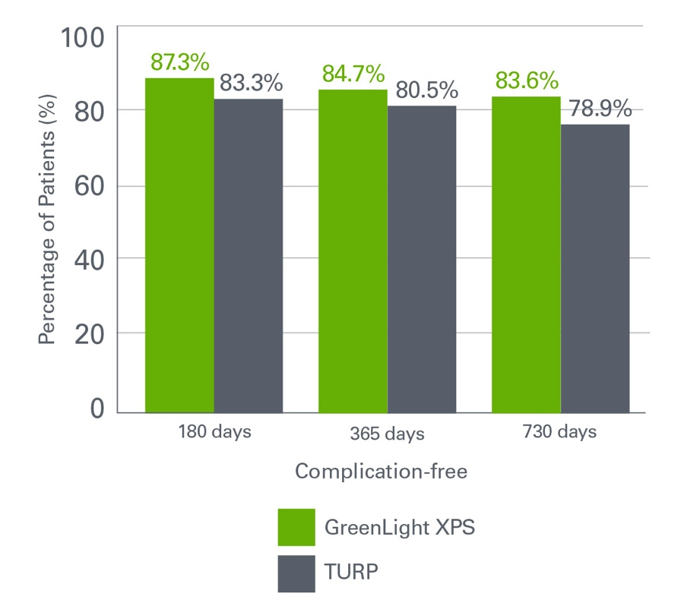
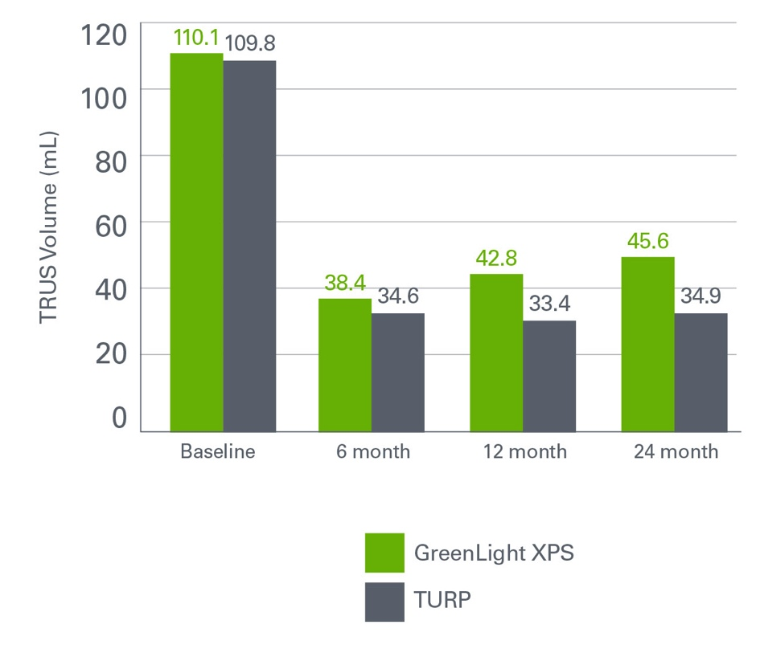
Primary Safety and PV Results
Primary Safety Results: GreenLight XPS System was Equivalent to TURP
PV at 6, 12 and 24 Months: Comparable Prostate Size Reduction
Notes:
Speaker Notes:
Primary Safety Results: The GreenLight XPS System was equivalent to TURP
The proportion of patients who were complication-free during the first 180 days was comparable between the GreenLight XPS System and TURP and continued to be comparable through 24 months
The criteria for non-inferiority of the GreenLight XPS System was met at 6 months, p=0.019. Difference (95% CI): 4.1% (-4.5% to 12.7%)
The results of the per protocol and modified ITT analyses were identical
PV at 6, 12 and 24 Months: Comparable Prostate Size Reduction
Substantial reduction over time seen in both arms
Comparable reduction at 6 months, p=0.079 and at 12 months, p=0.574
In the TURP group, a mean of 19.1 g of tissue was resected (41.4%) during procedure (reported at 6 months)
A similar prostate size reduction was achieved in the GreenLight XPS System arm

Slide 5
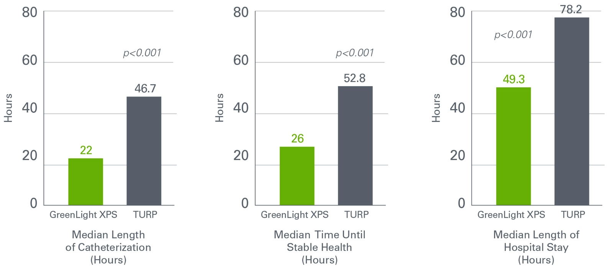
Recovery Parameters
Catheterization
Stable Health
Hospital Stay
Notes:
Speaker Notes:
(Data published in 6 month manuscript.)
Length of catheterization was significantly shorter with the GreenLight XPS System than with TURP
Length of catheterization: 22 hours versus 46.7 hours, p <0.001
Time to stable health status was significantly shorter with the GreenLight XPS System than with TURP
Time until stable health: 26 hours versus 52.8 hours, p <0.001
Time until stable health defined as: Time from entering the recovery room until the earlier of discharge from the medical facility or the first successful voiding trial without an ongoing treatment-related AE.
Length of hospital stay was significantly shorter with the GreenLight XPS System than with TURP
Length of hospital stay: 49.3 hours versus 78.2 hours, p <0.001
Median is shown for length of catheterization, time to stable health status and length of hospital stay due to outliers. The mean is average of a set of numbers where the median is the exact middle of a set of values. The mean is best used when there is a normal distribution in the data-set; the median is typically used when the data-set is skewed (contains outliers). All results given as median.

Slide 6
Adverse Events
No significant difference could be detected between the GreenLight XPS System and TURP with regards to any adverse events (AE) (p=0.330)
There were fewer serious bleeding complications after the GreenLight XPS procedure
Fewer Grade III AEs were observed (19 in 17 patients, 12.5%) compared with TURP (29 in 26 patients, 19.5%)
Grade III bleeding AEs were less common (2.9%) compared with TURP (6.8%), p=0.165
Storage symptoms (dysuria/irritative pain/discomfort) were the most commonly observed Grade I events in 18.4% (GreenLight XPS System) and 18.0% (TURP) patients
Urinary tract infections (defined by intention to treat without microbiological confirmation documented) were the most commonly observed Grade II events in 16.2% after the GreenLight XPS procedure and 9.0% after TURP (p=0.098)
Statistically significant difference in early AE (48 hours to 30 days) with 12 complications in the TURP group and zero in the GreenLight XPS procedure group (p=<0.001)
At 12 months, ongoing self-reported urinary leakage of any degree was observed in 4 (2.9%) after the GreenLight XPS procedure and 4 (3.0%) after TURP; this has been easily tolerated without intervention. The prevalence and grade of UI at 24 months were unchanged from those observed at 12 months.
During the second year of the study, there were few AE reported incidents.
Five GreenLight XPS patients (3.7%) accounted for five events: one Grade I irritative symptom, two Grade II urinary tract infections, one Grade IIIa stricture (bladder neck) and one Grade IIIb urinary retention incident
In the TURP group, two patients (1.5%) accounted for two events: one Grade I other (worsening erectile function) and one Grade IIIa urinary retention incident

Slide 7
Surgical Retreatments for Obstruction
During Months 0-12, there were 19 retreatment surgeries:
10 for GreenLight XPS patients and 9 for TURP patients.
During the Month 13-24 period, there were 5 additional cases:
4 for GreenLight XPS patients and 1 for a TURP patient
The Kaplan Meier estimates for reoperation by 24 months are 9.0% for the GreenLight XPS procedure and 7.6% for TURP; these are not statistically different (p=0.723, log rank test)
Study Period | Months 0 – 6 |  | Months 7-12 |  | Months 13-124
Event | GL XPS | TURP | GL XPS | TURP | GL XPS | TURP
Prostate Tissue Regrowth | 1 (0.7%) | 0 (0.0%) | 1 (0.7%) | 0 (0.0%) | 1 (0.7%) | 1 (0.8%)
Bladder Neck Contracture | 2 (1.5%) | 2 (1.5%) | 3 (2.2%) | 1 (0.8%) | 3 (2.2%) | 0 (0.0%)
Urethral Stricture | 1 (0.7%) | 4 (3.0%) | 1 (0.7%) | 1 (0.8%) | 1 (0.7%) | 0 (0.0%)
Other | 1 (0.7%) | 1 (0.8%) | 1 (0.7%) | 0 (0.0%) | 0 (0.0%) | 0 (0.0%)
Total Surgeries | 4 (2.9%) | 7 (5.3%) | 6 (4.4%) | 2 (1.5%) | 4 (2.9%) | 1 (0.8%)

Slide 8
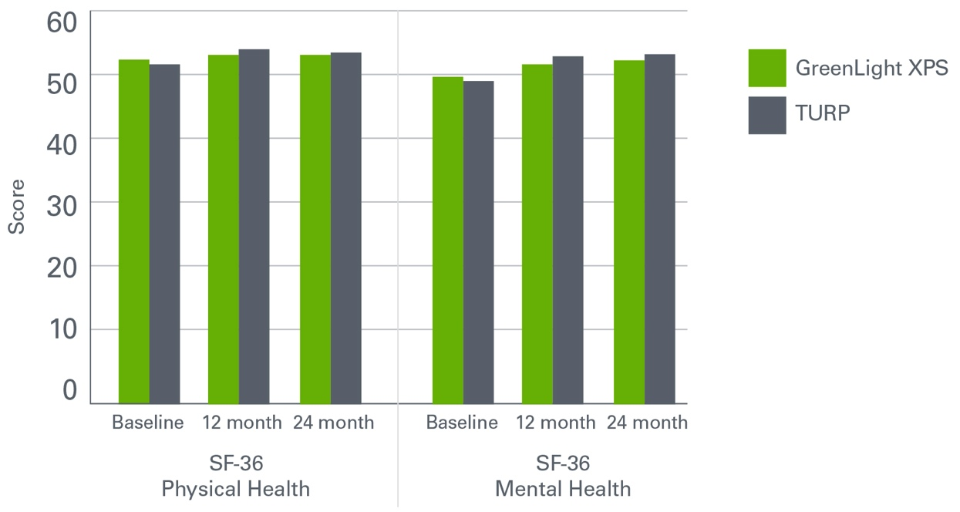
Patient Reported Outcome Measures
Patients’ overall satisfaction with the GreenLight XPS procedure was high, with over 94% of men willing to undergo the treatment again and recommend it to a friend.
Notes:
SPEAKER NOTES:
Data from the patient reported outcome measures
SF-36 Physical Health Summary
SF-36 Mental Health Summary

Slide 9
Conclusions
First randomized controlled trial powered to compare safety and efficacy of the GreenLight XPS Laser System and TURP demonstrated
Primary endpoints at 6 months of the study were met:
IPSS: Equivalent to TURP
Qmax: Equivalent to TURP
The proportion of patients who were complication-free during the first 180 days was comparable between the GreenLight XPS System and TURP
Comparable results in terms of IPSS, Qmax, and complication-free after 24 months
Patients treated with the GreenLight XPS System had a significantly shorter median length of catheterization, time until stable health, and hospitalization compared with TURP
Overall portion of patients free from any AE was comparable between the GreenLight XPS procedure and TURP
In the 48 hour to 30 day period, there were zero AE in the GreenLight XPS System arm compared to 12 in the TURP arm (p<0.001)
Comparable storage symptoms (dysuric or irritative symptoms) between treatment arms
At 12 months, self reported urinary leakage of any degree was reported in 2.9% of the GreenLight XPS System procedure patients and 3% of TURP patients, this was unchanged at 24 months
Overall post-operative re-intervention rates were not significantly different between treatment arms

Slide 10
Bachmann A, Tubaro A, Barber N, et al. 180W XPS GreenLight Laser Vaporization Versus Transurethral Resection of the Prostate for the Treatment of Benign Prostatic Obstruction: 6-Month Safety and Efficacy Results of a European Multicentre Randomized Trial – The GOLIATH Study. Euro Urol May 2014; 65(5): 931-942.
Bachmann A, Tubaro A, Barber N, et al. A European Multicenter Randomized Noninferiority Trial Comparing 180 W GreenLight-XPS Laser Vaporization and Transurethral Resection of the Prostate for the Treatment of Benign Prostatic Obstruction: 12-Month Results of the GOLIATH Study. J Urol. 2015 Feb;193(2):570-8.
Thomas JA, Tubaro A, Barber N, et al. A Multicenter Randomized Noninferiority Trial Comparing GreenLight-XPS Laser Vaporization of the Prostate and Transurethral Resection of the Prostate for the Treatment of Benign Prostatic Obstruction: Two-yr Outcomes of the GOLIATH Study. Eur Urol. 2016 Jan;69(1):94-102.
Caution: Federal (U.S.) law restricts these devices to sale by or on the order of a physician.
Caution: The law restricts these devices to sale by or on the order of a physician.
Refer to package insert provided with these products for complete Indications for Use, Contraindications, Warnings, Precautions, Adverse Events, and Instructions prior to using these products. Information for the use only in countries with applicable health authority product registrations.
© 2016 Boston Scientific Corporation or its affiliates. All rights reserved.
All trademarks are the property of their respective owners.
URO-390014-AA MAY 2016

